Slide 1


Management and control of heat transport in superconducting tunnel structures. Proposal for a thermal logic
University of Pisa and NEST, Istituto Nanoscienze-CNR, Pisa, Italy
Giampiero Marchegiani
Supervised by Dr. F. Giazotto & Prof. F. Fuso
Pre-Thesis, October 9, 2017, Pisa, ITALY

Slide 2







Contents

Slide 3







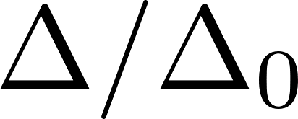

Normal (N) vs Superconductor (S)

Slide 4






Single particle transport in tunnel junctions

Slide 5









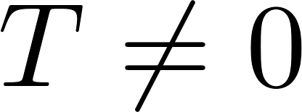




No current below Gap at T=0
There is something else...
NIS cooling

Slide 6



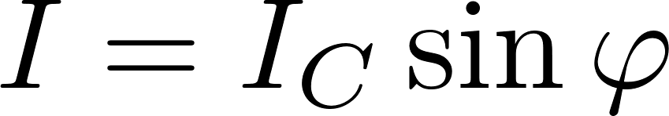

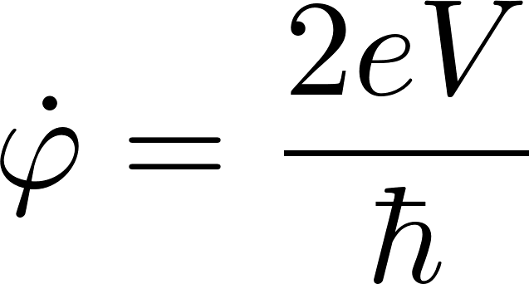

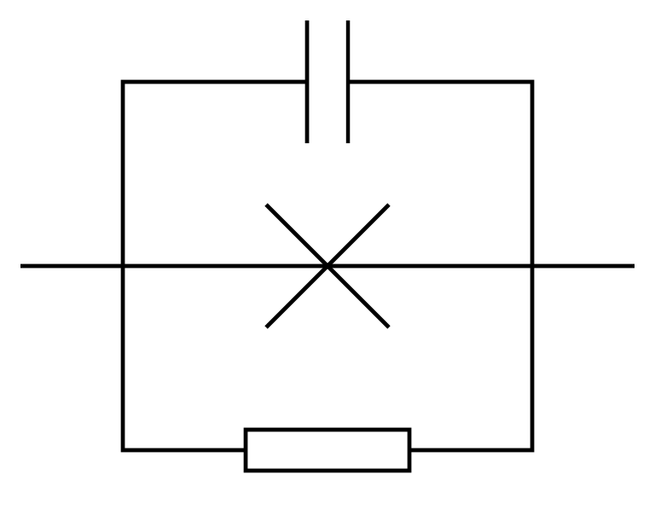

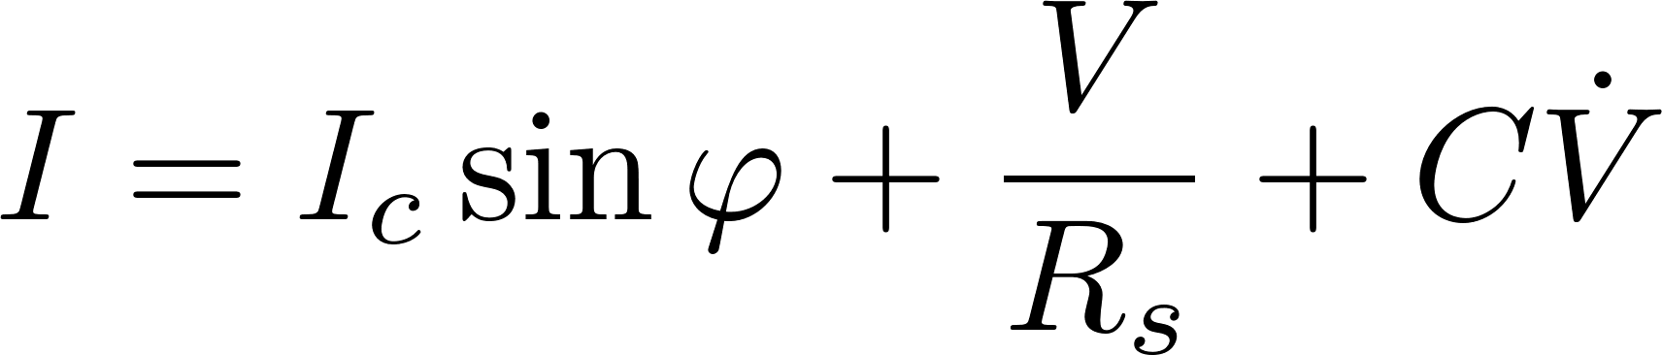
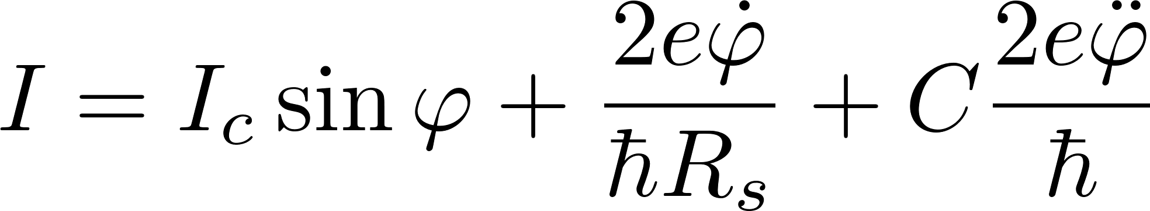

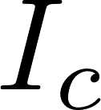
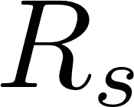
Coherent Transport: Josephson Effect

Slide 7










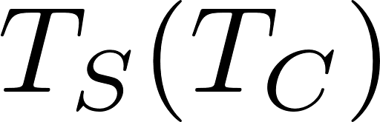

NFIS-Thermoelectric Effect

Slide 8


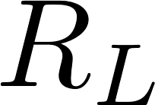

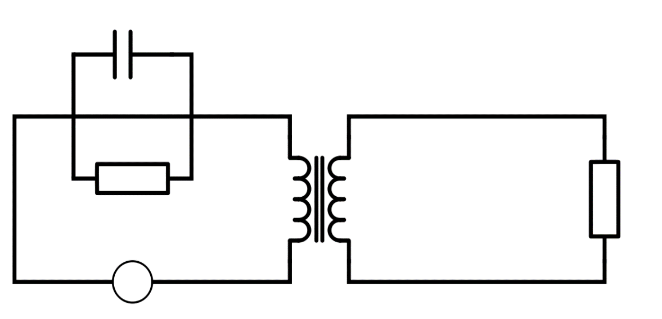






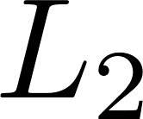
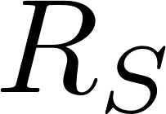
Heat Recycle: Josephson Quantum Heat Engine
Electromagnetic coupling
DC to AC inverter
Thermoelectric

Slide 9



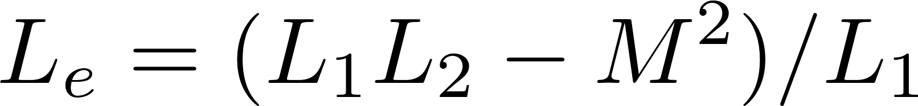
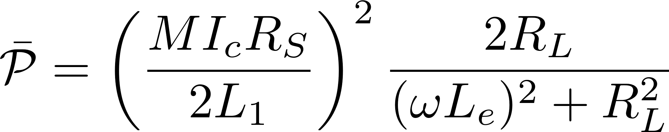
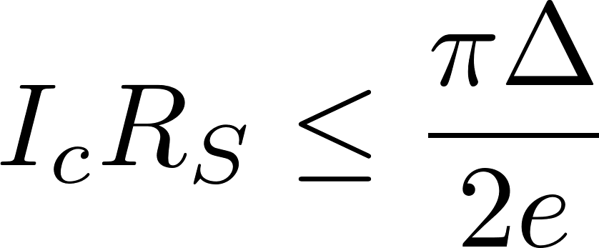
Josephson Quantum Heat Engine: power
Off region (black)
Asymmetric behaviour
Frequency matching
Notes:
Plot realized with realistic values, considering a superconducting thin film aluminum coupled trhough a FI of EuS

Slide 10
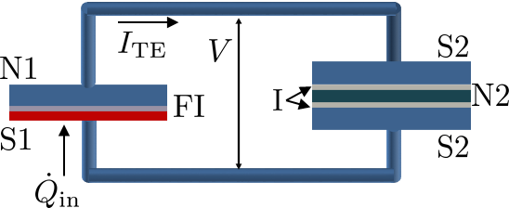
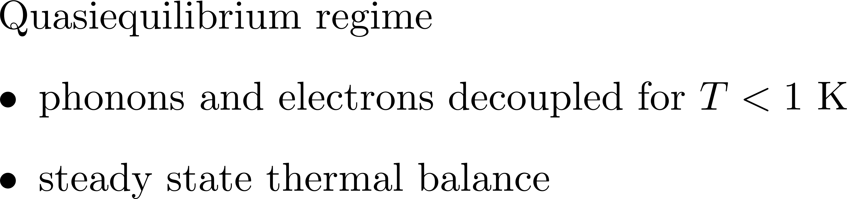
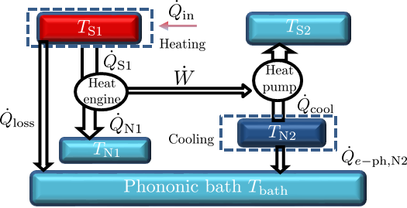





Heat Recycle: Cooling by Heating

Slide 11

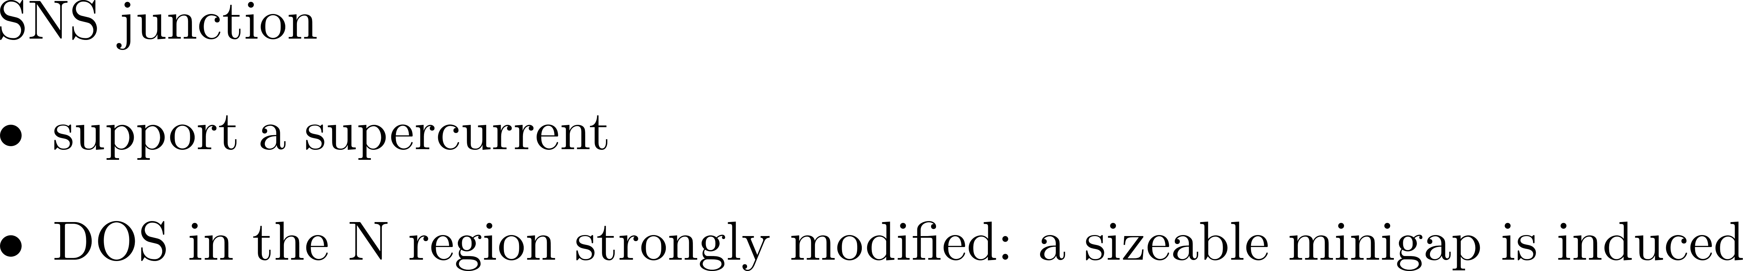

Superconducting Proximity Effect

Slide 12


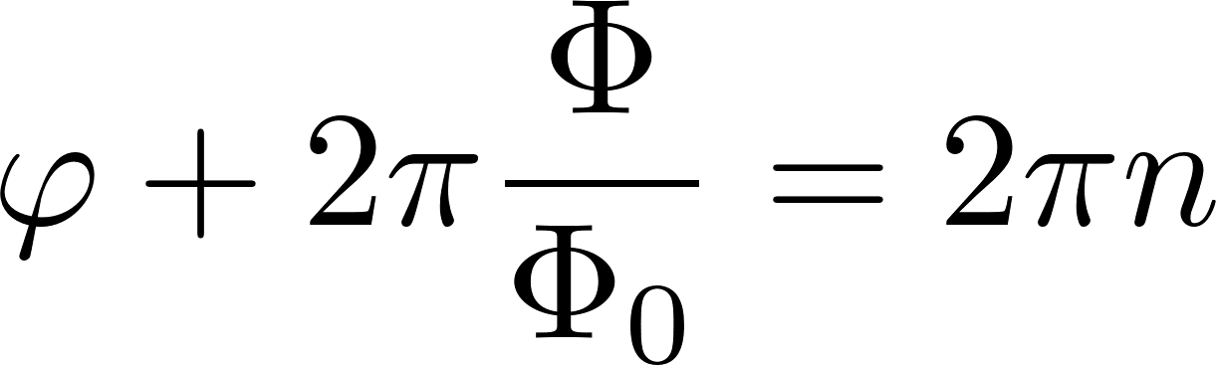
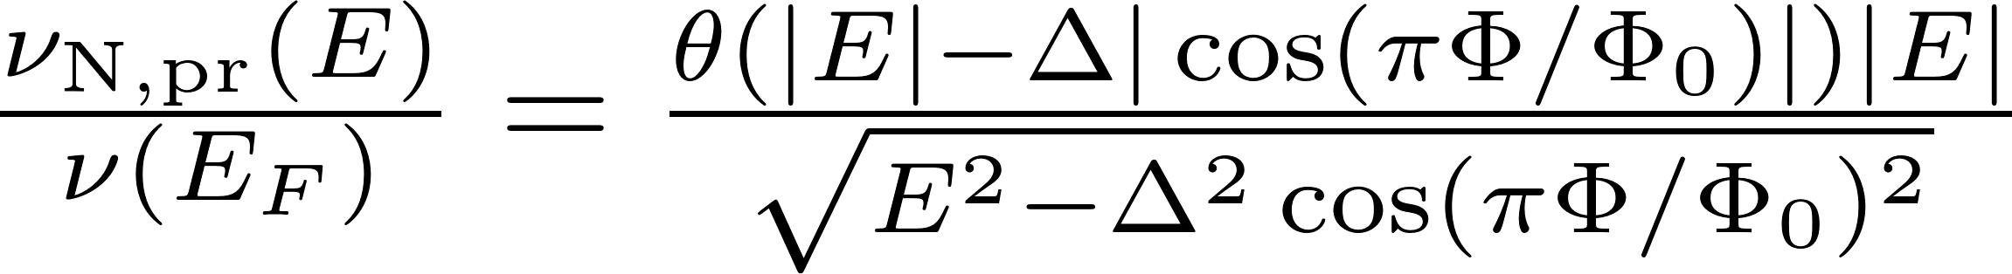
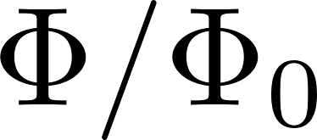









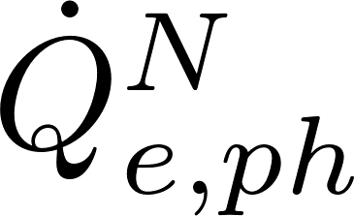

Superconducting Quantum Interference Proximity Device (SQUIPT)

Slide 13
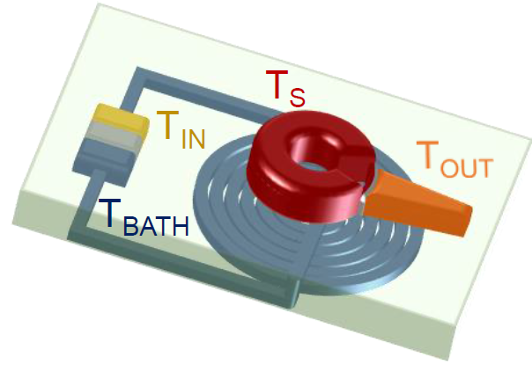
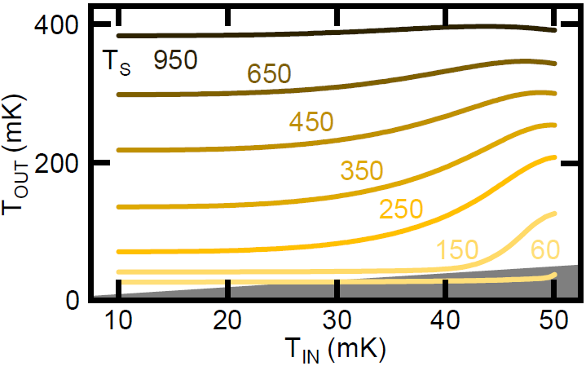
Heat logic: Temperature Amplifier

Slide 14



Heat logic: Computation with heat

Slide 15
Conclusions
Thermoelectric effects in superconducting-ferromagnetic tunnel junctions can be exploited either for heat recycle and for the implementation of thermal transistors
Experimental demonstration of the temperature modulation in a SQUIPT
Experimental realization of a thermal memory
Future Perspectives
Publications during PhD:
G. Marchegiani, P. Virtanen, F. Giazotto, and M. Campisi, Phys. Rev. Applied 6, 054014 (2016)
F. Paolucci, G. Marchegiani, E. Strambini, and F. Giazotto, EPL (Europhysics Letters) 118, 68004
(2017)
F. Paolucci, G. Marchegiani, E. Strambini, and F. Giazotto, arXiv:eprint1709.08609 (2017)
N. Ligato et al., Scientic Reports 7, 8810 (2017) (not discussed here)

