Slide 1
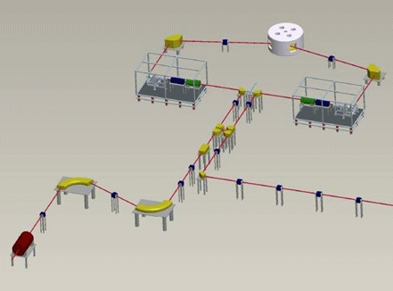
Production Target developments for the SPES project
Alberto Andrighetto
LNL-INFN
EURSOL Town Meeting - 2012 - Lisbon

Slide 2
Talk Overview
  The SPES project at LNL.
The production target (TIS).
The target materials for RIB.
The European scenario & perspectives.

Slide 3

The SPES project
Goal: to expand in the future the nuclear physics tests at LNL
SPES is: 1) A second generation ISOL facility (for neutron-rich ion beams)
2) An interdisciplinary research center (for p,n applications)
Building + Cyclotron
& ISOL target
High current RFQ
& neutrons for BNCT
The SPES staging
Fully Financed
Partially Financed
α
γ
β
δ
N rich RIBs production
& reacceleration
PCyclo & Ncyclo
Protons & neutrons
from cyclotron
Partially Financed

Slide 4
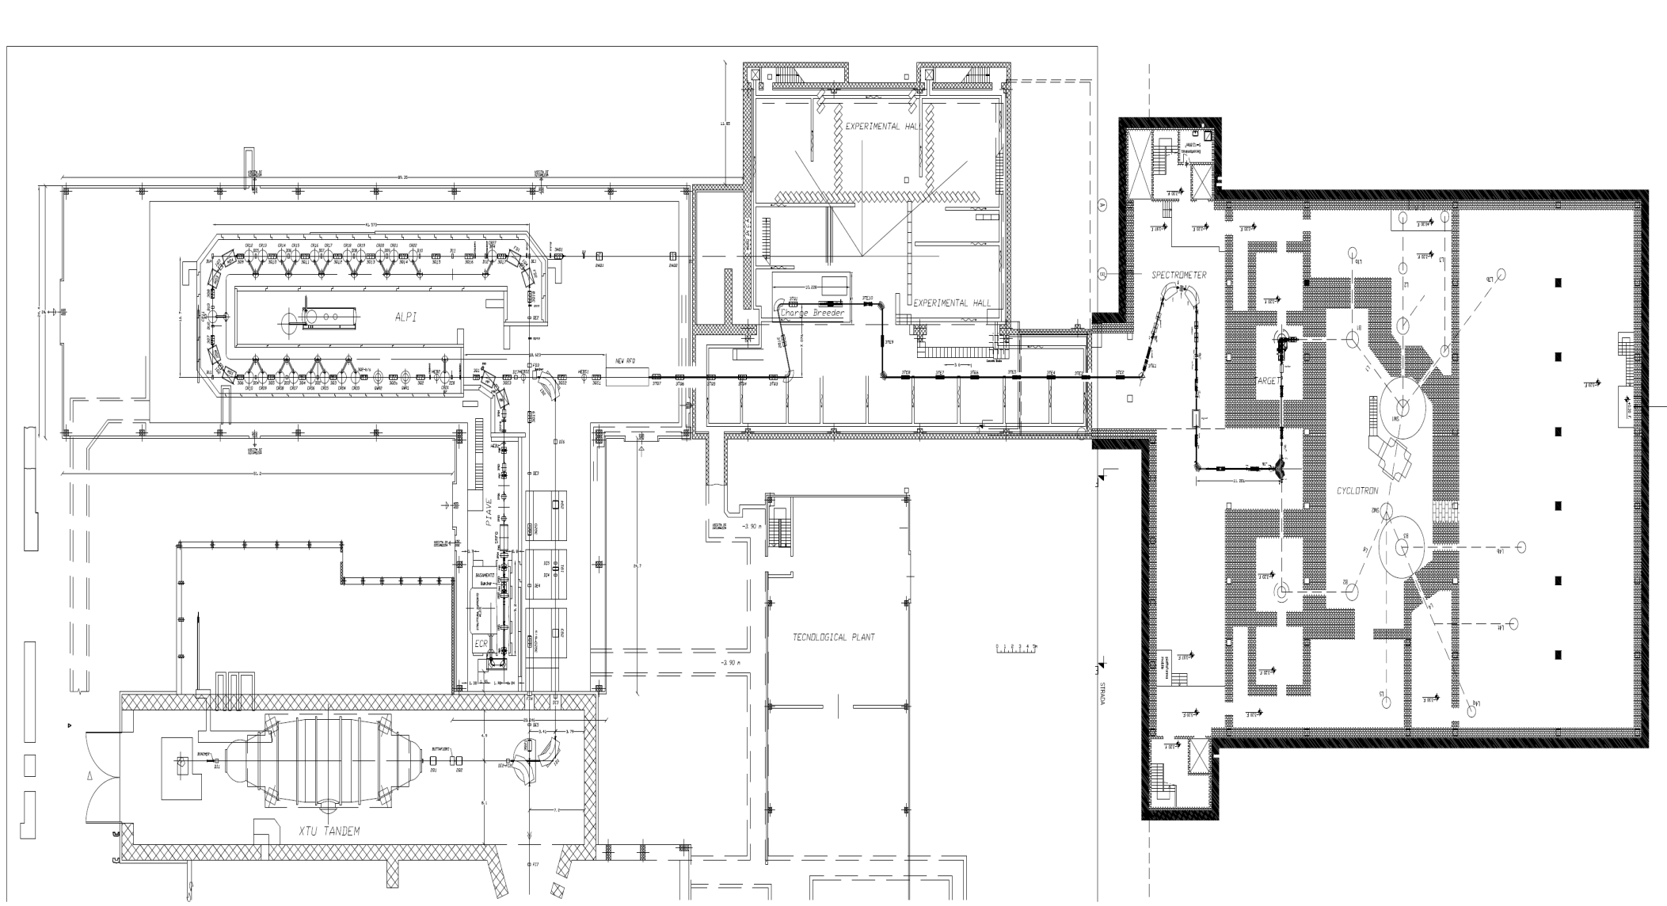
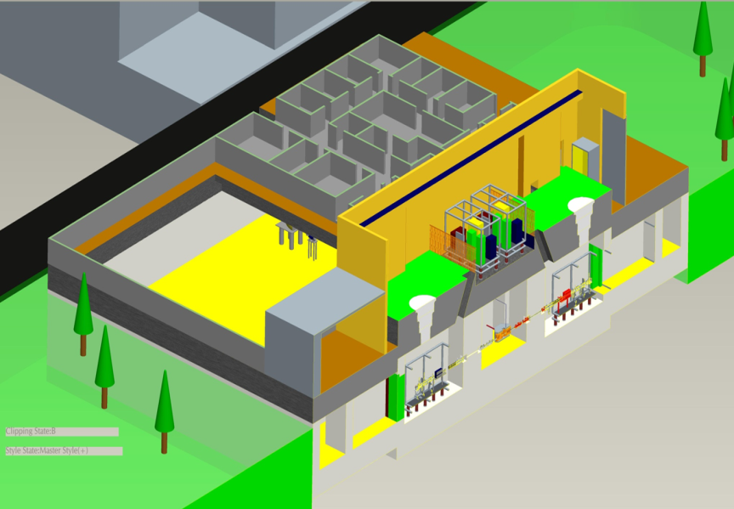
SPES project status:
Charge Breeder
RFQ
Spes (new) building
Exp. Hall 3
Cyclotron
ALPI building
HRMS
Beam Cooler
RIB target stations
Expected ground breaking in February 2013

Slide 5
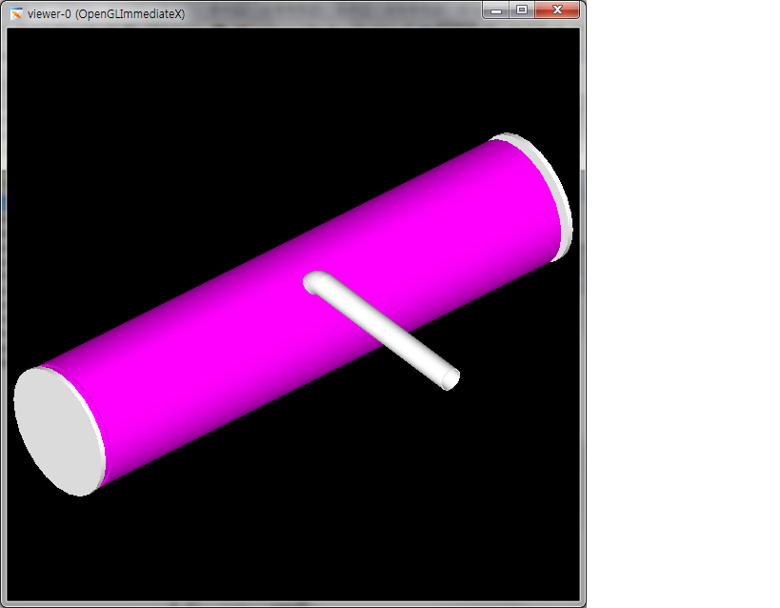
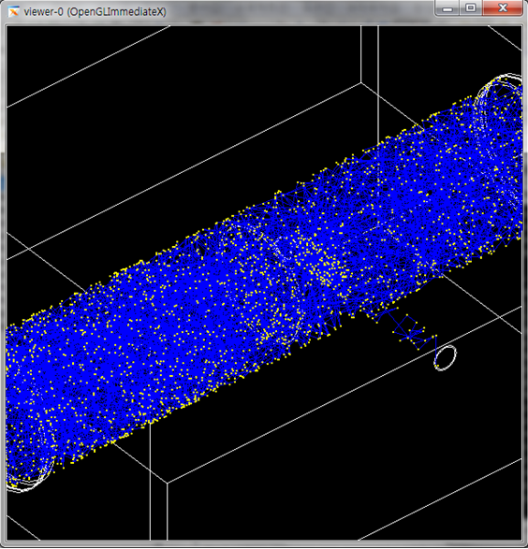
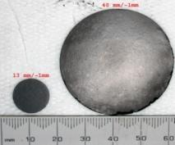

Target complex – disc & container
Temperature distribution [°C] (ANSYS ®)

Slide 6
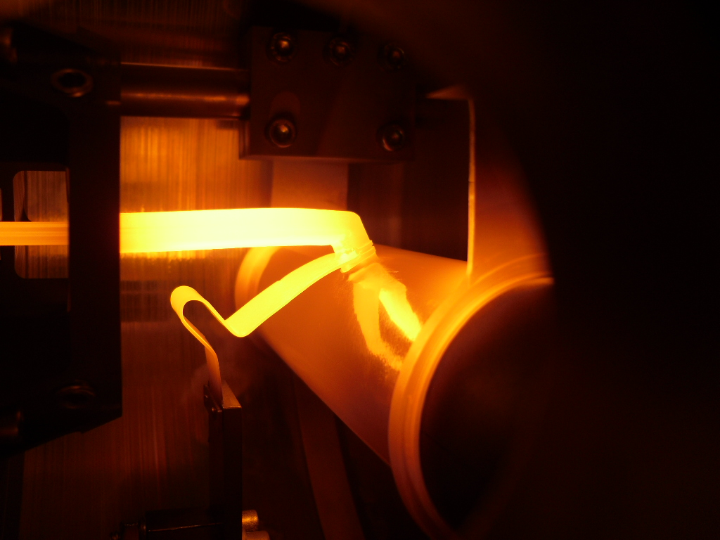
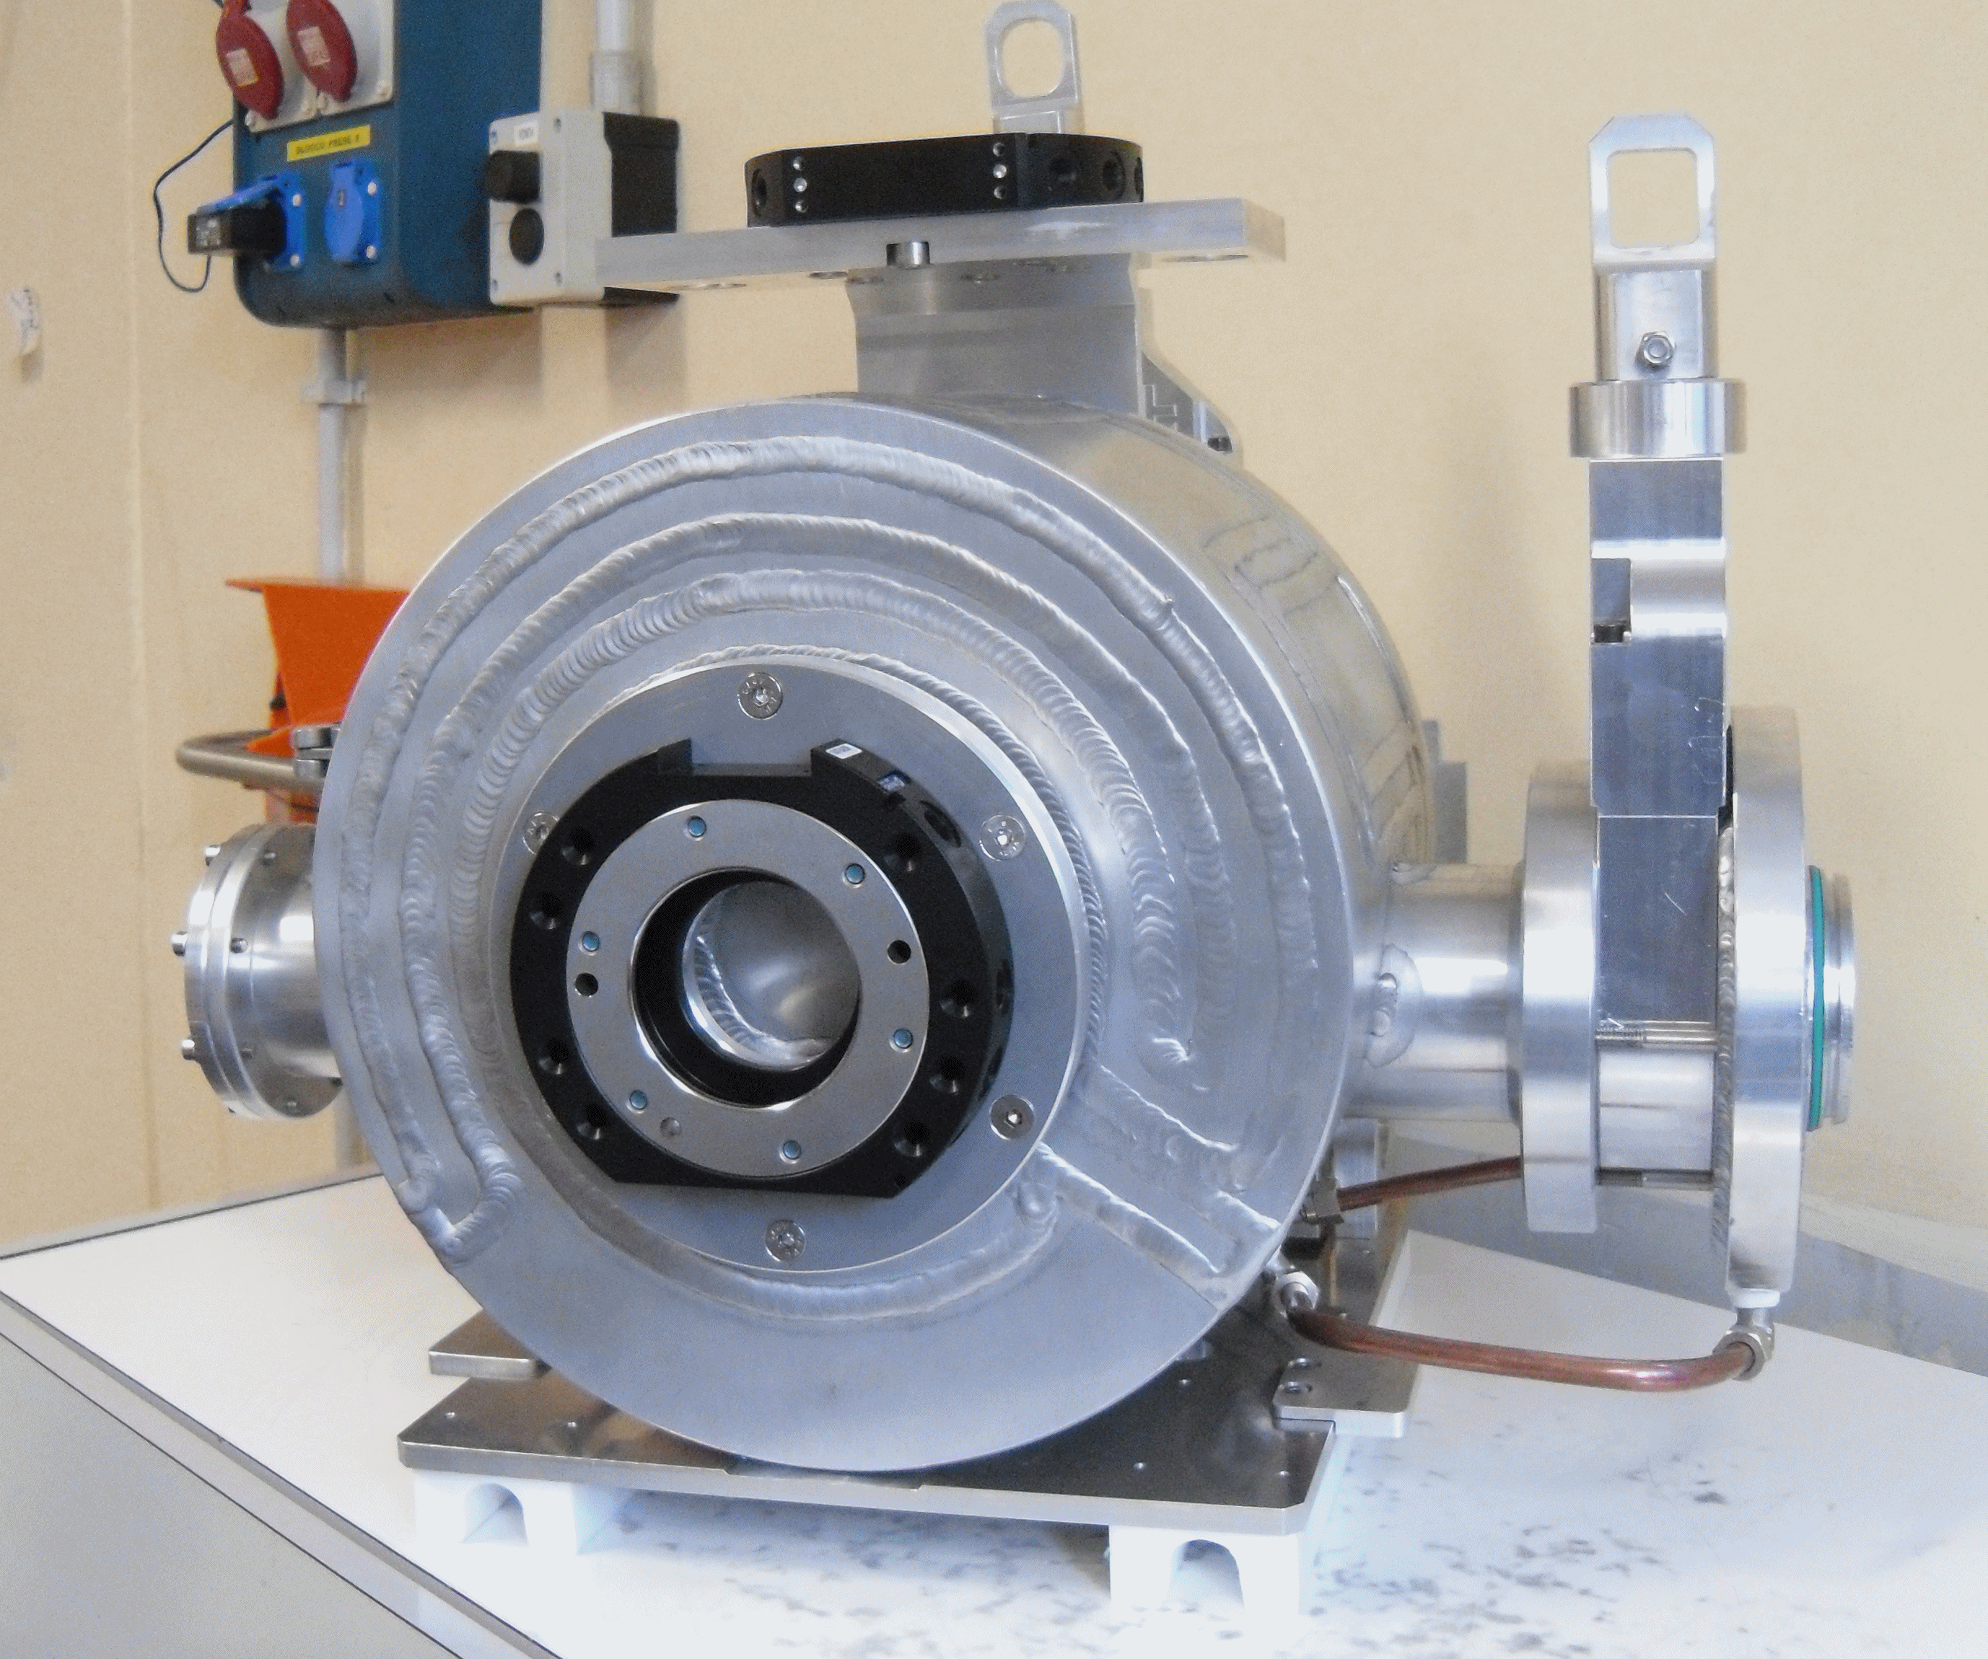
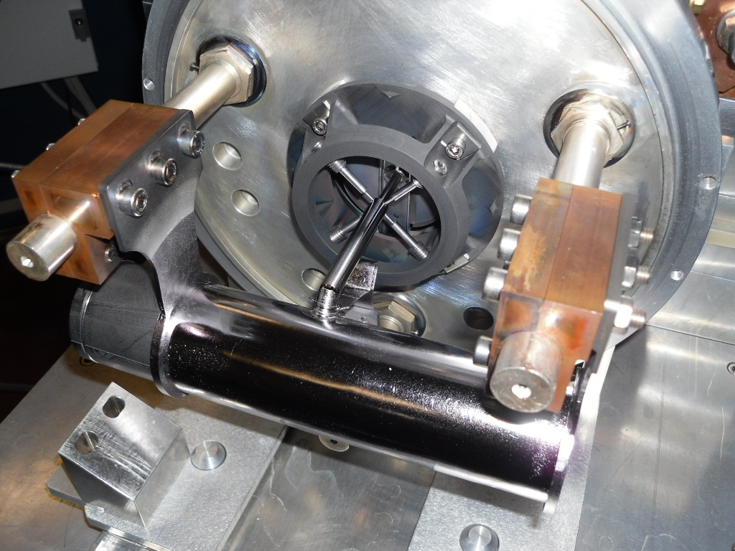
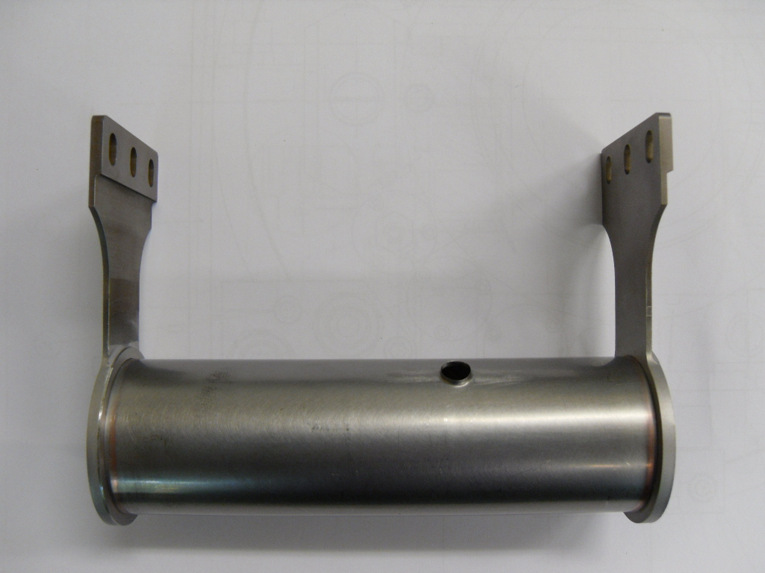
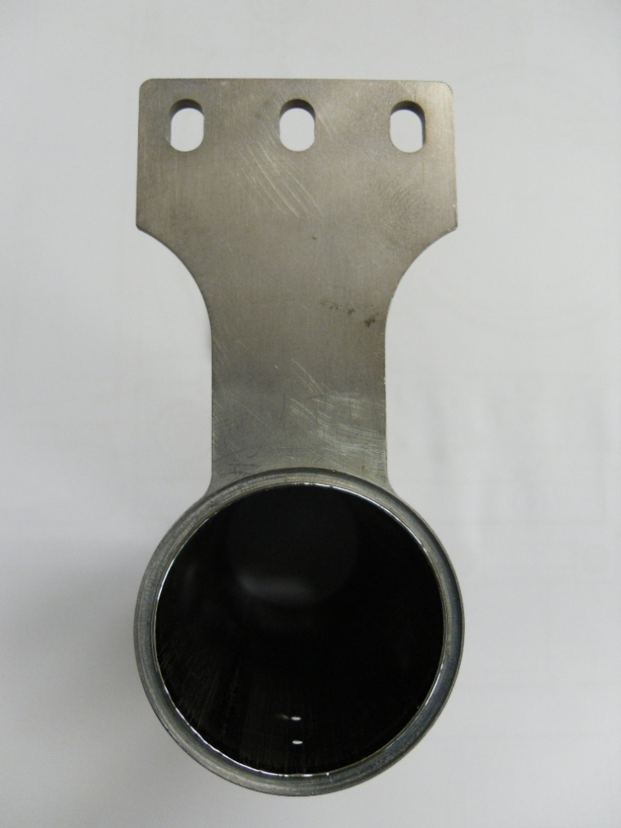
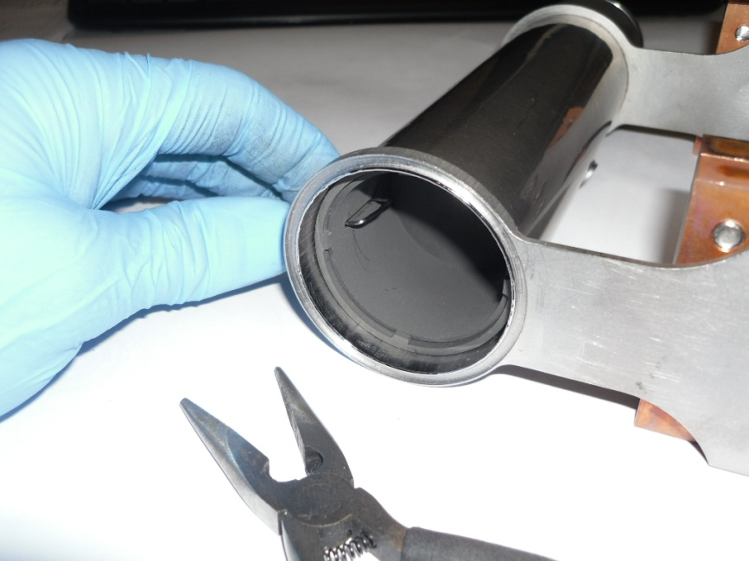
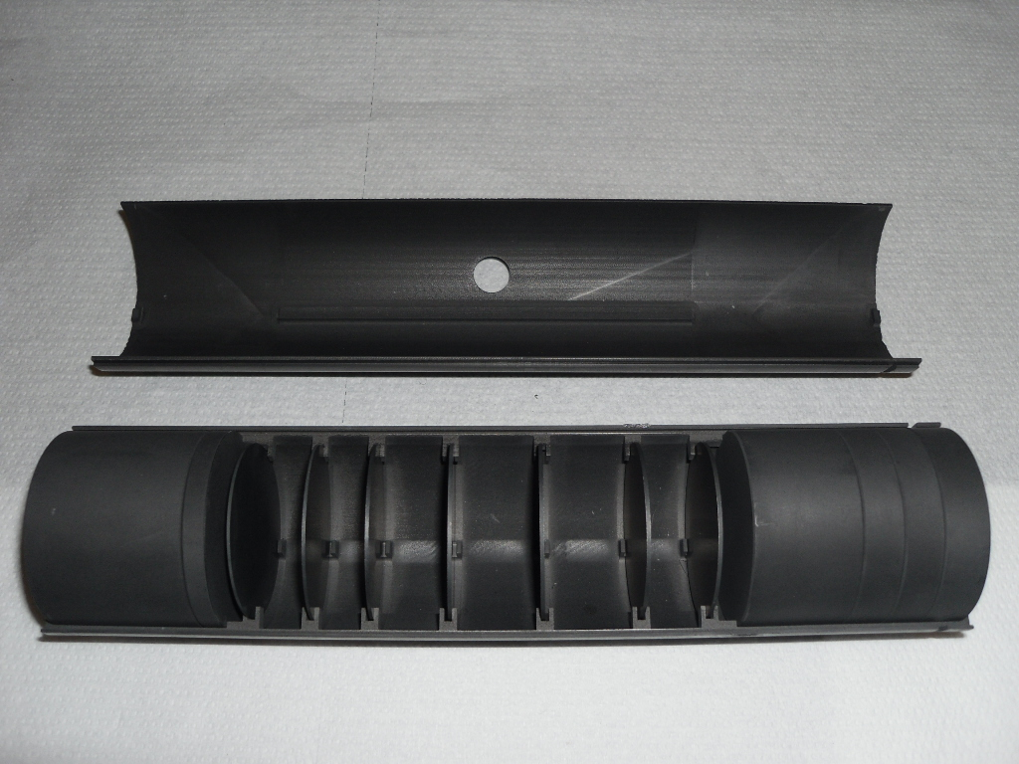
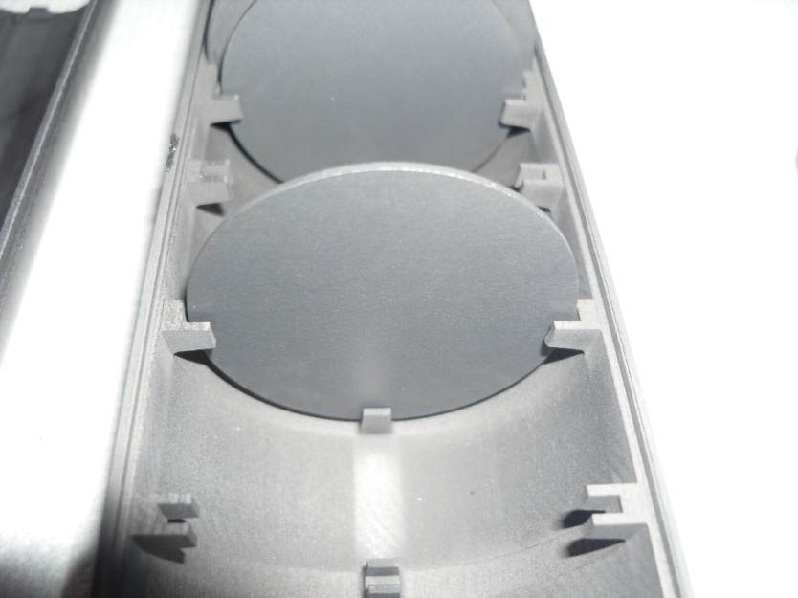
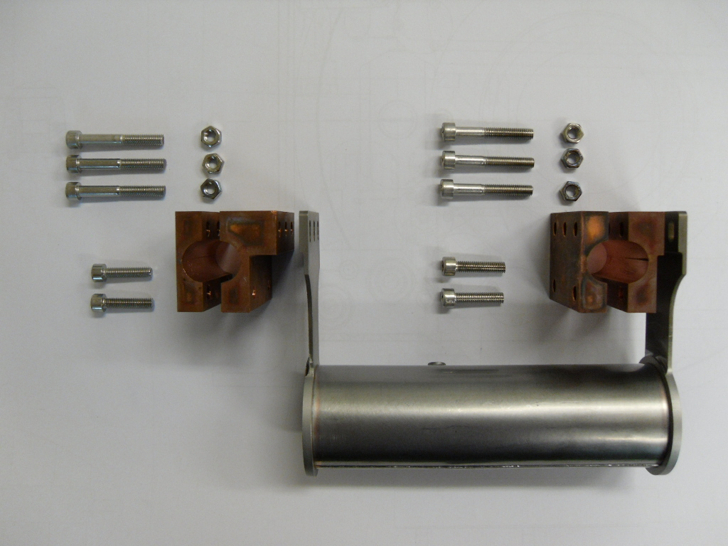
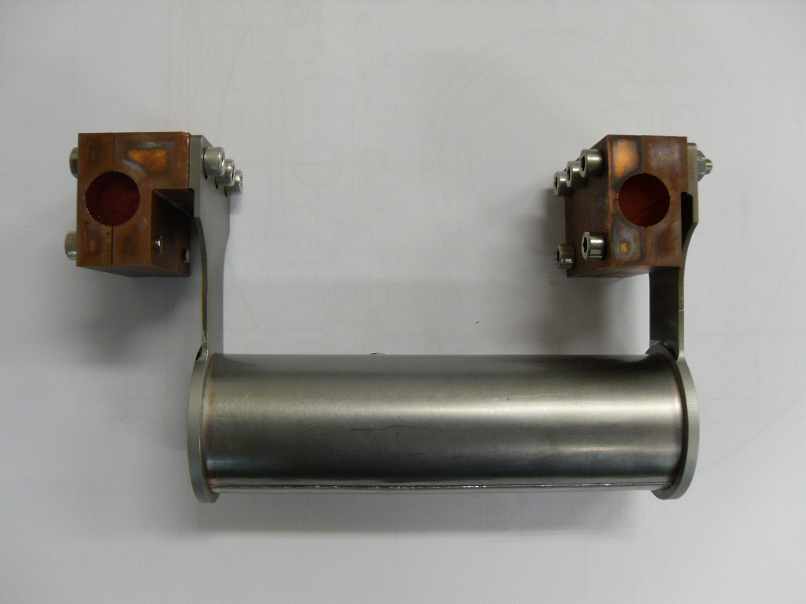
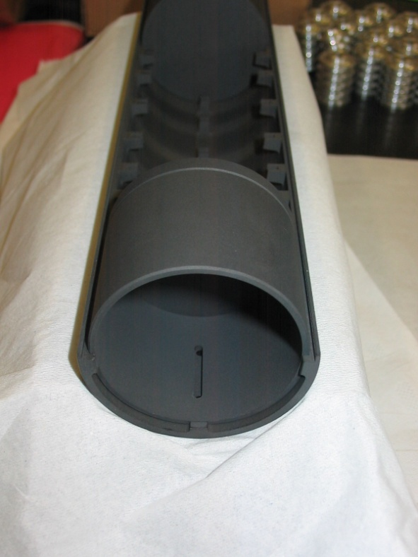
Target & ion source
I_{Target}= 700A -> 1200A max
I_{Line}= 200A -> 600A max

Slide 7
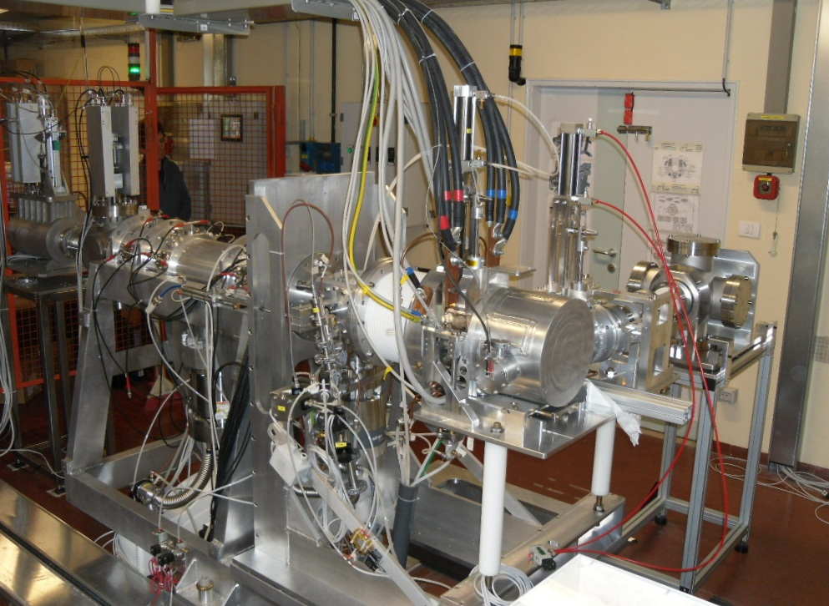
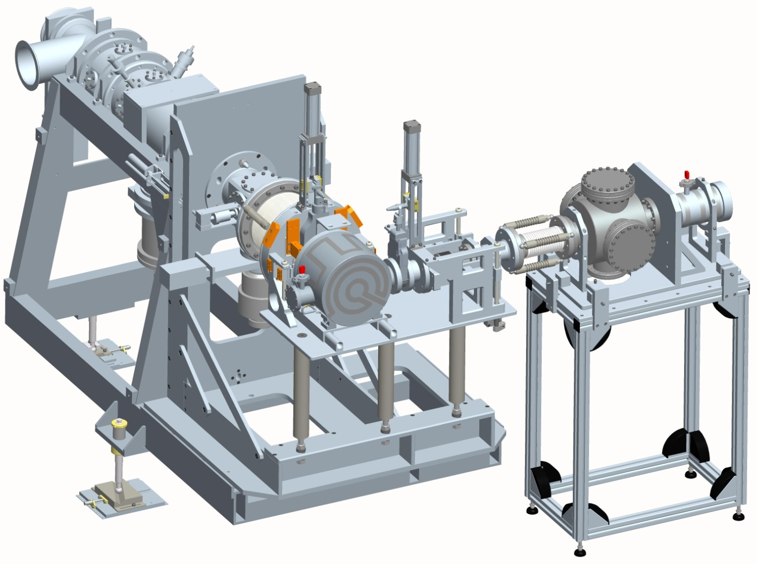
The SPES off-line Front end
(working since 2010)
60 kV platform

Slide 8
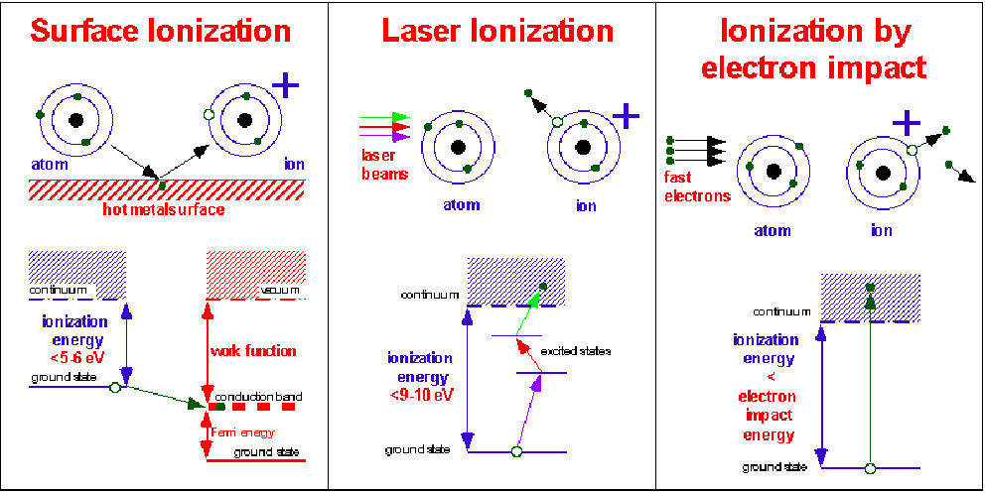
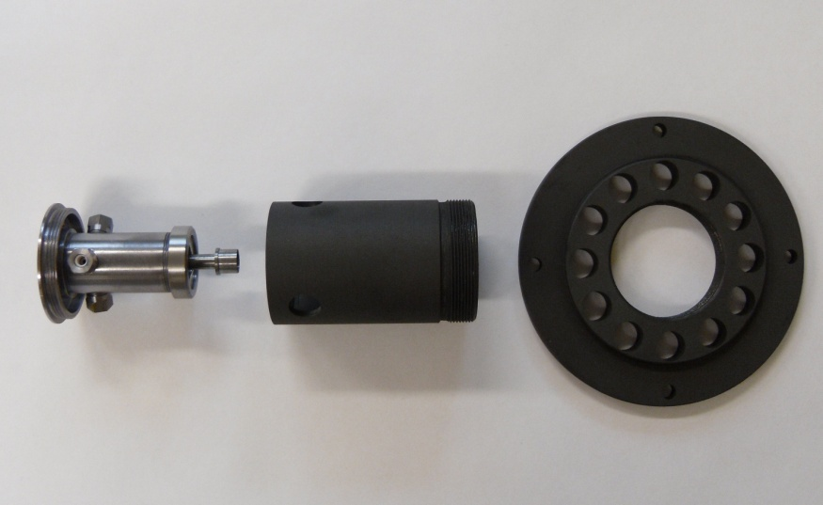
The SPES 1⁺ Ion Sources
SPES SIS
& LIS
SPES PIS

Slide 9
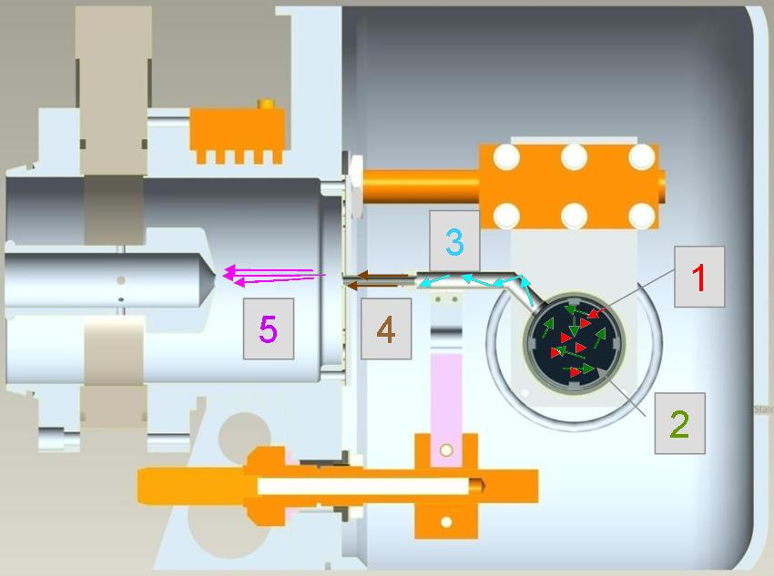
The isotope release
Release of isotopes from a ISOL target: involved processes
The target yield and release efficiency
Y_{Target} = Φ ·σ ·N ·ε_{R}
φ= Injector flux, σ = Cross section
N= Target thickness, ε_{R}= Release efficiency
ε_{R} takes into account the efficiencies of all the involved processes
ε_{R} = ε_{diffusion} · ε_{effusion} · ε_{ionization} · ε_{transport}
Most critical processes for release efficiency, they are affected by:
1) Material composition and density
2) Material microstructural properties
(grain size,porosity, interconnectivity)
3) Working Temperature
(use of high limiting temperature materials)
1. In-target reaction (fission)
2. In-target diffusion
3. Effusion from target to ion source
4. Ionization
5. Acceleration and transport

Slide 10
Temperature vs yield …
Spes data from HRIBF measurement
T very important for short
lived isotopes!

Slide 11
First conclusion…
Is necessary to produce for SPES RIB:
Target with high working temperature -> refractory carbides/oxides
2) Material with good characteristics in terms of release (grain and porosity) -> carefully R&D is mandatory!

Slide 12
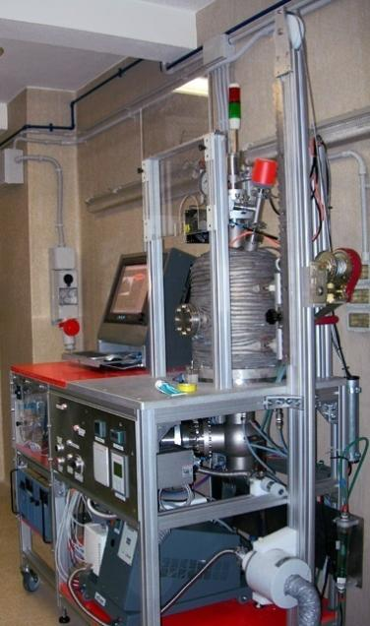
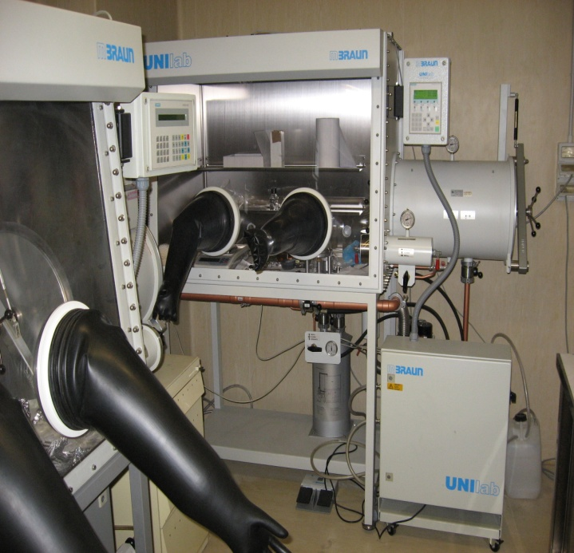
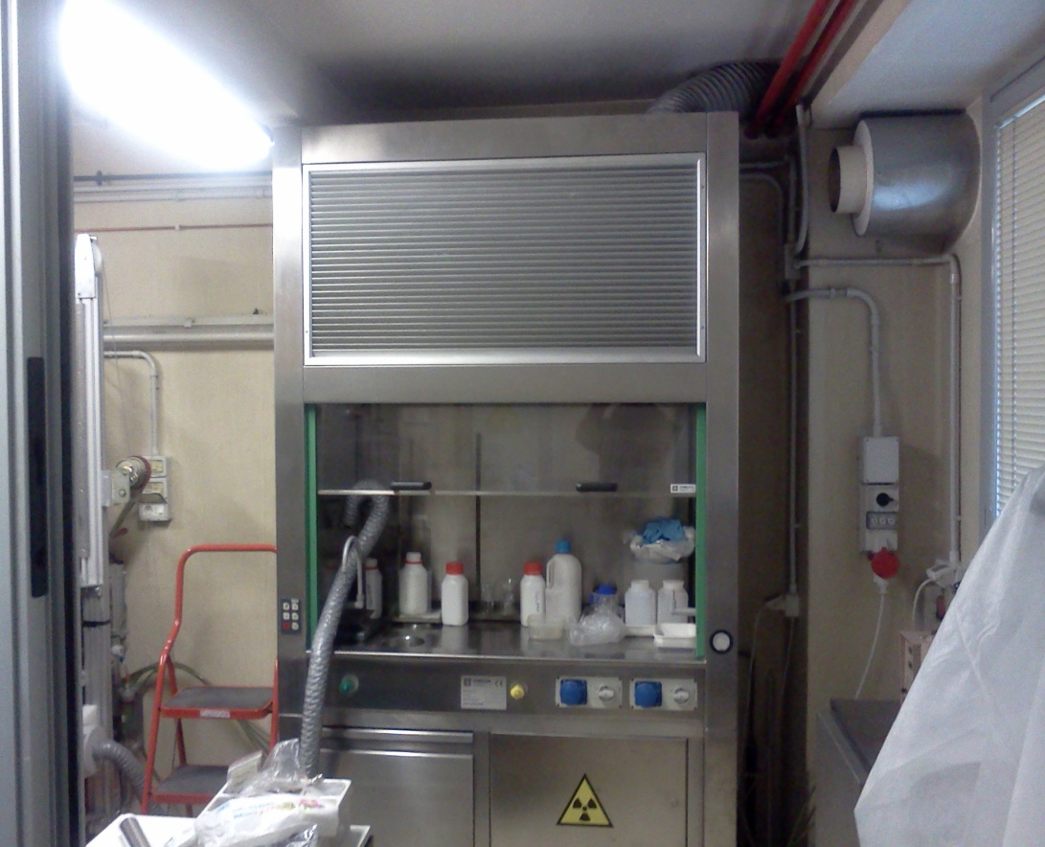
UNI Padova Radiochemistry Facility
Two dedicated glove boxes for handling and storage of sensitive compounds.
High Vacuum furnace for sample carburization & sintering
Fume hood for wet chemistry with uranium and thorium preparative chemistry.

Slide 13
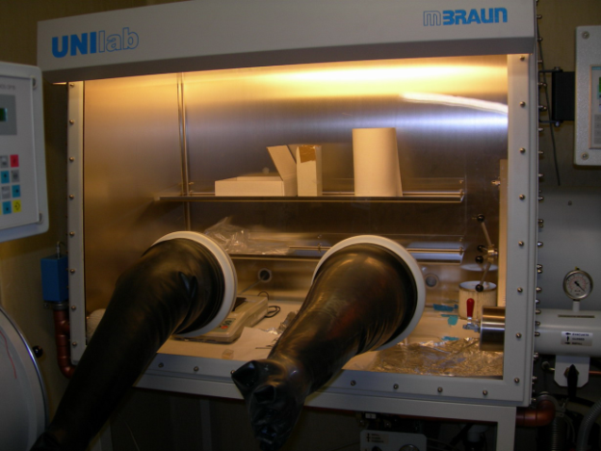
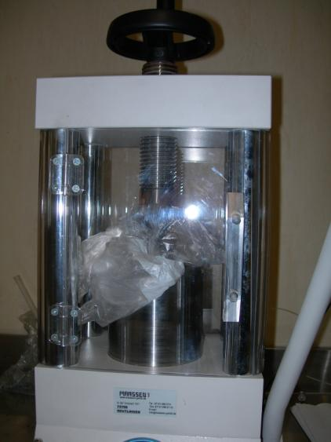
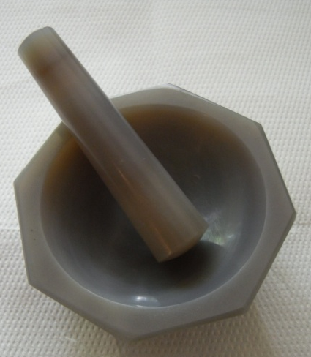
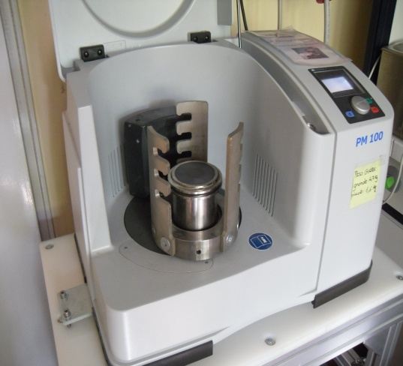
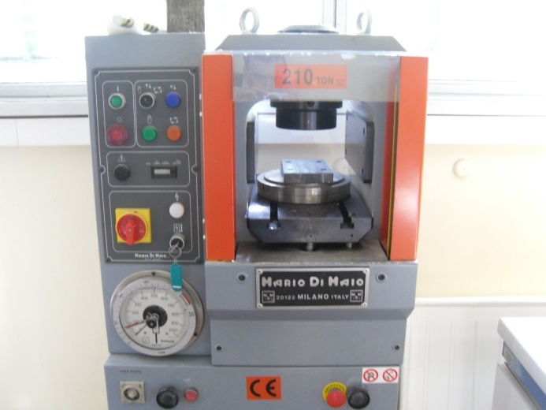
Equipments (1/3)
Mixing and grinding
Cold pressing
Glove box for safe operation with actinides
Manual hydraulic press for φ13 mm samples
Manual mixing
Mill for automatic mixing
Hydraulic press for φ30 and φ40 mm samples

Slide 14
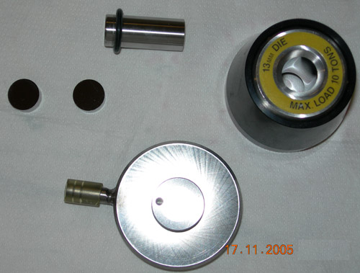
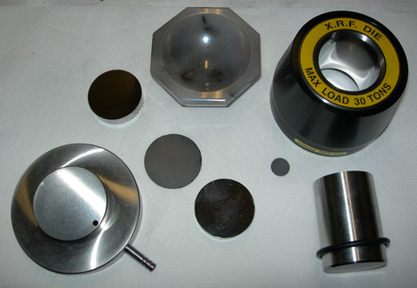
Equipments (2/3)
Die set
For 13 mm. discs
(Prototype format)
For 40 mm. discs
(SPES format)

Slide 15
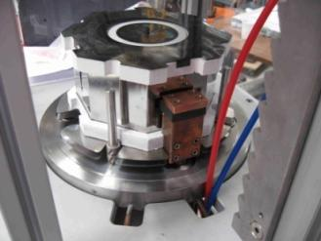
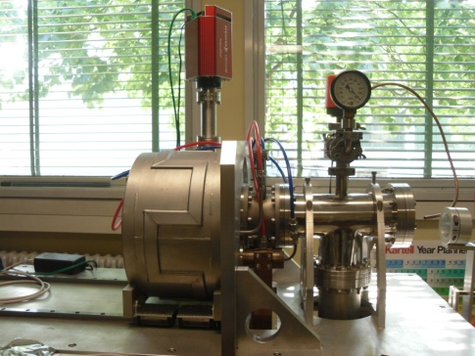
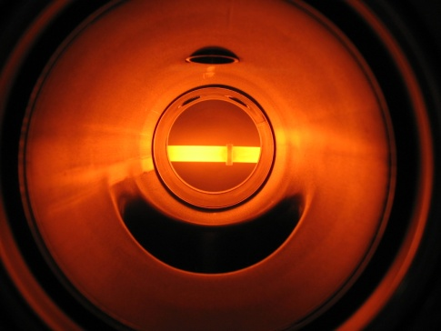
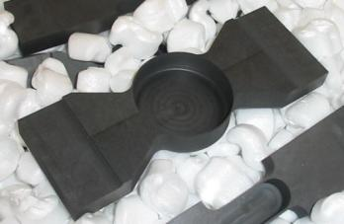
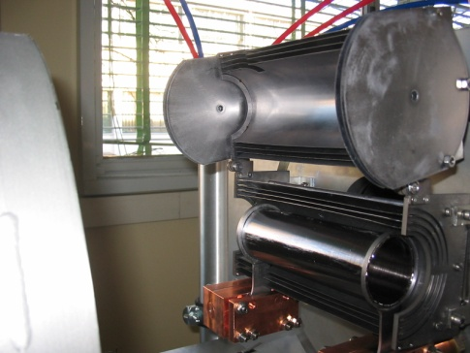
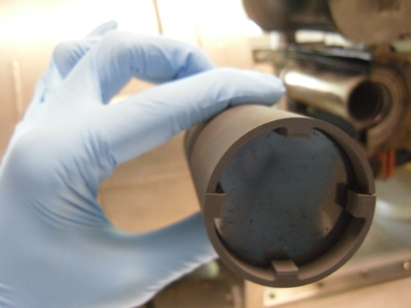
Equipments (3/3)
HT-HV furnace for actinide carbides
HT-HV furnace for other carbides
T up to 2100 °C, P = 10⁻⁶ mbar
Horizontal carburization and sintering on a graphite crucible
Treatment of up to 3 φ13 mm samples or 1 φ40 mm sample
Used for UC_{X} production
T up to 2000 °C, P = 10⁻⁶ mbar
Vertical carburization and sintering in a graphite box inside a Ta heater (similar configuration to SPES target)
Treatment of up to 7 φ40 mm samples
Used for other carbides production

Slide 16
Production methods
Three different production routes:
Carbothermal reaction between the precursor oxide and carbon → commonly used
Direct reaction between metal and graphite → more difficult and expensive
Sol-gel route → a liquid precursor is transformed into a gel that is pyrolized to obtain the carbide at lower T than reaction 1) and 2)
MxOy + (2x+y+n)C → xMC₂ + yCO + nC (Route 1)
xM + (y+n)C → MxCy + nC (Route 2)
Carbothermal reduction of the precursor oxide (reaction 1) is necessary to operate at high temperature and high vacuum → SPES HT furnace

Slide 17
Synthesis of carbides
Carbothermal reduction of oxides at SPES chemistry laboratories
RAW MATERIALS
Oxide + carbon source (usually graphite)
MIXING AND GRINDING OF THE POWDERS
Manual (mortar) or automatic (planetary mill)
COLD PRESSING INTO PELLETS
Industrial or home-made dies, up to 90 ton
THERMAL TREATMENT
High temperature, high vacuum
CHARACTERIZATION OR ON-LINE TESTS
Crystal phases, microstructure, thermal properties, porosity evaluation, ecc.

Slide 18
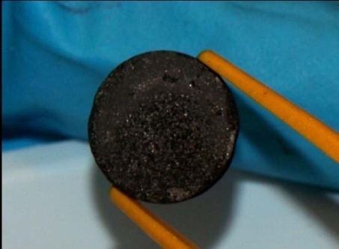
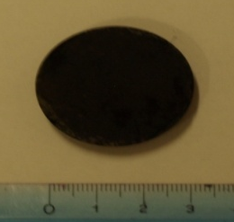
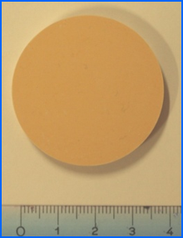
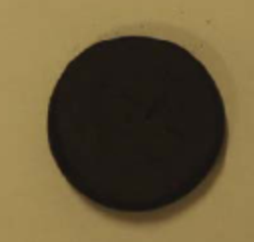
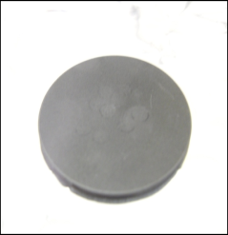
Target: n-rich vs. p-rich
Among the possible choices for the materials constituting the SPES target, low density, carbon dispersed metal carbides have been chosen.
Actinide carbides
Other refractory carbides
Main challenging
UC_{X} target
Used for n-rich isotopes production.
High melting point (T > 2000°C)
High limiting temperature
Acceptable thermal conductivity
Good mechanical stability
Ex: SiC, ZrC, B₄C
High melting point (T > 2000°C)
High hardness
Good thermal conductivity
Chemical inertness up to very high T

Slide 19
Possible p-rich beams for SPES-α
1 H |  |  |  |  |  |  |  |  |  |  |  |  |  |  |  |  | 2 He
3 Li | 4 Be |  |  |  |  |  |  |  |  |  |  | 5 B | 6 C | 7 N | 8 O | 9 F | 10 Ne
11 Na | 12 Mg |  |  |  |  |  |  |  |  |  |  | 13 Al | 14 Si | 15 P | 16 S | 17 Cl | 18 Ar
19 K | 20 Ca | 21 Sc | 22 Ti | 23 V | 24 Cr | 25 Mn | 26 Fe | 27 Co | 28 Ni | 29 Cu | 30 Zn | 31 Ga | 32 Ge | 33 As | 34 Se | 35 Br | 36 Kr
37 Rb | 38 Sr | 39 Y | 40 Zr | 41 Nb | 42 Mo | 43 Tc | 44 Ru | 45 Rh | 46 Pd | 47 Ag | 48 Cd | 49 In | 50 Sn | 51 Sb | 52 Te | 53 I | 54 Xe
55 Cs | 56 Ba |  | 72 Hf | 73 Ta | 74 W | 75 Re | 76 Os | 77 Ir | 78 Pt | 79 Au | 80 Hg | 81 Tl | 82 Pb | 83 Bi | 84 Po | 85 At | 86 Rn
87 Fr | 88 Ra
 |  | 57 La | 58 Ce | 59 Pr | 60 Nd | 61 Pm | 62 Sm | 63 Eu | 64 Gd | 65 Te | 66 Dy | 67 Ho | 68 Er | 69 Tm | 70 Yb | 71 Lu
 |  | 89 Ac | 90 Th | 91 Pa | 92 U | 93 Np | 94 Pu | 95 Am | 96 Cm | 97 Bk | 98 Cf | 99 Es | 100 Fm | 101 Md | 102 No | 103 Lr
Alkaline - Alkaline earth metals
Post-transition elements
Halogens
Noble gases
Transition metals
Lanthanides

Slide 20
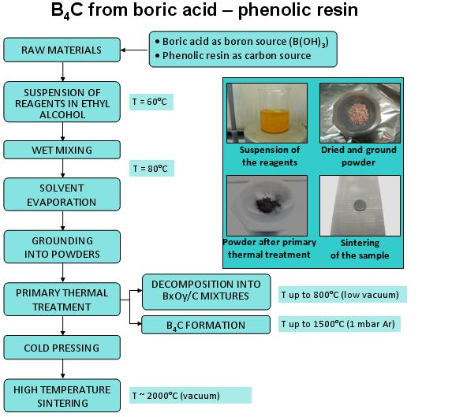
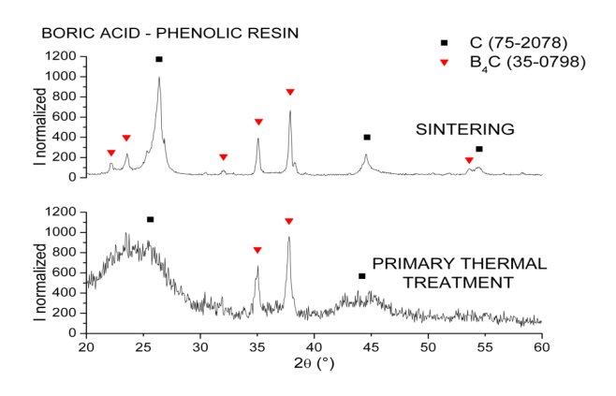
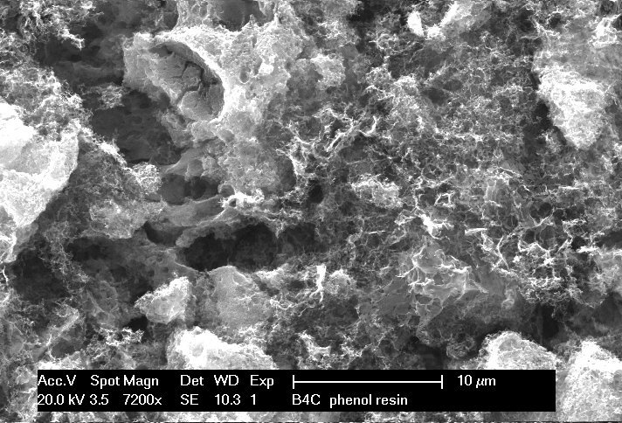
p-rich production: B₄C target
Possible p-rich elements: Be
Long treatment to produce porous B₄C samples
φ13 and φ40 mm samples produced and characterized

Slide 21
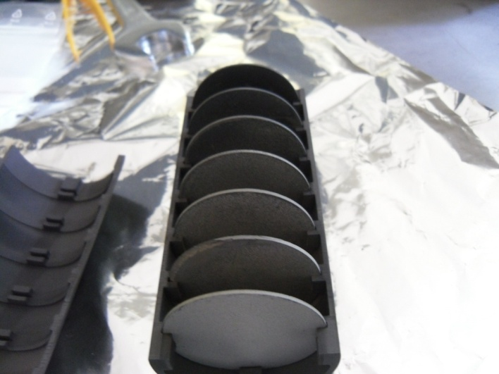
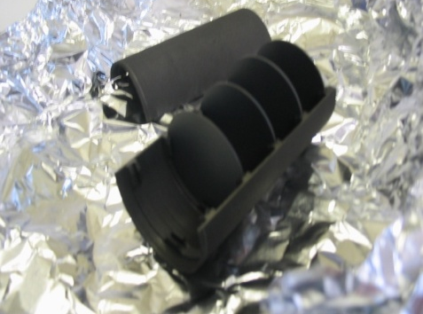
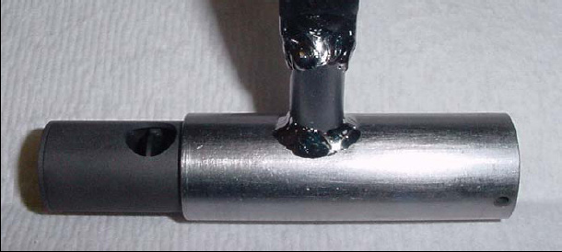
p-rich production: other targets
SiC target
Other targets
Possible p-rich elements: Al
Disks are purchased already made
φ40 mm disks ready and currently used for thermal tests on the target-ion source complex
φ30 mm disks used for thermal conductivity measurements
A φ13 mm prototype already tested at HRIBF → ²⁶Al
LaC_{X} target prototype
Targets: LaC_{X}, ZrC, oxides
Possible p-rich elements: Cs,I,As,Br, Rb,Na,Mg,Si and others
φ40 mm disks ready
φ30 mm disks used for thermal conductivity measurements
Production of foams (very porous solids)

Slide 22
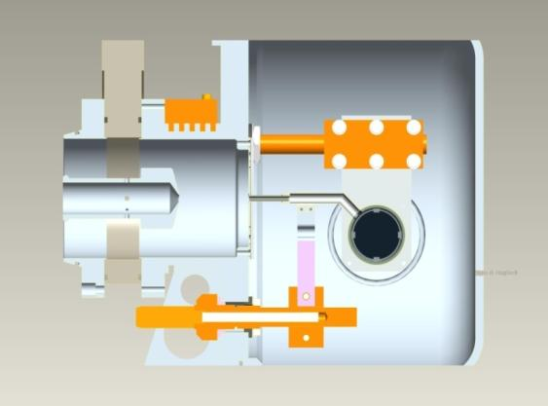

n-rich beams for SPES-β
Selective method
Elements with bad volatility (NOT EXTRACTED)
Surface Ionization Method
1
2
Surface Ion source
H
Photo Ionization Method
He
3
4
5
6
7
8
9
10
Very selective method
Li
Be
B
C
N
O
F
Ne
11
12
Plasma Ionization Method
13
14
15
16
17
18
Na
Mg
Al
Si
P
S
Cl
Ar
19
20
21
22
23
24
25
26
27
28
29
30
31
32
33
34
35
36
Laser beam
K
Ca
Sc
Ti
V
Cr
Mn
Fe
Co
Ni
Cu
Zn
Ga
Ge
As
Se
Br
Kr
37
38
39
40
41
42
43
44
45
46
47
48
49
50
51
52
53
54
Laser with SIS
Rb
Sr
Y
Zr
Nb
Mo
Tc
Ru
Rh
Pd
Ag
Cd
In
Sn
Sb
Te
I
Xe
55
56
57
72
73
74
75
76
77
78
79
80
81
82
83
84
85
86
No selective method
Cs
Ba
La
Hf
Ta
W
Re
Os
Ir
Pt
Au
Hg
Tl
Pb
Bi
Po
At
Rn
87
88
89
104
105
106
107
108
109
110
111
112
Fr
Ra
Ac
Rf
Db
Sg
Bh
Hs
Mt
Main fission (p-> ²³⁸U) fragments
Plasma Ion source

Slide 23





n-rich production: UC_{X} targets
1) Standard UC_{X}
Standard carbothermal reduction process using graphite as carbon source
Density is about 4.3 g/cm³
φ13 mm target prototype made of 7 disks produced and tested on-line at HRIBF

Slide 24




n-rich production: UC_{X} targets
2) Low density UC_{X}
Carbothermal reduction process using graphite and carbon nanotubes as carbon source
Density is about 2.6 g/cm³
φ13 mm target prototype made of 7 disks produced and tested on-line at HRIBF

Slide 25


HRIBF: On-Line TIS Testing Facility
low intensity (<50 nA) tests of RIB production targets
Beam from Tandem Accelerator
Target / Ion Source
Beam Diagnostics
Dipole Magnet
M/ΔM = 2000
Moving Tape System
and γ-ray Detector

Slide 26


Experimental tests at HRIBF
1) Standard UC_{X}
Targets tested at three different temperatures: 2000°C, 1800°C and 1600°C
Irradiation by 40 MeV, 50 nA proton beam, ionization with plasma ion source
21 elements, about 75 isotopes collected
Yield vs. half-life characterization
 | Standard UC_{X} | Low density UC_{X}
Density (g/cm³) | 4.25 | 2.59
Diameter (mm) | 12.50 | 13.07
Thickness (g/cm²) | 0.41 | 0.41
Calculated porosity (%) | 58 | 75

Slide 27
Experimental tests at HRIBF
1) Standard UC_{X}
Yield vs. T_{1/2}
Holdup-time (⁹²Sr)
D. Scarpa et al., Eur. Phys. J. A 47 (2011) 32.
S. Corradetti et al., Eur. Phys. J. A 47 (2011) 119.

Slide 28

Experimental tests at HRIBF
2) Low density UC_{X}
Targets tested at three different temperatures: 2000°C, 1800°C and 1600°C
Irradiation by 40 MeV, 50 nA proton beam, ionization with plasma ion source
21 elements, about 80 isotopes collected
Yield vs. half-life characterization
 | Standard UC_{X} | Low density UC_{X}
Density (g/cm³) | 4.25 | 2.59
Diameter (mm) | 12.50 | 13.07
Thickness (g/cm²) | 0.41 | 0.41
Calculated porosity (%) | 58 | 75

Slide 29
Experimental tests at HRIBF
2) Low density UC_{X}
Yield vs. T_{1/2}
Holdup-time (⁹²Sr)
New manuscript by S. Corradetti, S. Carturan, M. Manzolaro, D. Scarpa, L. Biasetto, A. Andrighetto, P. Zanonato, P. Colombo, C. Jost and D. W. Stracener in progress

Slide 30

New UCx target
New production 6 g/cm³ (MD) UC_{X} targets
Production process:
1)“Standard” carbothermal reduction synthesis→~4 g/cm³
2) Grinding and re‐pressing of the powders→ to be done
3) Re-sintering of the pellets →to be done
First prototype sample produced with density ~ 6.2 g/cm³

Slide 31








ISOL FACILITY in EUROPE
France
CERN
Italy
SPIRAL –
LNS -

Slide 32




The Excyt LNS RIB facility
Target Chamber Unit
Target Front End

Slide 33

SPIRAL facility at GANIL
3 simultaneous beams at different energies
Stable beams from C to U
E =
0.3A - 1.0A MeV
5A - 13.0A MeV
SISSI
27A - 95 A MeV
RIB
E = 25A - 80A MeV
RIB: He, N, O,
F, Ne, Ar, Kr
E < 20A keV
E = 1.7A - 25A MeV
IRRSUD
(Information from : A.Villari talk)

Slide 34

ALTO facility at ORSAY
(Information from : C. Lau talk)

Slide 35




ISOLDE at CERN
Over 100 TIS combinations!
Thanks to R. Catherall

Slide 36






FP7 ENSAR – the ActiLab JRA
Task 1: Synthesis of new actinide targets (CERN, INFN, IPNO) Subtask 1: Sol-gel synthesis in complex fluids
Subtask 2: Nanostructures
Task 2: Characterization of actinide targets (CERN, INFN)
Subtask 1: Microstructure, porosity, specific surface, crystalline phase
Subtask 2: Emissivity, thermal conductivity at high temperature
Task 3: Actinide targets properties after irradiation (CERN, PSI)
Subtask 1: Post-irradiation examination of target prototypes
Task 4: Online tests of actinide targets (CERN, GANIL, IPNO)
Subtask 1: Impact of pulse time structure on release and ageing properties
Subtask 2: Analysis of the results-effusion and diffusion phenomena

Slide 37

New UCx target at ISOLDE
(Information from : A. Gotteberg talk)

Slide 38





IPNO contribution to ActiLab
Thanks to C. Lau
UC_{X} Laboratory:
Extension works completed (April 2012)
New heating bench for fast and programmable carburization is operational (May 2012)
Gas and water supply in the extended UC_{X} Lab (Nov. 2012)
Contribution to ACTILAB:
Carburization and analysis of UO2+CNT pellets from ISOLDE (shipping in progress)
Contribution to woks on HD UC pellets (Rosatom - Russia) tested at ISOLDE
Contribution to next experiment at ISOLDE (IS540)
Extension of the UC_{X} Lab
New heating bench

Slide 39

IPNO contribution to ActiLab
R&D on UC_{X} in progress:
ALTO leads a R&D program on UC_{X} synthesis, exploitation and reprocessing with the collaboration of the radiochemistry and the Chemistry Sciences (Rennes) groups.
Nuclear Instruments and Methods in Physics Research B 288 (2012) 34–41
“An off-line method to characterize the fission product release from
Uranium-carbide-target prototypes developed for SPIRAL2 project ”
Dense (13.5) and porous (40%), with high level of PFs release at 1550°C
Cf. Poster by S. Tusseau-Nenez:
“Uranium-carbide-target prototypes for SPIRAL2 project:
fission product release and physicochemical properties”
10 μm

Slide 40
LNL contribution to ActiLab
New post-doc position at LNL-INFN in the framework of
‘UC_{X} production, characterization and on-line testing’
Investigated topics:
Influence of starting materials characteristics (powders size, composition, mixing and grinding operation) on the final UC_{X} properties
Goal: test of the produced UC_{X} targets at ALTO facility
for the evaluation of microstructure and release of isotopes

Slide 41


UC_{X} developement - ActiLab
INFN – LNL Activity
New radiochemistry laboratory at LNL-INFN, setup on progress.
‘Old’ radiochemistry laboratory at Padova University, after a long period o maintenance, is now fully operative
Acquisition of a micromill and sieves to perform granulometry analysis on the starting and final powders

Slide 42


LNL new Radiochemistry Facility
Devices: glove box , fume hood , high vacuum furnace
Decontamination room
UCx Laboratory (working in progress…)
Estimated end of works: Dec ‘12

Slide 43


The SPES-TIS group
Thanks for your attention!

