Slide 1

Applications of radioactive ion beams at EURISOL new tools, new ideas, new people
João Guilherme Correia
IST-ITN
Instituto Técnológico e Nuclear - Instituto Superior Técnico
Universidade Técnica de Lisboa

Slide 2
EXOTIC
“APPLICATIONS” OF RADIOACTIVE BEAMS
Questions to answer now:
What do we have today that will still work ...
work better !!!
In 15 years
What will be NEW ... ?
... useful and usable ?
Who will be the users ... ?

Slide 3
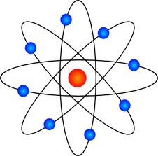






About EXOTIC radioisotopes:
+
=
LAB
Potential
Bag of
“Applications”

Slide 4
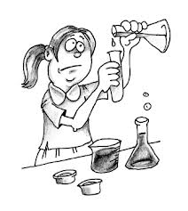

Today’s “Applications” of exotic radioisotopes:
+
=
At
(and others)...
Creative People

Slide 5

Applications of EXOTIC isotopes at EURISOL:
Defining the application areas:
(Life Sciences, Materials, Soft Matter, Chemistry...)
Defining the right Coordination with USERS:
UNIVERSITIES AND LABORATORIES
Conceiving an infrastructure with:
Dedicated BEAM LINES and BEAM TIME
Dedicated LABORATORY SPACE
(Re)defining “Applications” of exotic radioisotopes:
+
=
+

Slide 6
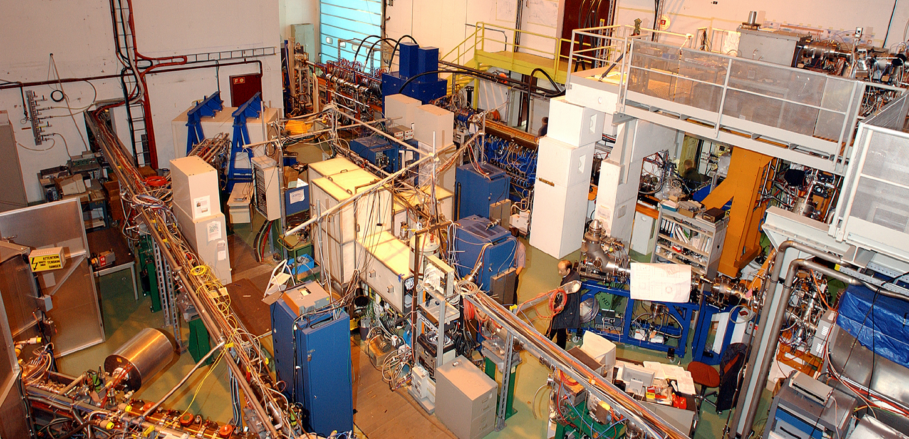
2011
37 Experiments
300 Users
96 Institutes
22 Countries
235 8h-shifts of radioactive beams
Particle and Astro-Physics 11%
Biology/Medicine 2%
University Hospitals
Universities
Research Institutes
Atomic Physics 21%
Weak Interaction and Nuclear Physics 56%
BEAM TIME PIE
10%
Solid State
Physics
Material’s research 10%

Slide 7
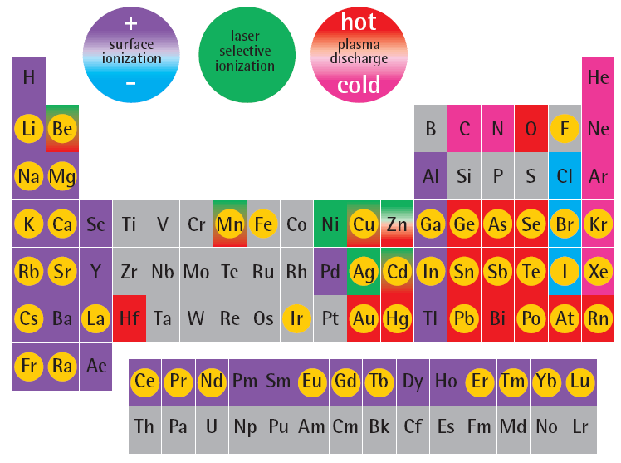
Why Radioactive Isotopes for Mater and Life Sciences?
NEW ION SOURCES
Mg
isotopes of this element
used for solid state physics or life science
Co
Ni
SENSITIVITY AND TRACEABILITY: Nothing is more easy to detect with high sensitivity than nuclear radiation. Very low concentrations of radioactive impurity atoms in a material or on a surface or interface can be detected, or followed in a body.
LOCAL INFORMATION: Hyperfine interaction (ME, PAC, β-NMR) and Emission Channeling deliver local information on lattice sites and neighborhood.
SELECTIVITY: Element transmutation due to the radioactive decay add chemical selectivity to “classical” spectroscopy techniques (photoluminescence, deep level transient spectroscopy).
TUNEABLE RANGE OF ENERGY DEPOSITION: Different isotopes and decay particles for tumor and tumor cell killing.

Slide 8
Current and PROSPECTIVE Work using
EXOTIC Radioactive isotopes
When thinking Materials and Molecular Properties we are
dealing with electromagnetism, mass, many body systems and scaling
Atomic-like information is the aim
➔ Semiconductor Physics (Si, Oxides, organic compounds)
➔ Nanomaterials (geometry, downsizing and integration)
➔ Surfaces and interfaces (bulk properties are modified)
➔ Soft matter : liquid crystals and graphen,
➔ Bio / Molecular chemistry and physics
When thinking Life Sciences – the deal is how to bring and use the highly concentrated excess energy of a radioactive nuclei, within the living body or … living cell of interest.
➔ NEW isotopes and decay modes for diagnosis and treatments.

Slide 9
-The future from the point of view of today’s NEW EXAMPLES
A commitment based on facts !

Slide 10
Emission Channeling of decay particles, on single crystals
(β⁻, β⁺, c.e., α)
electron emission channeling
@ ISOLDE - CERN
β decay
+
+
+
+
+
+
+
+
+
-
+
+
+
-
-
+
+
+
+
+
-
-
+
+
+
-
+
+
+
-
-
particle yield
angle

Slide 11
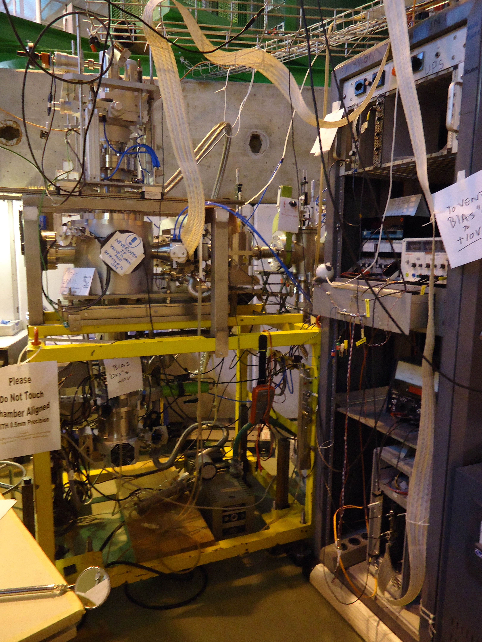
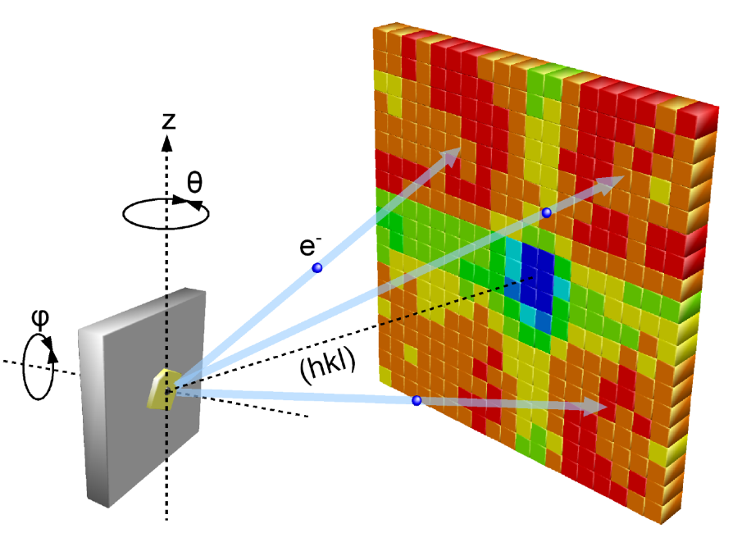
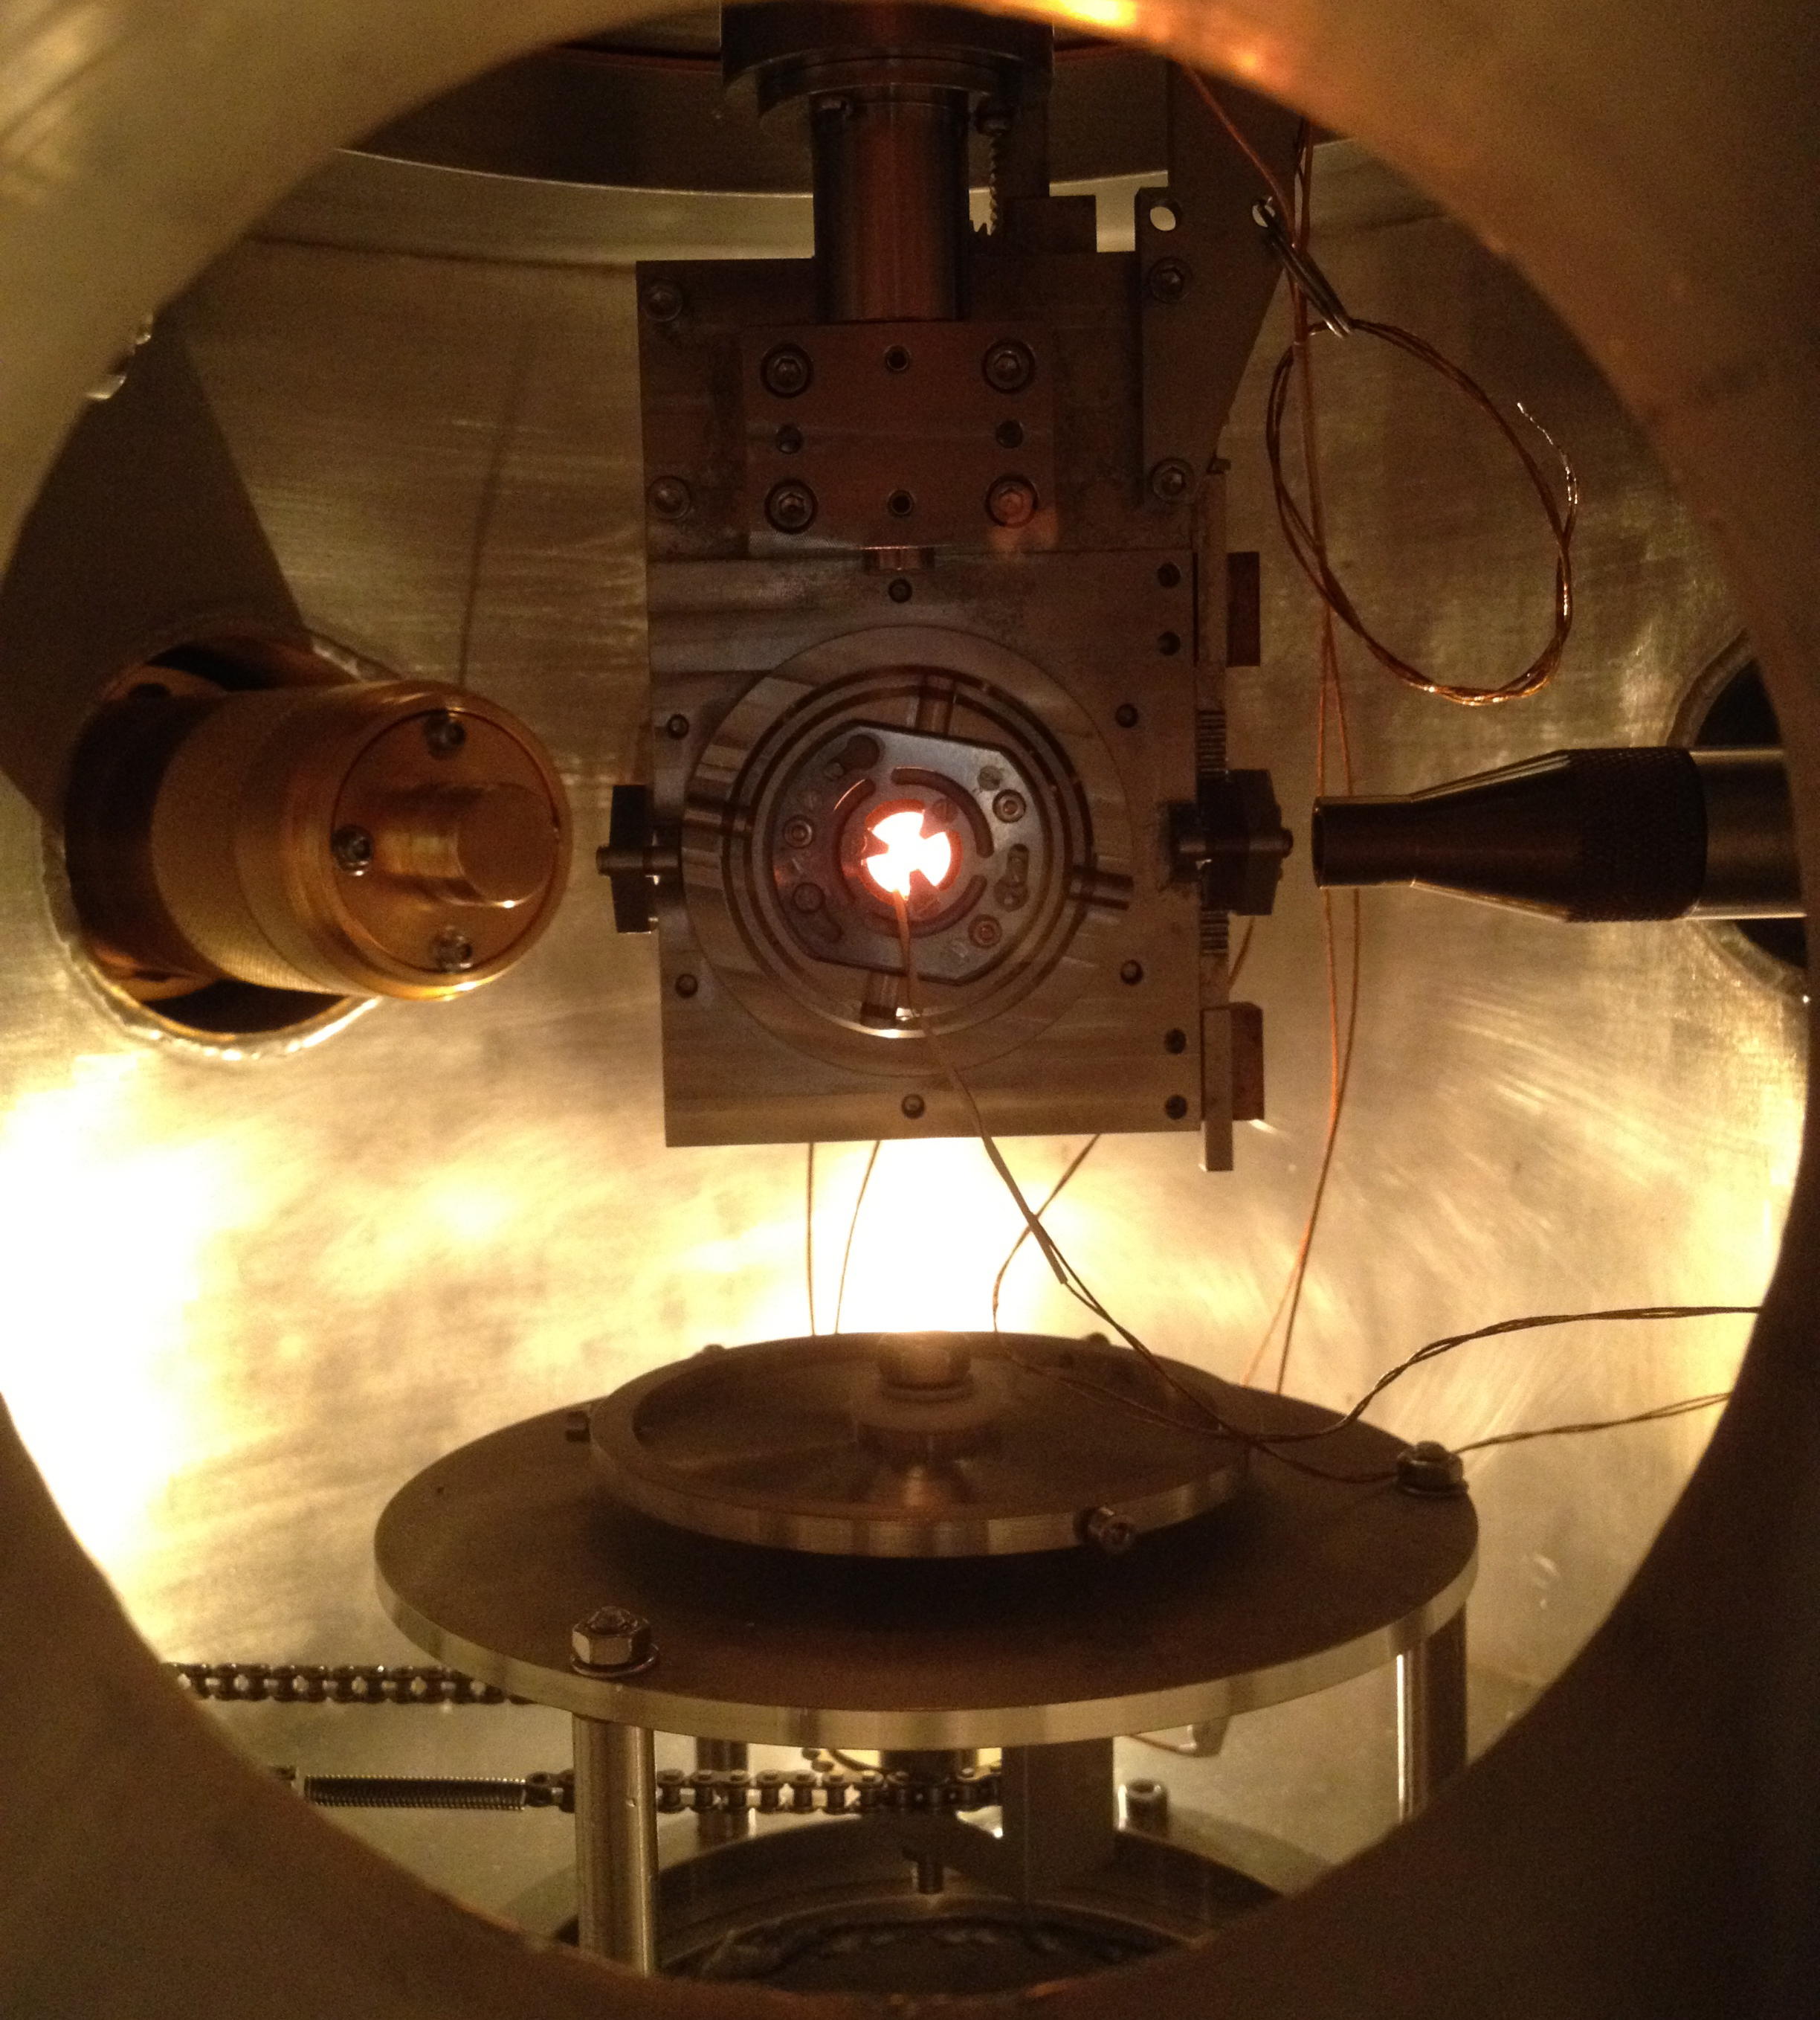
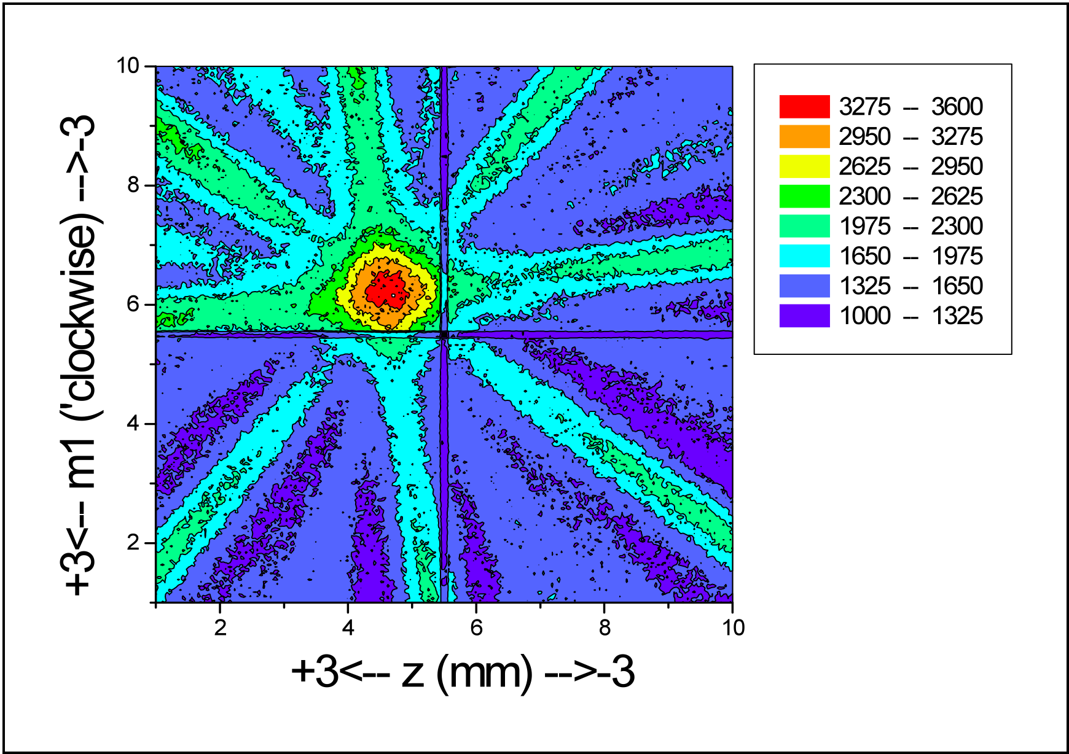
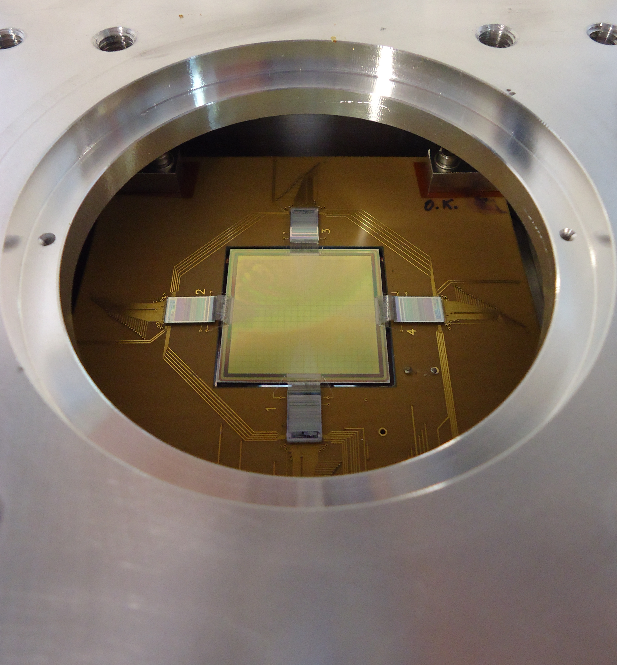
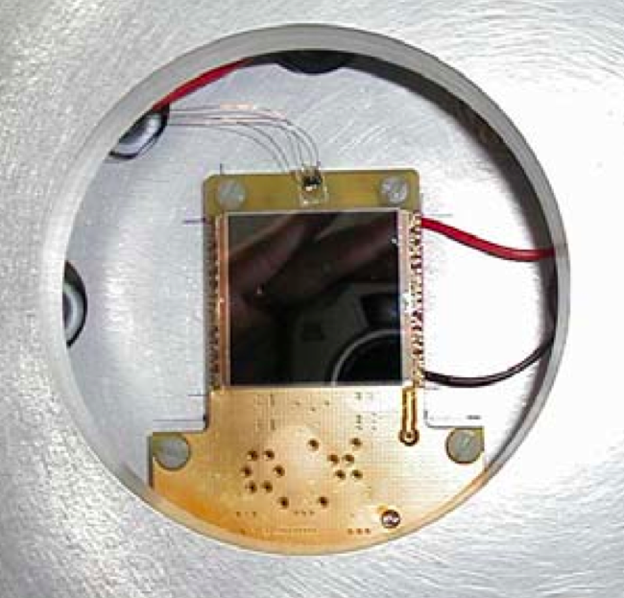
2012
β- from 89Sr(50d) SrTiO3 <100>
262144 pixels...
512 x 512 55μm pixels
NEW TIMEPIX
2013 ...
2012 NEW FAST VATAGP7
PAD detector
(22x22 = 484 pads 1.4 x 1.4 mm²
> 4.5 kHz

Slide 12
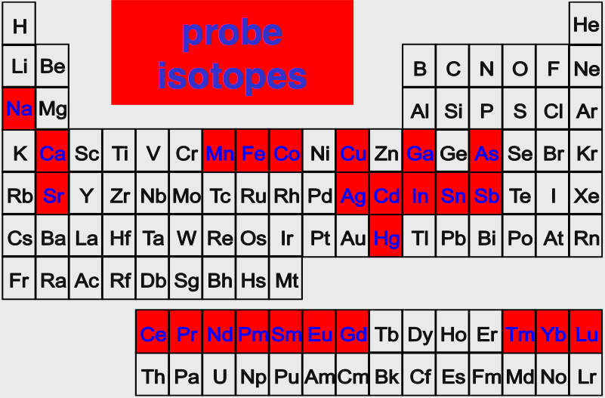
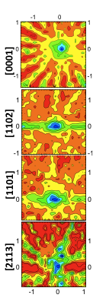
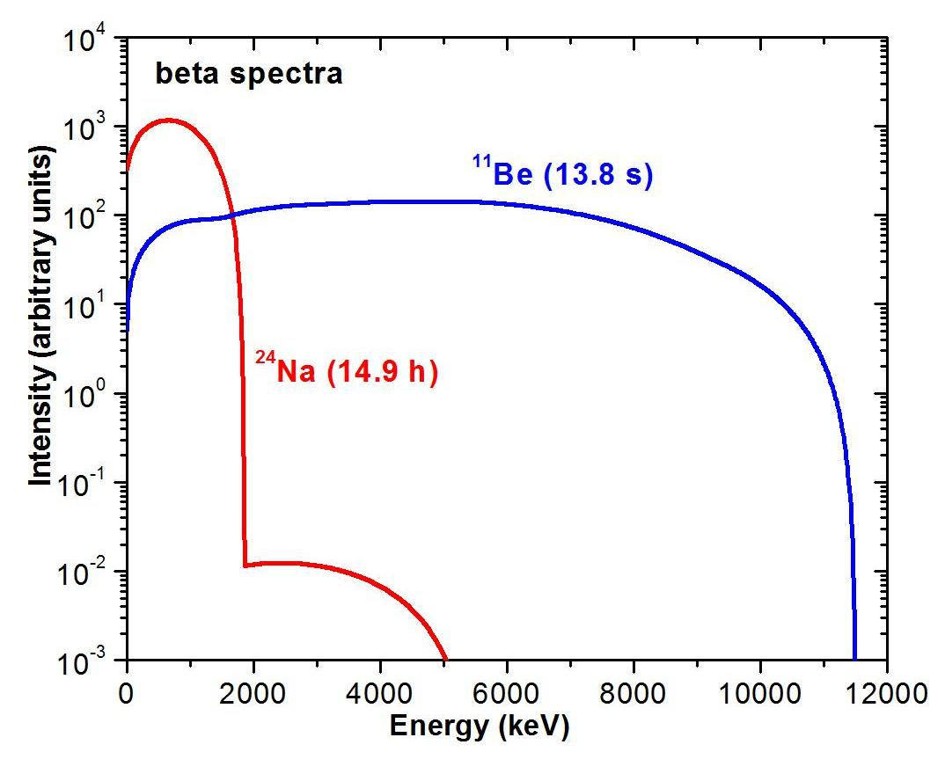
2012
WHISH LIST
2012
first ever done β⁻
EC patterns
using ¹¹Be(14 s)
in GaN
Be
B
C
N
O
Mg
2009
Si
P
S
2008
2011
Mn
Co
Ni
Ge
Source <-> detector : 60 cm
¹¹Be β−
²⁴Na β-
Source <-> detector : 30 cm

Slide 13
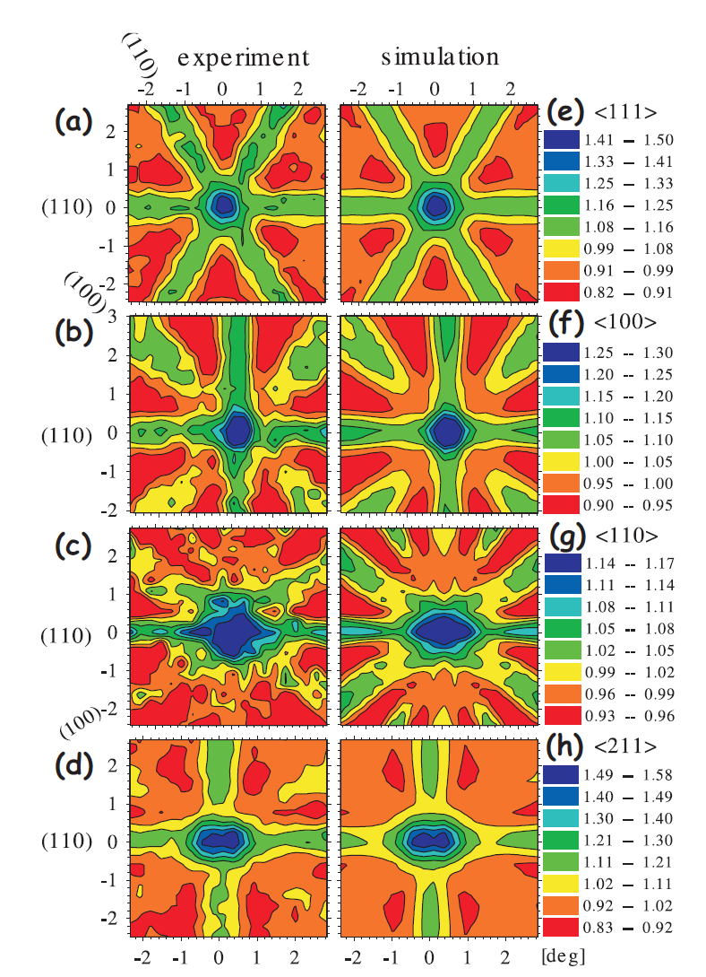
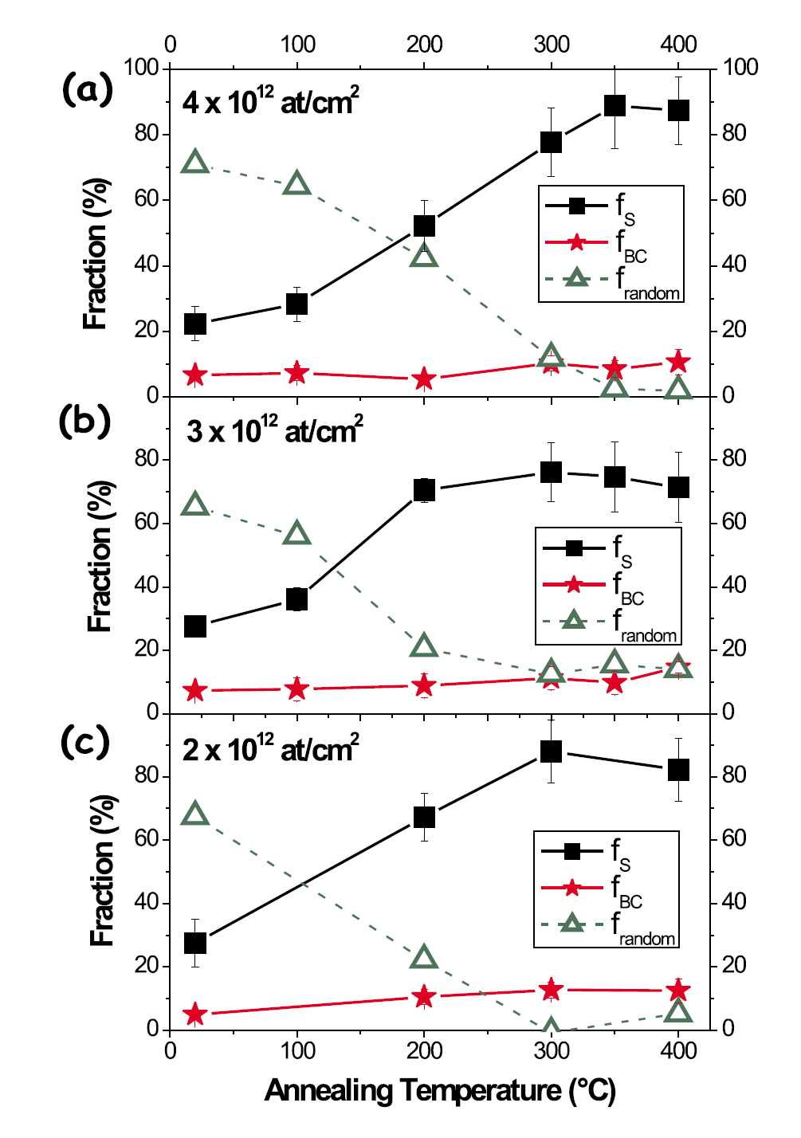
Lattice location study of implanted ¹²¹Sn (27h) : Ge
S. Decoster, U. Wahl et al., Phys. Rev. B 81, 155204 (2010) Sn_{x}Ge_{1-x} direct band gap for infrared applications
Visual inspection of spectra: substitutional Sn
detailed fitting procedure: majority on S site but also fraction on BC site!
S_{Ge}
¹²¹Sn
BC_{Ge}
BC fraction is observed in different samples up to 400°C annealing!
No direct experimental observation of Sn on BC site reported in literature

Slide 14
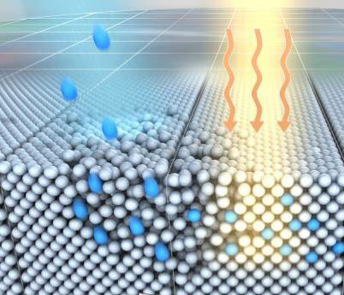
heat
Sn
Sn at:
76(6)% Mn(S)
+
11(3)% Mn(BC)
- we know “where”,
but
- do not know
how and why
Ge
Image credits: Sander Münster / Kunstkosmos via ScienceDaily

Slide 15
Ab initio calculations (DFT) for Sn defects complexes in Ge
! Benefit from great development of theoretical tools and computing power!
Single vacacny + Sn (S) NOT STABLE
Sn on BC sites (split vacancy)
Sn on … | ΔH_{f} (eV)
Sn on S site | 0.19
Sn on T site | 3.96
Sn on BC site (split-vacancy) | 1.86
Sn on BC site (no vacancies) | 3.83
Sn on S site + Ge self-interstitial | 3.51
Ge vacancy | 2.23
0.19
ΔH_{f, subst.} + ΔH_{f, vacancy} > ΔH_{f, BC}
spontaneous capture of vacancies by substitutional Sn
1.86
Previous – controversial - publications Höhler et al., PRB 71, 035212 (2005) and Coutinho et al., PRB 73, 235213 (2006)

Slide 16
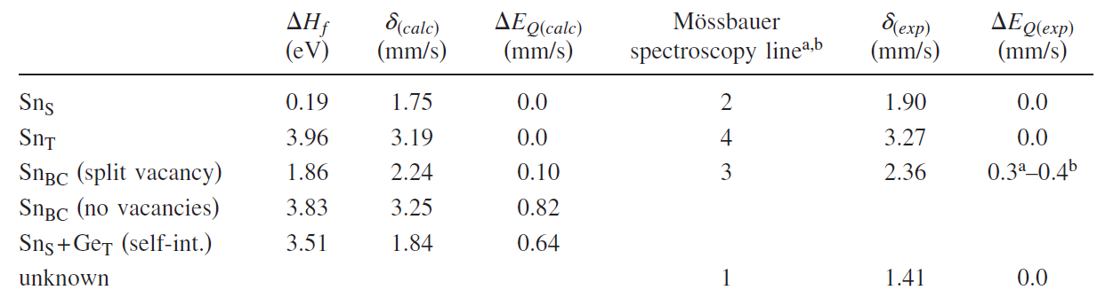
Ab initio calculations for Sn defects complexes in Ge
Isomer shift and hyperfine parameters
DFT Simulations
2010
Mossbauer
1981
G. Weyer et al., Phys. Lett. 76A, 321(1980)
G. Weyer et al., Hyp. Int. 10, 775 (1981)
Damgaard, A. el atl., Phys. Scr. 22, 640 (1981)
Sn(S)
Sn(T)
Sn(S)-V
Sn(BC)-V
Good agreement for Sn on S and T site
Mossbauer values for “Sn(S)-V defect“ is in very good agreement with Sn-V defect in split-vacancy configuration (i.e. with Sn_{BC}) !!

Slide 17
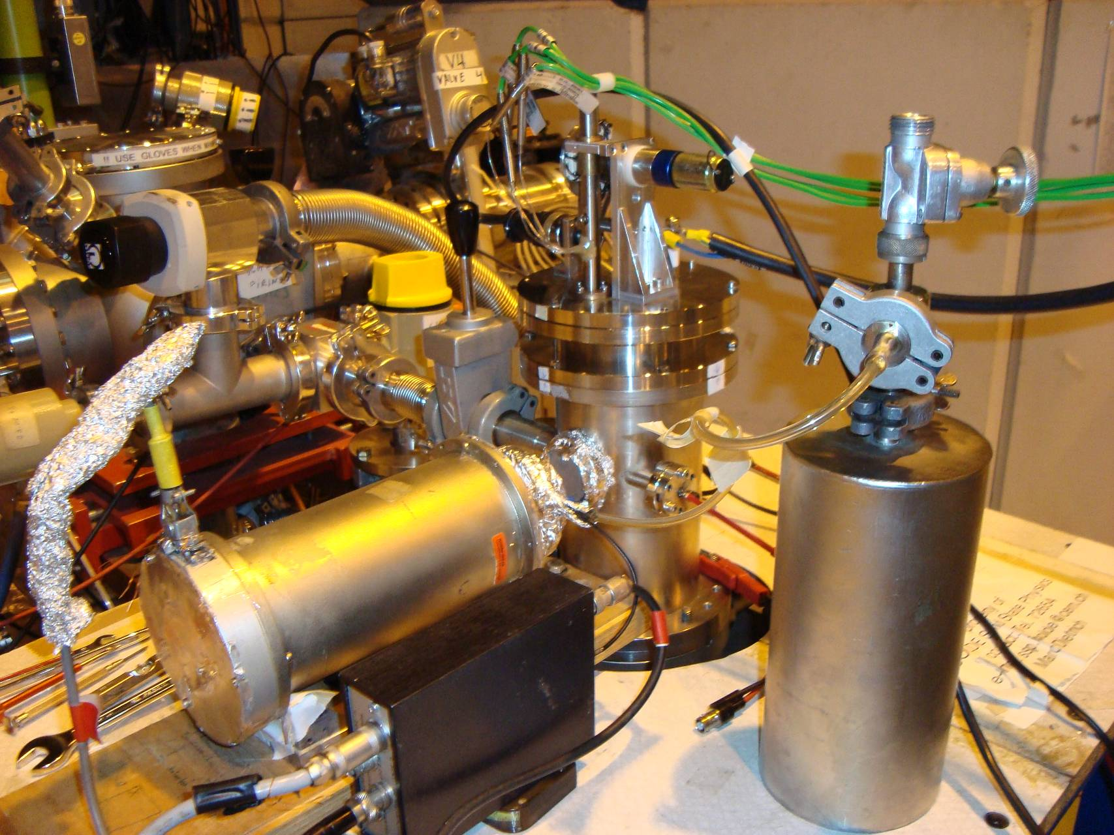
Hyperfine Interactions with Mossbauer spectroscopy
Development of 57Mn beam in late 1990s (with laser ionisation) brought about a new era in Mossbauer experiments at ISOLDE.
Incoming 40-60 keV ⁵⁷Mn⁺ beam Intensity: ~2×10⁸ ⁵⁷Mn⁺/cm²
Implantation chamber
Very clean, intense beam of ⁵⁷Mn (>3x10⁸ ions sec⁻¹)
Allows collection of single Mossbauer spectrum in ~ 3 mins.
Able to collect many hundreds over course of a 3 day run.
Allows low concentrations of probe atoms to be used (~10⁻⁴At%)
Sample
Mössbauer drive with resonance detector

Slide 18
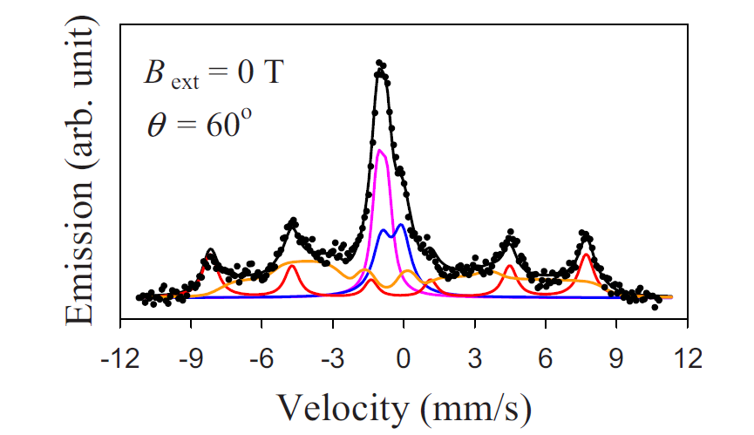
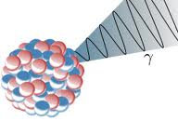
Fe: ZnO a ferromagnetic semiconductor?
(nope!)
ZnO C axis
6 fold spectrum: characteristic of magnetic structure (at room temperature!!!).
Results in an external magnetic field show that the spectrum shown to be a slowly relaxing paramagnetic system .
Gunnlaugsson et al (APL 97 142501 2010)
B
After high-dose implantations, precipitates of Fe-III are formed. These form clusters yielding misleading information about the nature of magnetism in ZnO (as reported by many groups over the last number of years).
B
Gunnlaugsson et al APL 100 042109 2012

Slide 19
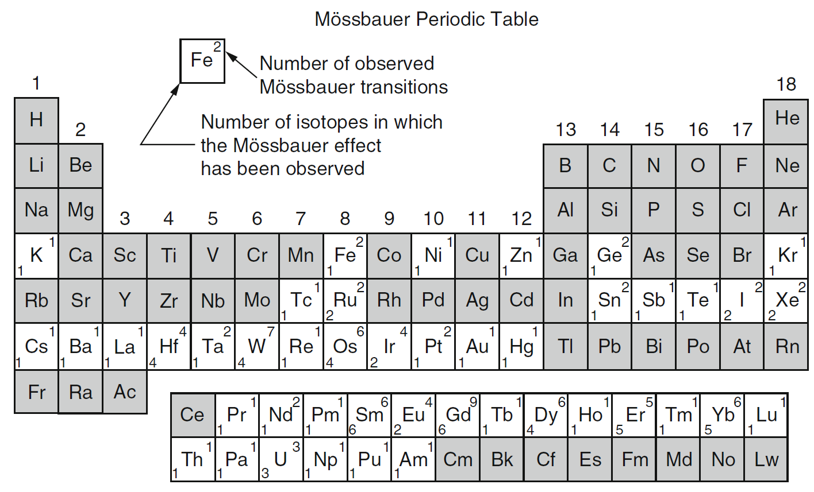
Mössbauer periodic table
Green – reproducible good beam
Red – low quality beam
Fe
Sn

Slide 20
More exotic Isotopes for Mössbauer spectroscopy
and PAC
Mössbauer Isotope | Beams | Main Applications
¹⁸¹Ta | ¹⁸¹Hf (42 d) ¹⁸¹W (121 d) | ”+” Very sensitive magnetic probe ⇒ applications within defect magnetism for spintronics applications.
⁷³Ge | ⁷³Ga (5 h) ⁷³As (80 d) | ”+” Extremely narrow line-width ⇒ various applications within semiconductors. ”-” Highly converted, very intense beams needed.
⁶⁷Zn | ⁶⁷Cu (62 h) ⁶⁷Ga (3.3 d) | ”+” Extremely narrow line-width ”-” high transition energy
+ many others
and PAC
Perturbed Angular Correlations work from 1K ... 1800 K

Slide 21
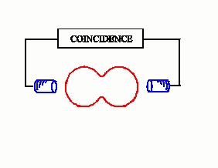
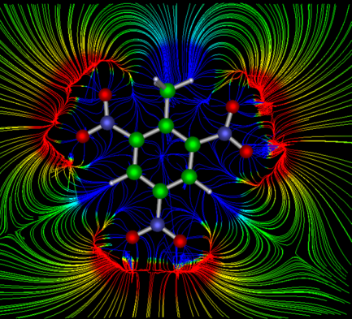
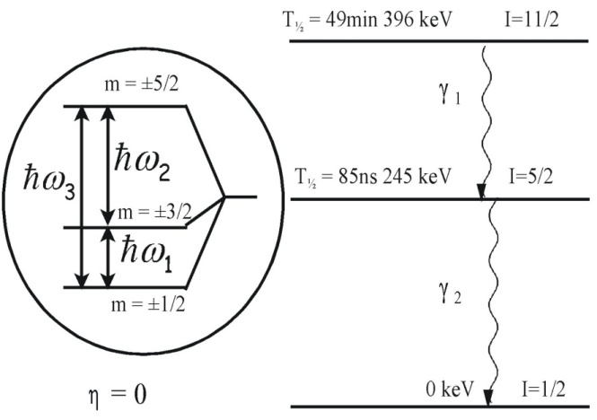
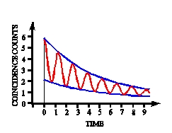

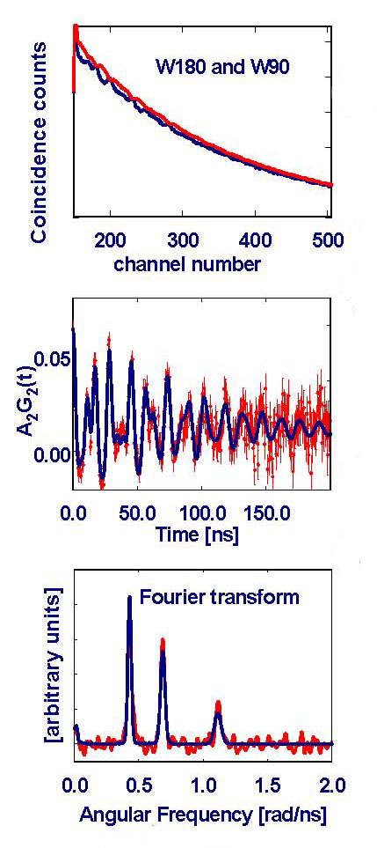
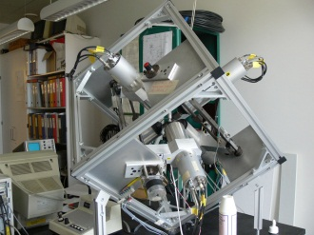
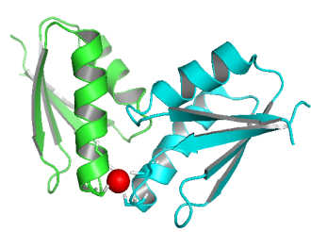
Perturbed angular correlation (PAC) Spectroscopy
applied to BIOPHYSICS
Fourier transform
Least χ² analysis
ω_{Q} and η
+
BASIL model
QM calculations
6·180º spectra and 24·90º spectra
Notes:
21

Slide 22
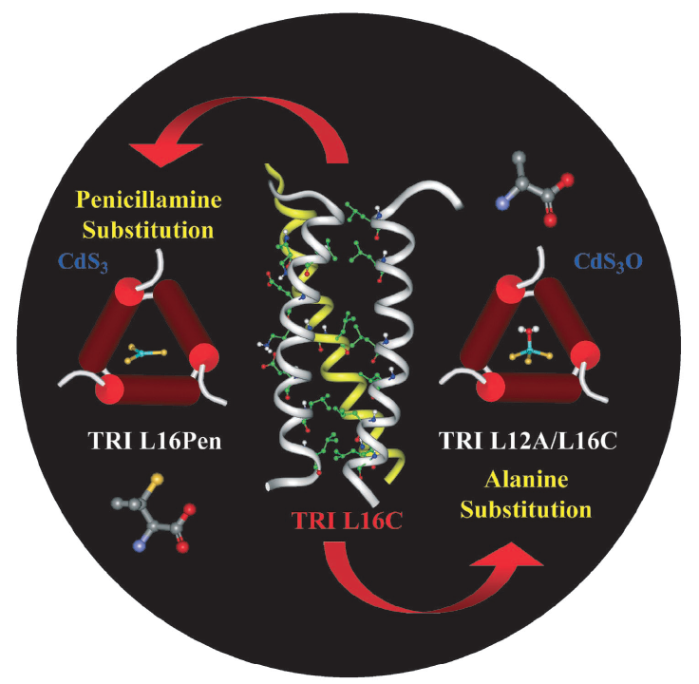
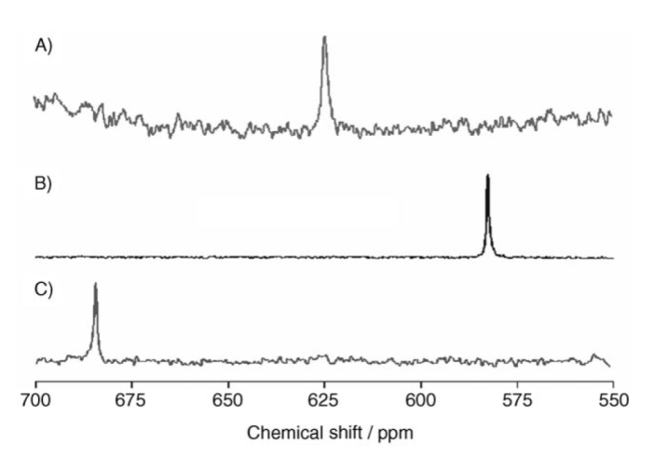
A
Metal Ion Binding Site Structure:
Fast inter-conversion between species
B
^{111m}Cd-PAC
C A B
C
A
B
¹¹³Cd-NMR
C
Matzapetakis et al. J. Am. Chem. Soc. 2002, 124: 8042; Lee et al.
Angew. Chem., 2006, 45: 2864; Peacock et al. Proc. Nat. Acad. Sci. 2008, 105: 16566

Slide 23
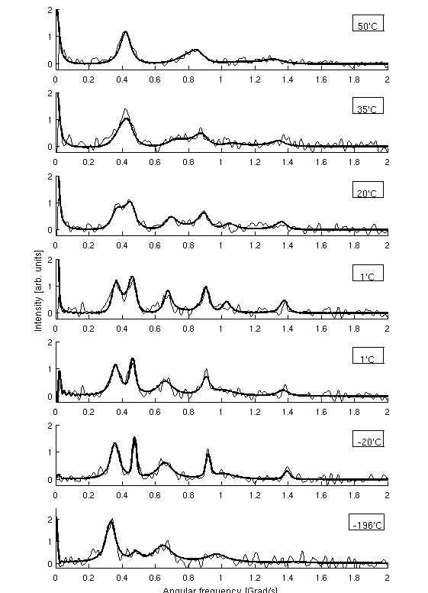
De novo designed heavy metal
Ion binding proteins: ns dynamics
^{111m}Cd-PAC
50 ºC
35 ºC
20 ºC
1 ºC
1 ºC
-20 ºC
-196 ºC
Temp [ºC] | τ₁ [ns] | τ₋₁ [ns]
1 | 52 | 48
20 | 42 | 36
35 | 28 | 20
50 | 19 | 12
Stachura et al. Manuscript in preparation

Slide 24
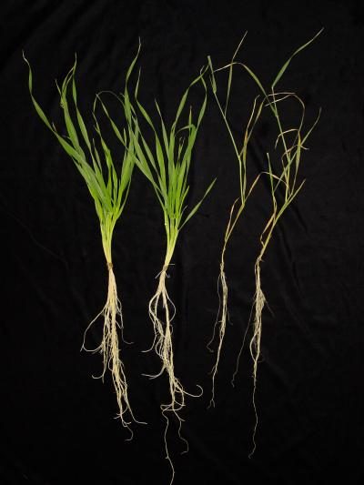
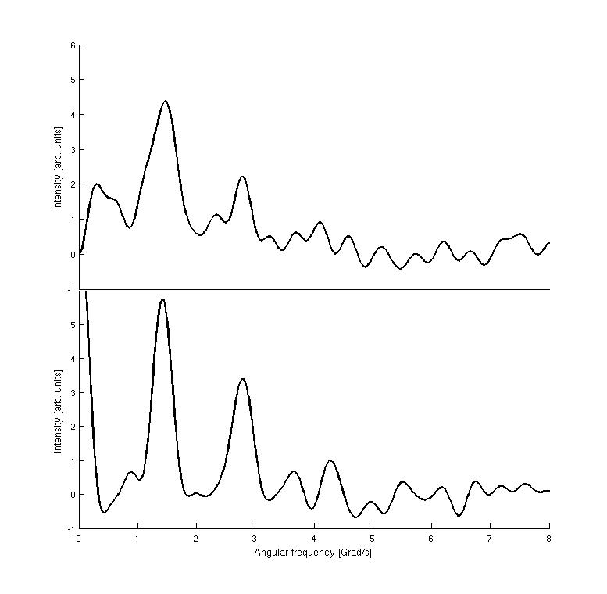
In vivo experiments
Hg(II) binding to barley
Whole barley plant
Homogenised barley leaves
5-7 days-old plants
Plant inserted into test tube.
Fast uptake of Hg(II) (<1h)
Bound to large molecules, similarities to HgS₂ compounds
Adolph et al. Chem. Eur. J., 2009, 15, 7350 – 7358
Notes:
24

Slide 25
Perturbed angular correlation (PAC) Spectroscopy
Running isotopes
low energies & high multipolarities → highly converted cascades → e-γ PAC
e-γ
RED → γ−γ PAC BLUE γ-e PAC
e-e
O
F
P
Ti
V
P
Cr
Fe
M
Co
Ni
P
Cu
P
Zn
Zr
Nb
P
Ru
Rh
P
Pd
Hf
C
P
Ta
X
X
Available Not Available desirable - clean, > 10⁸ at/s

Slide 26
2011 - DIGIPAC – a digital FPGA compact 6 - LaBr₃ spectrometer
⁶¹Cu
(3.3h - EC)
→ ⁶¹Ni
⁶¹Ni:Co(foil) from decay of ⁶¹Cu

Slide 27
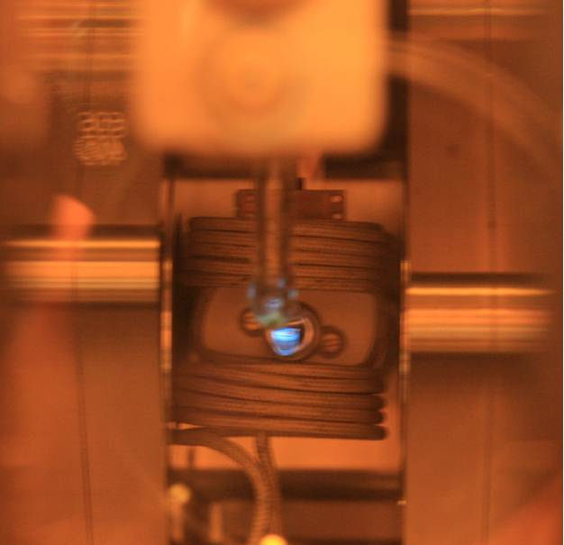
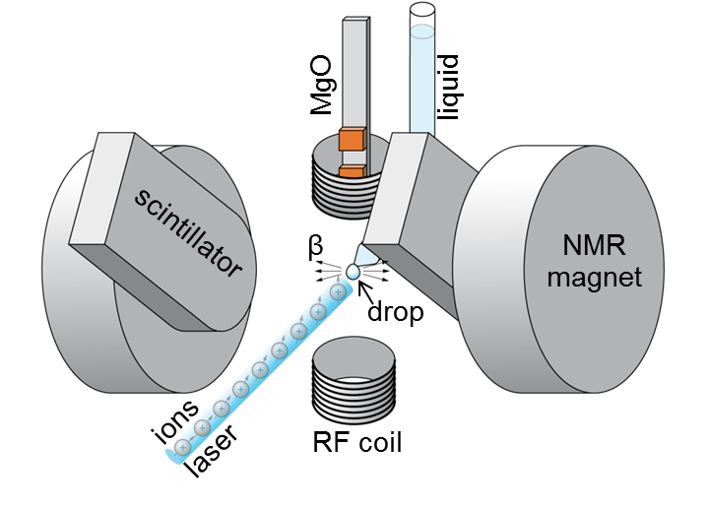
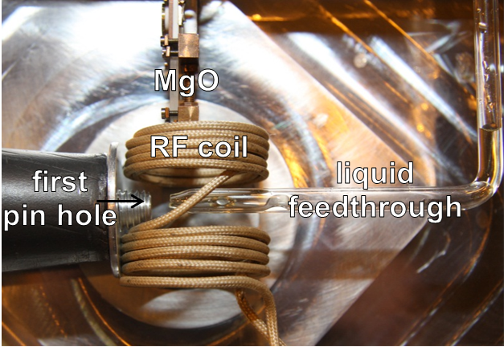
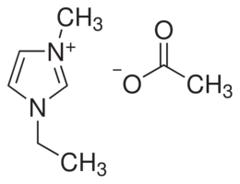
2012 – first (and successful)
β-NMR experiment applied to soft condensed matter
Differential pumping and drop
Mounted @ COLLAPS experiment
³¹Mg⁺ implanted into an ionic liquid (EMIM-Ac):
Monika Stachura, University of Copenhagen; Magdalena Kowalska, CERN, Geneva; Alexander Gottberg, CSIC, Madrid; Klaus Blaum, Max Planck Institute for Nuclear Physics, Heidelberg; Gerda Neyens, Leuven University, (Leuven); Rainer Neugart, Mainz University, (Mainz); Deyan Yordanov, Max Planck Institute for Nuclear Physics, Heidelberg; Mark Bissell, Leuven University, (Leuven); Kim Kreim, Max Planck Institute for Nuclear Physics, Heidelberg
Bulletin.cern.ch

Slide 28
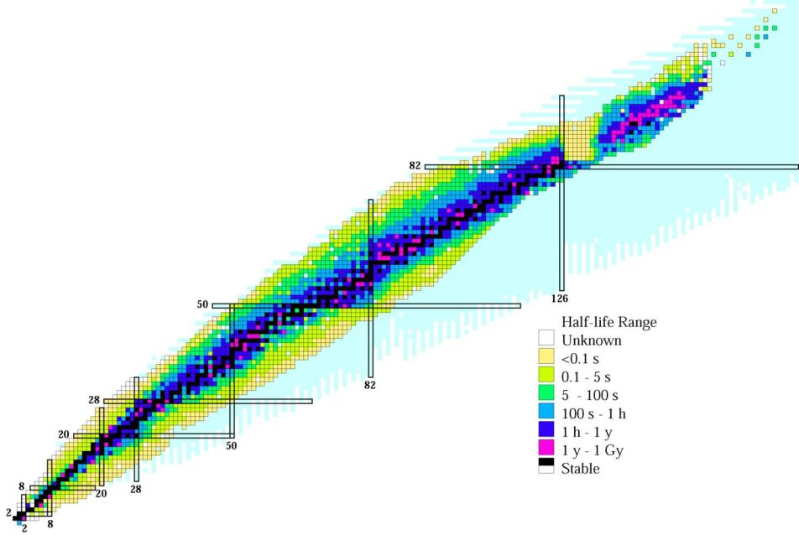
The chart of nuclides – nuclear medicine perspective
SPECT
PET
Therapy
²⁰¹Tl
^{186,188}Re
¹⁷⁷Lu
¹⁵³Sm
¹³³Xe
¹²³I
¹³¹I
¹¹¹In
^{99m}Tc
⁶⁸Ga
⁹⁰Y
⁶⁷Ga
⁸⁹Sr
¹⁸F
¹¹C
“exotic” isotopes
Notes:
We know today over 3000 radioisotopes. Thereof over 100 have suitable properties (half-life, decay mode, chemistry) for nuclear medicine applications. However, at present only a small subgroup is actually being used.
While for general purpose diagnostics applications 99mTc (SPECT) and 18F (PET) have indeed close-to-optimum properties, optimization of therapy will require new radioisotopes.

Slide 29
Radionuclides for therapy
Radio-nuclide | Half-life | E mean (keV) | Eγ (B.R.) (keV) | Range
Y-90 | 64 h | 934 β | - | 12 mm
I-131 | 8 days | 182 β | 364 (82%) | 3 mm
Lu-177 | 7 days | 134 β | 208 (10%) 113 (6%) | 2 mm
Tb-161 | 7 days | 154 β 5, 17, 40 e⁻ | 75 (10%) | 2 mm 1-30 μm
Tb-149 | 4.1 h | 3967 α | 165,.. | 25 μm
Ge-71 | 11 days | 8 e⁻ | - | 1.7 μm
Er-165 | 10.3 h | 5.3 e⁻ | - | 0.6 μm
Estab-
lished isotopes
Emerging isotopes
localized
radiation
Notes:
The historic therapy isotopes 131I and 90Y were first because of specific applications (131I for thyroid) and ease of large-scale production (fission), but their properties are far from ideal: hard gamma rays for 131I require isolation of the patient, long range betas of 90Y make collateral damage outside tumors. Today there is a strong trend towards new therapy isotopes with improved properties and to related diagnostic isotopes for specific applications.

Slide 30
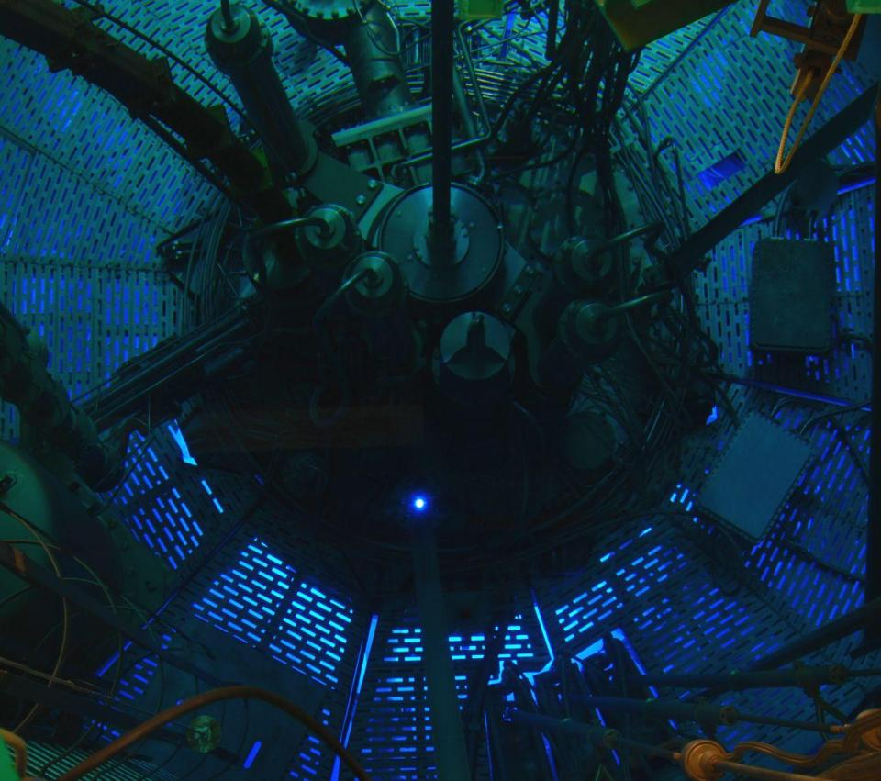
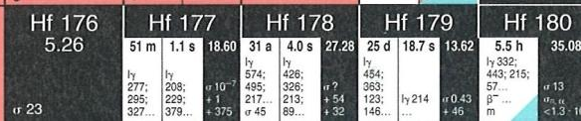
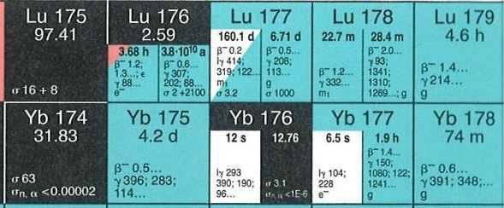

Production of non-carrier-added ¹⁷⁷Lu
Irradiation in high flux reactor (e.g. ILL Grenoble),
then chemical separation of ¹⁷⁷Lu from stable Yb.
Notes:
At present the best commercially available therapy isotope is 177Lu. “quasi-pure” 177Lu (non-carrier added, i.e. nearly without stable isotopes) is obtained by an “indirect production”. Enriched 176Yb is partially transmuted in a high flux reactor to 177Yb that decays quickly to 177Lu. The latter is chemically separated from the target material. The complete chemical separation of microamounts of 177Lu from macroamounts (grams) of 177Yb is very challenging due to the chemical similarity of both neighboring lanthanides. Only recently this radiochemical challenge was solved at large scale and now high activities (TBq per week) are available.

Slide 31
Radionuclides for therapy
Radio-nuclide | Half-life | E mean (keV) | Eγ (B.R.) (keV) | Range
Y-90 | 64 h | 934 β | - | 12 mm
I-131 | 8 days | 182 β | 364 (82%) | 3 mm
Lu-177 | 7 days | 134 β | 208 (10%) 113 (6%) | 2 mm
Tb-161 | 7 days | 154 β 5, 17, 40 e⁻ | 75 (10%) | 2 mm 1-30 μm
Tb-149 | 4.1 h | 3967 α | 165,.. | 25 μm
Ge-71 | 11 days | 8 e⁻ | - | 1.7 μm
Er-165 | 10.3 h | 5.3 e⁻ | - | 0.6 μm
cross-fire
Estab-
lished isotopes
Emerging isotopes
R&D isotopes:
supply-limited!
localized
Modern, better targeted vectors require shorter-range radiation ⇒ need for adequate (R&D) radioisotope supply.
Notes:
While 177Lu has ideal properties to fight small metastases (average range of betas 0.2mm, maximum range 2mm), future treatments targeting individual cancer cells (i.e. circulating cancer cells even before they create metastases and in non-solid cancers such as leukemia) require still shorter-range radiation. This can be achieved with alpha emitters (about 1 cell diameter range, high probability of double strand break by a single alpha) and by Auger emitters.

Slide 32
Radioisotopes for targeted alpha therapy
Radio-nuclide | Half-life (h) | Advantage | Problem
Tb-149 | 4.12 | Known (bio)chemistry | Availability
Pb-212 | 10.6 | Availability | Release of daughter?
Bi-212 | 1.01 | Known (bio)chemistry Availability | Short half-life
Bi-213 | 0.76 | Known (bio)chemistry | Short half-life Availability
At-211 | 7.22 | Half-life | Challenging (bio)chemistry
Ra-223 | 274 | Half-life Availability | Only for bone metastases
Ac-225 | 240 | Half-life Known (bio)chemistry | Release of daughters? Availability
Notes:
There are only few potential radioisotopes for alpha therapy, each with limitations linked to bio-chemistry, half-life or availability:
1. In-vivo chemistry:
The trivalent metals (Tb, Bi, Ac) behave similar to presently used elements (Ga, Y, In, Lu) and can be labeled to existing vectors (=chelators for peptides and antibodies).
Radium behaves chemically like calcium and will metabolically target bone metastases but cannot be linked stably to vectors.
Astatine has a very difficult biochemistry (sometimes iodine-like, sometimes metal-like) that can only be studied in trace quantities with alpha emitters (no stable At isotope).
2. Half-life:
Bi-212 and Bi-213 are very short-lived, useful for “loco-regional” applications (i.e. direct injection into tumor) but challenging for systemic applications (full body).
Longer-lived Pb-212 produces Bi-212 in the body (“in-vivo generator”) but one has to make sure that Bi-212 stays linked to the vector and is not released and makes collateral damage elsewhere.
Ac-225 decays by a chain of 4 alphas and two betas via 6 different elements. It is challenging to assure that the daughters stay linked to the vector and are not released and make collateral damage elsewhere. Also Ra-223 decays by a chain of alphas and betas but the first two are short-lived and do not diffuse far from the bone metastasis before decaying.
3. Availability:
Ra-223, Pb-212 and Bi-212 are (becoming) available in large-scale.
Only small quantities of Ac-225 and Bi-213 daughter are available today, spallation production with GeV protons is considered to make more (> extraction from used EURISOL direct UCx targets possible!).
At-211 available from few cyclotrons that have 30MeV alpha beams [209Bi(a,2n)], large-scale application would require network of such cyclotrons.
Tb-149 is presently only available at ISOLDE but could be produced in huge quantities at EURISOL.

Slide 33
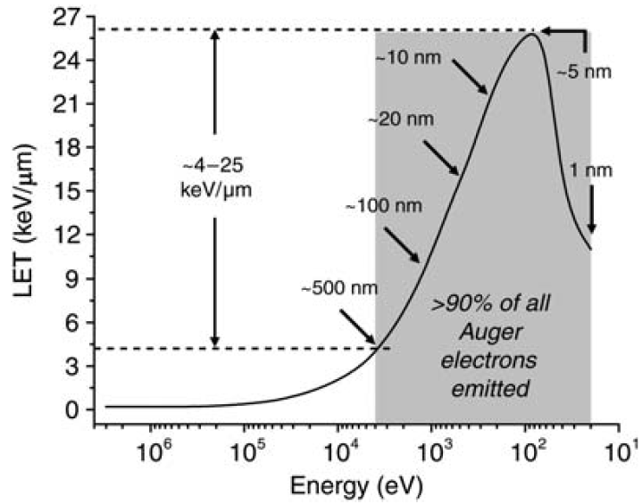
Linear EnergyTransfer of Auger electrons
Very targeted therapy (high efficacity/low side effects) possible if “internalizing” vectors (peptides, antibodies,…) are found that penetrate the cancer cell’s nucleus.
A.I. Kassis, Rad. Prot. Dosimetry 143 (2011) 241.
Notes:
Auger electrons have an even shorter range than alphas. If transported into the cancer cells nucleus they can destroy the DNA while they are pretty harmless outside cells. Thus a vector that penetrates selectively the cell walls of cancer cells and accumulates in the nucleus would provide ultimate selectivity. Such vectors are now in the R&D phase.

Slide 34

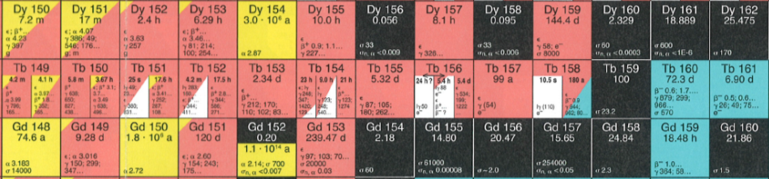
Terbium: a unique element for nuclear medicine
Notes:
In chemotherapy all patients get a prescribed treatment, all patients suffer from side-effects but only few respond to the therapy (reduction/elimination of tumor). These “responders” are only identified after the treatment. In contrast therapy with radioisotopes is a good example of “personalized medicine”. First the vector is marked with a diagnostic isotope (PET/SPECT) to measure if the individual patient will really respond to the treatment (i.e. if the chosen vector is selectively taken up by his cancer cells), only then the same vector labeled with a therapeutic isotope (activity according to the measured uptake) is injected. The high success rate of radioisotope therapy is due to the fact that only those patients are treated that will profit of it! To minimize uncertainties due to different bio-chemical behavior of diagnostic and therapeutic isotope “matched pairs” of diagnostic and therapeutic isotopes of the same element are particularly useful. Terbium is unique since it has suitable isotopes for all nuclear medicine modalities:
155Tb: a SPECT isotope
152Tb: a PET isotope
149Tb: an alpha emitter
161Tb: a beta- and Auger emitter
Thus fundamental R&D can be performed, e.g. to clearly measure in-vivo the relative efficacity of alpha versus beta- versus Auger electrons.
[Note in case of questions: obviously 161Tb emits always both, b- and Auger together but one can either compare an internalizing with a non-internalizing vector or compare 161Tb with 177Lu that behaves bio-chemically identically and has the same half-life and beta- range as 161Tb.]

Slide 35
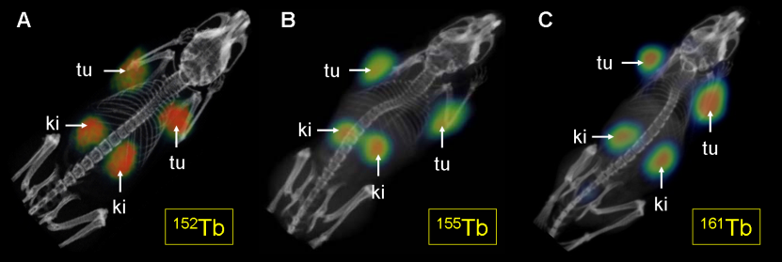




Imaging Studies Using PET and SPECT
PET SPECT SPECT
C. Müller et al., J. Nucl. Med. (2012), in press.
IS528 collaboration: supported by ENSAR, Swiss National Science Foundation and Swiss South African Joint Research Program.
Notes:
152Tb and 155Tb are available from ISOLDE, 161Tb is produced in non-carrier added quality by irradiations of 160Gd targets at ILL, then separated at PSI. All imaging studies performed at PSI and ETH Zurich.
[Note in case of questions: to saturate uptake in the tumor one gives always more vector; excess is rapidly excreted via kidney>bladder>urin. The relatively high activity in the kidneys shown on the images is no real problem for human patients:
size difference between tumor volume and kidney volume more favorable for humans than for mice
human patients are asked to drink a lot which will accelerate elimination from the kidneys but one cannot force mice to drink
there are other “kidney protection strategies” for humans (saturate receptors in the kidney to accelerate elimination even more) but that would be too complex in mice

Slide 36
Radionuclides for therapy
Radio-nuclide | Half-life | E mean (keV) | Eγ (B.R.) (keV) | Range
Y-90 | 64 h | 934 β | - | 12 mm
I-131 | 8 days | 182 β | 364 (82%) | 3 mm
Lu-177 | 7 days | 134 β | 208 (10%) 113 (6%) | 2 mm
Tb-161 | 7 days | 154 β 5, 17, 40 e⁻ | 75 (10%) | 2 mm 1-30 μm
Tb-149 | 4.1 h | 3967 α | 165,.. | 25 μm
Ge-71 | 11 days | 8 e⁻ | - | 1.7 μm
Er-165 | 10.3 h | 5.3 e⁻ | - | 0.6 μm
cross-fire
Estab-
lished isotopes
Emerging isotopes
R&D isotopes:
supply-limited!
localized
Modern, better targeted vectors require shorter-range radiation ⇒ need for adequate (R&D) radioisotope supply.
Notes:
The continuous development of biotechnology towards better targeted vectors (10 G$/year goes into the development of new antibodies!) has to be accompanied by a supply of adequate radioisotopes (short-range radiation and corresponding diagnostic isotopes). Until these are available commercially (usually only once the R&D has shown that there is a “new market”) these radioisotopes have to be provided by R&D facilities.

Slide 37
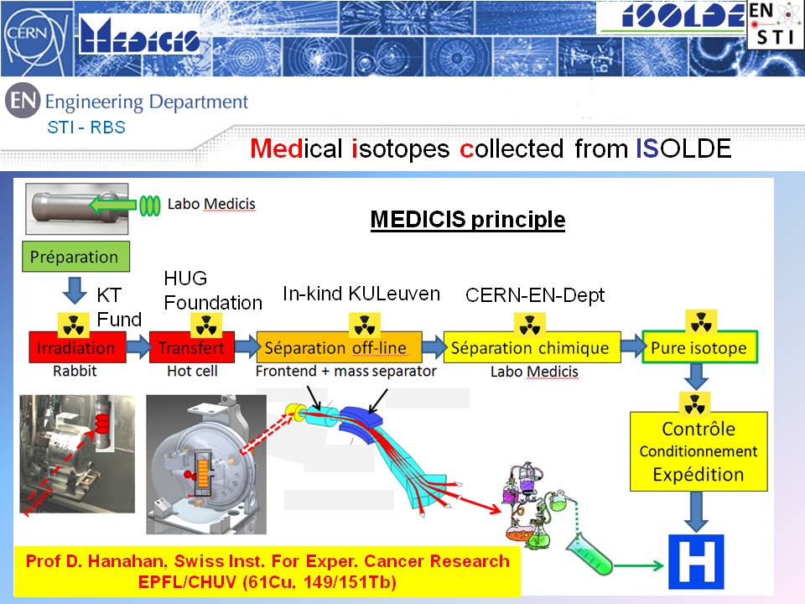

Slide 38
The (potential) role of ISOL in nuclear medicine
Samples of R&D isotopes that are not commercially available or easily producible with other means.
Isotopes with ultimate specific activity for R&D, e.g. studies of efficacy versus specific activity.
Isotopes that are best produced by spallation (¹⁴⁹Tb,…).
Existing ISOL beams are sufficiently intense for preclinical studies, in certain cases even for clinical studies.
How to organize R&D with RIBs in nuclear medicine?
Physicists are used to “travel to the isotopes”,
but isotopes must “travel to physicians and patients”.

Slide 39
Applications of EXOTIC isotopes at EURISOL:
Define a clear mid term strategy with visibility
Deciding the application areas:
(Life Sciences, Materials, Soft Matter, Chemistry...)
Deciding the right Coordination with USERS:
UNIVERSITIES AND LABORATORIES
Presenting an infrastructure with:
Dedicated BEAM LINES and BEAM TIME
Dedicated LABORATORY SPACE

Slide 40
acknowledgments
V. Amaral
L. Amorim
Y. Blumenfeld
S. Decoster
M. Deicher
A. Fenta
J.N. Gonçalves
A. Göttberg
H. Gunnlaugsson
K. Johnston
U. Köster
M. Kowaslka
A. L. Lopes
T. Mendonça
L. Pereira
M. Stachura
T. Stora
U. Wahl
and The ISOLDE collaboration

Slide 42
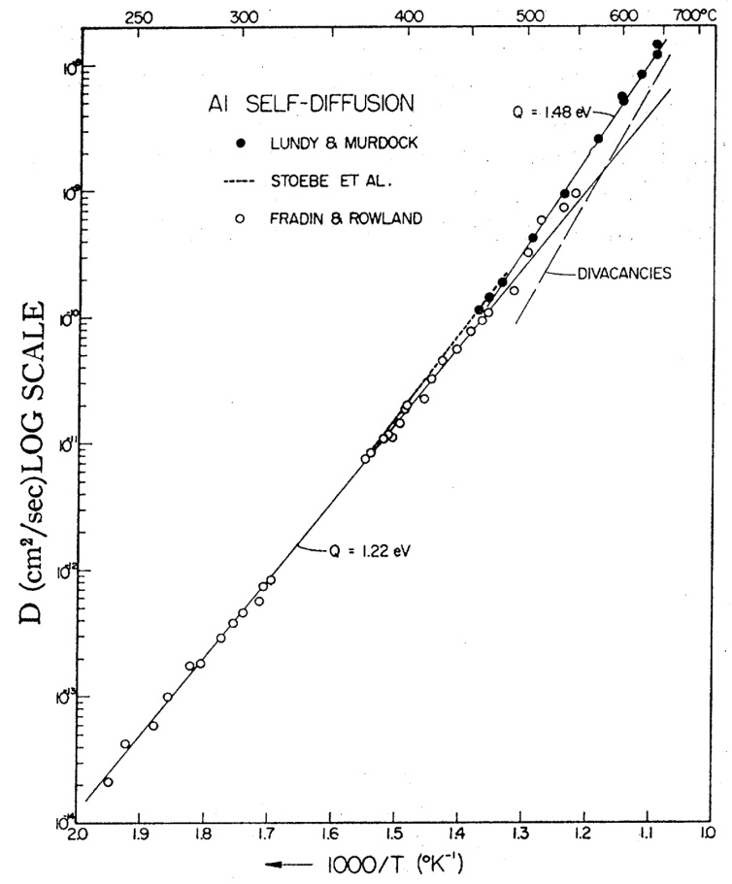
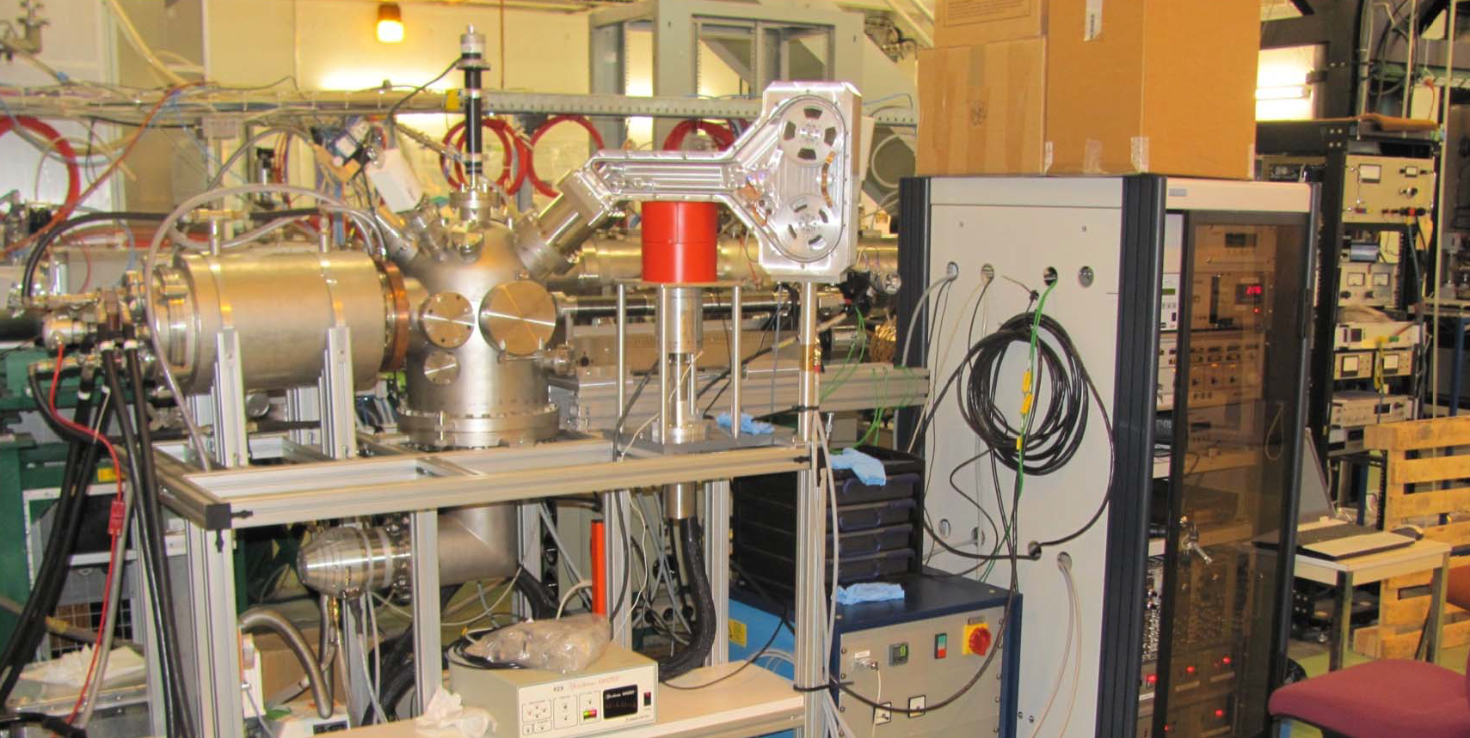
Understanding Diffusion and self diffusion ... On-line !
Aluminum, self-diffusion
Tracer diffusion
26Al (T1/2 = 7.2×105 y !!!)
(T.S. Lundy et al., J. Appl. Phys. 33 (1962)1671)
NMR
Indirect
void shrinkage etc.
Isotope | t_{1/2} | Detection
³⁸Cl | 37.3 min | β⁻_{4800keV} ; γ_{2168keV}
¹¹C | 20.38 min | β⁺ ; γ_{511keV}
¹³N | 9.96 min | β⁺ ; γ_{511keV}
²⁹Al | 6.6 min | γ_{1273keV}
(¹⁵O) | 122 s | β⁺ ; γ_{511keV}
(T.G.Stoebe et al., Phys. Rev. 166 (1968) 621)
Single stable Al isotope:no SIMS measurements Unknown activation energy of self diffusion in Al
Unknown role of vacancies, divacancies at different temperatures
Unknown Al diffusion in Al-based compounds

Slide 44
Nuclear Probes, Interactions and Methods
NUCLEAR PROBES
INTERACTIONS
METHODS
Radioactive
Nuclei
➔ γ, α, β
Hyperfine
Interaction
Mößbauer effect
γγ & eγ angular correlation
Nuclear Magnetic resonance
Nuclear orientation
Materials
Soft-matter
and Bio-molecular physics
Research
Radioactive
decay
DLTS
Photoluminescence
Tracer Diffusion
Muons
➔ ß⁺
+
Coulomb
Interaction
Nuclear
Physics
Emission Channeling
Ion Channeling
Backscattering
Elastic Recoil
Resonant Scattering
Neutron Scattering
Ions
+
Scattering,
Diffraction
- add chemistry to get
NEW
Highly selective and confined tumor killers
Tunable & local energy deposition on matter
Neutrons
Nuclear
Reaction
Nuclear Reaction Analysis
Positrons
ß⁺-e⁻
Interaction
Positron Annihilation
Positron Angular Distribution
Positron Energy Distribution

Slide 45
”Common” Isotopes for Mössbauer spectroscopy
Mössbauer Isotope | Beams | Main Applications
⁵⁷Fe | ⁵⁷Mn (1.5 min) ⁵⁷Co (272 d) ⁵⁷Ni (38 h) | Dilute magnetism in 3d metal doped oxides Defect kinetics in Si and SiGe Implantation physics in oxides
¹¹⁹Sn | ¹¹⁹In (2.1 min) ^{119m}Sn (292 d) ¹¹⁹Sb (38 h) ¹¹⁹Te (4.7 d) | Lattice location and properties of dopants in group IV, III-V and II-VI Semiconductors
¹²¹Sb | ¹²¹(Xe, I, Te, Sn, In, Cd, Ag) | Lattice location and properties of dopants in group IV, III-V and II-VI Semiconductors
^{119m}Sn: γ-e PAC isotope
⁵⁷Mn: EC isotope
Possibilities for complementary physics

Slide 46
2012 – the oldest use of radioactive isotopes is (re)born ...
...ON-line diffusion with short lived isotopes
CdTe:¹¹¹Ag
T_{diff} = 570 K
t_{diff} = 30 min
1...30 µm
Implantation
Diffusion annealing up to 1800 °C
Sample sectioning by ion sputtering
Catching the sputtered ions by a tape system
In situ activity measurement
Remote control

Slide 47
Diffusion: Ag in CdTe
T_{diff} = 825 K
t_{diff} = 60 min
Shapes of diffusion profiles strongly depend on external vapor pressure
H. Wolf, F. Wagner, Th. Wichert, and ISOLDE Collaboration, Phys. Rev. Lett. 94, 125901, 2005

Slide 48
⁶¹Cu diffusion in Cd saturated CdTe

Slide 49
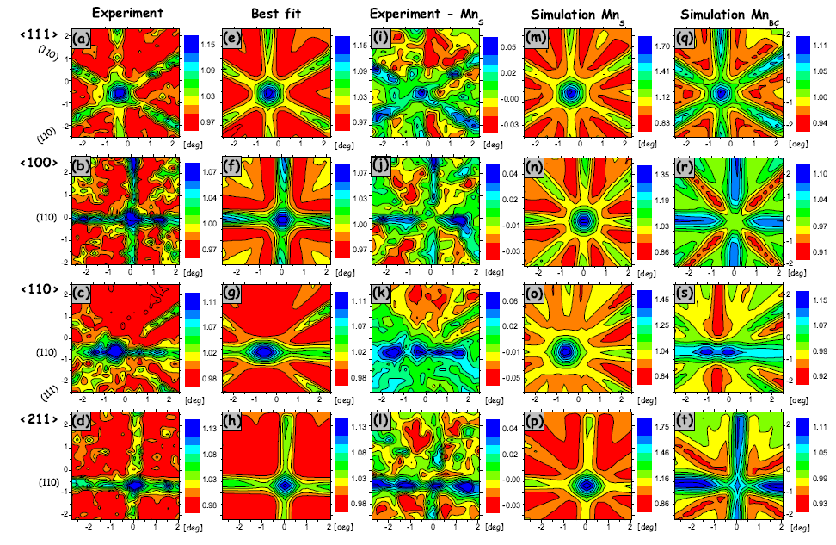
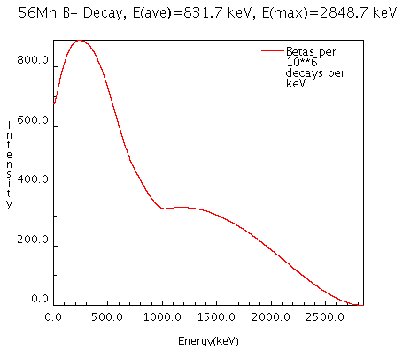
Lattice location study of implanted ⁵⁶Mn (2.6h) : Ge
Implantation at 300ºC
S. Decoster, U. Wahl et al., Applied Physics Letters 97, 151914 (2010)
Mn-doped Ge →(?)→ spintronic devices, Mn_{x}Ge_{1-x} → ferromagnetic 25 and 116 K,
TC increases linearly 0.6% <[Mn] < 3.5%.
Cho et al. showed ferromagnetic ordering in Ge_{0.94}Mn_{0.06} close to room temperature (285 K)2. The origin of ferromagnetism is not fully understood and has been related to Mn-rich precipitates.
38(7)% Mn(S)
+
59(8)% Mn(BC)

