Slide 1



EURISOL Town Meeting
17-18 October 2012 – Lisbon
EURISOL
Design Study
High-Power Targets
Developments and Testing of Spallation Neutron Sources
Yacine Kadi, Karel Samec & Yoann Fusco
(CERN)
On behalf of the TIARA-WP9 participants: CERN, IPNO, ESS

Slide 2
OUTLINE
Introduction
Recent achievements: EURISOL & MEGAPIE
Requirements on testing facilities
Proposed facilities & potential Partnerships
Current Design activities at CERN

Slide 3
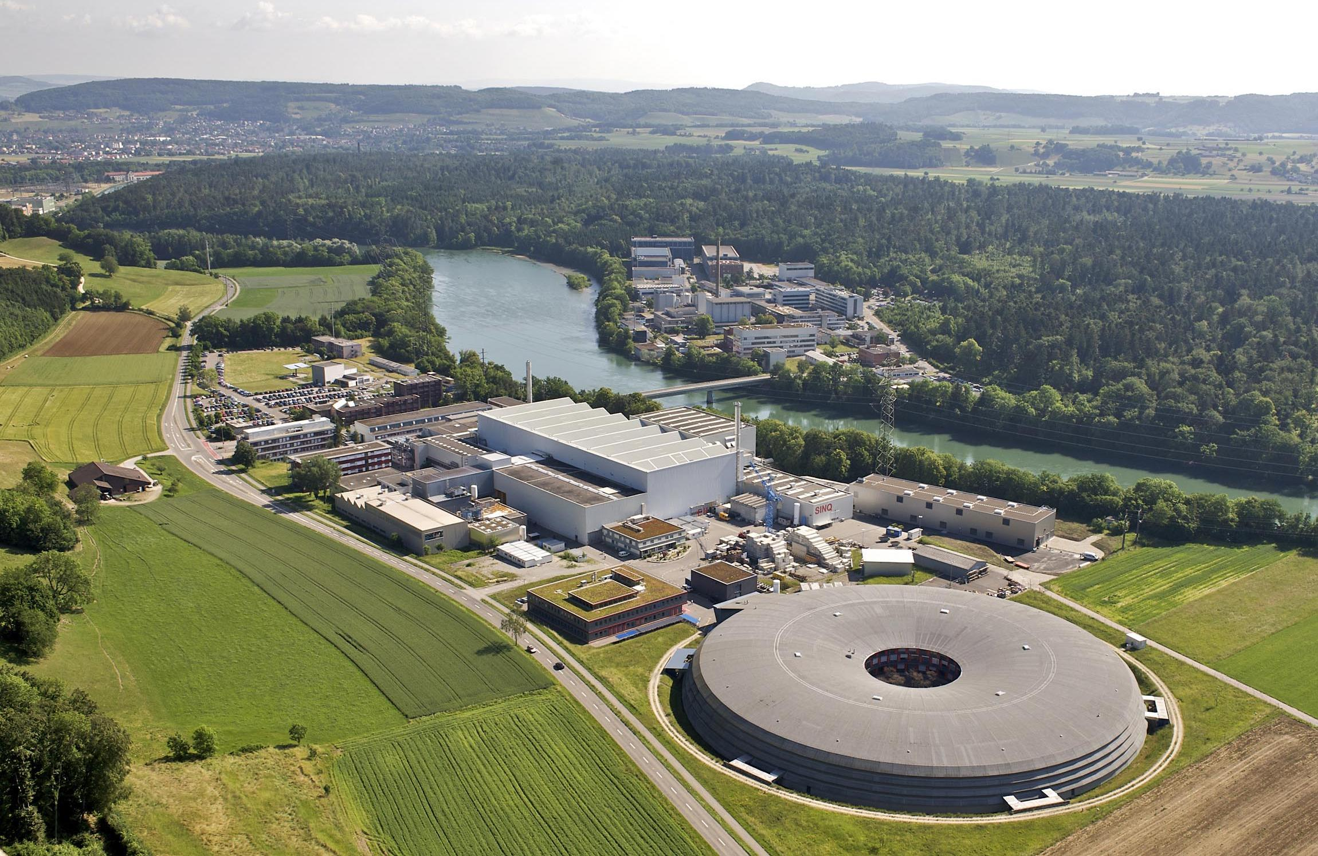
INTRODUCTION
Neutron sources are used in laboratories
SINQ - Villigen Switzerland,
JSNS –Hokkaido Japan,
SNS - Oakridge USA
Further installations are planned (ESS in Lund SE, MYRRHA in BE)
Life sciences / Material sciences / Particle physics
Growing interest in:
power from Thorium / Waste Incineration / ADS
Isotope production for medical purposes
Irradiation facility for nuclear materials

Slide 4
IDENTIFIED NEEDS
Need: Reliable neutron sources to be developed to accommodate the growing power delivered by accelerator facilities located in Europe.
Rationale: higher neutron fluxes are demanded from spallation sources … leading to ever higher beam power deposition densities.
Consequence: testing facilities are required.

Slide 5
2. Recent achievements: EURISOL & MEGAPIE

Slide 6
Neutron sources – high-power tests
Two recent tests at high power illustrate increasing neutron source capabilities in Europe :
MEGAPIE: tested under proton beam at 0.76 MW
EURISOL: tested under full-scale hydraulic conditions representative of 4 MW
Although succesful, the tests were short-lived.
The next logical step: dedicated test facilities to validate neutron source long-term operation

Slide 7
2006 - MEGAPIE experience
Megapie is a 10 year endeavour culminating in 2006 with an irradiation test and continuing today with post-irradiation analysis
4 months @ 0.76 MW - 600 MeV, 1.3 mA
Recorded beam interruptions – no negative effect on operation
Polonium production remains in LBE
Beam window intact
Leak from faulty heat exchanger contained

Slide 8
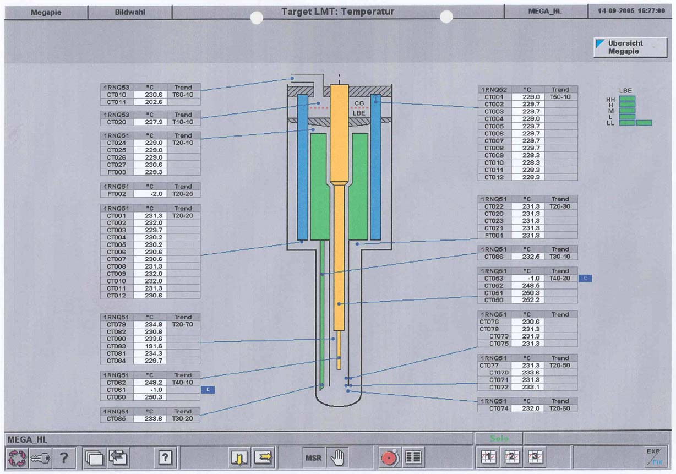
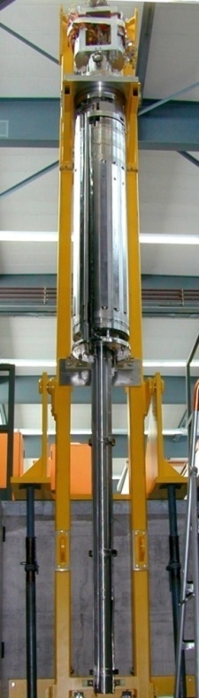

Slide 9
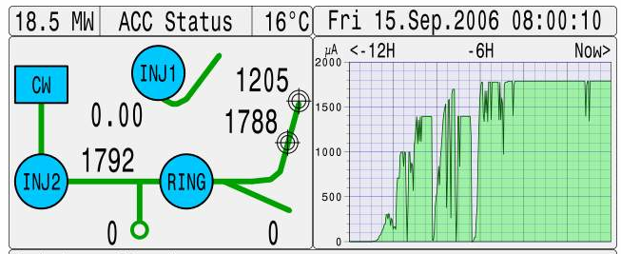
MEGAPIE Beam Window

Slide 10
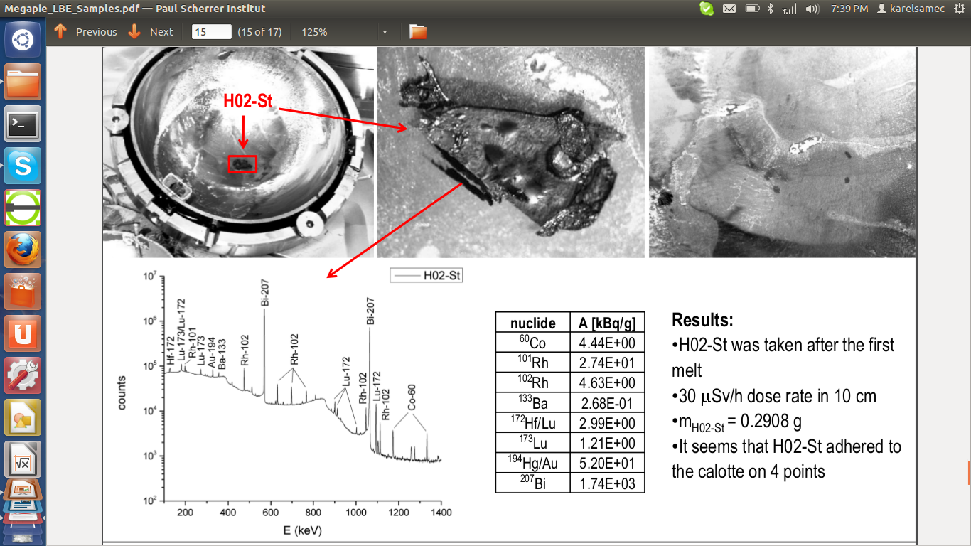
Beam interrupts in MEGAPIE

Slide 11
2009 - EURISOL experience
EURISOL, FP6 funded from 2005 to 2009
The primary goal of the EURISOL program was a design study of the „Ultimate“ RIB Facility.
In addition the program also proved experimentally a novel neutron source with:
Very high flow rates sufficient to absorb 4 MW beam
Compact design, 15 cm outer diameter
High speed in Hg and small diameter of the source for a dense neutron flux

Slide 12
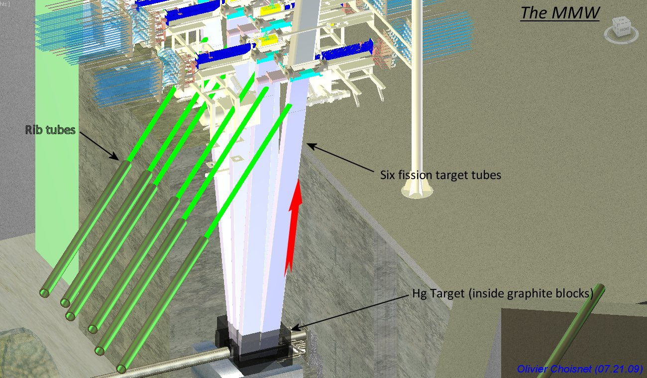
Overall view of projected EURISOL Multi-MW target station

Slide 13
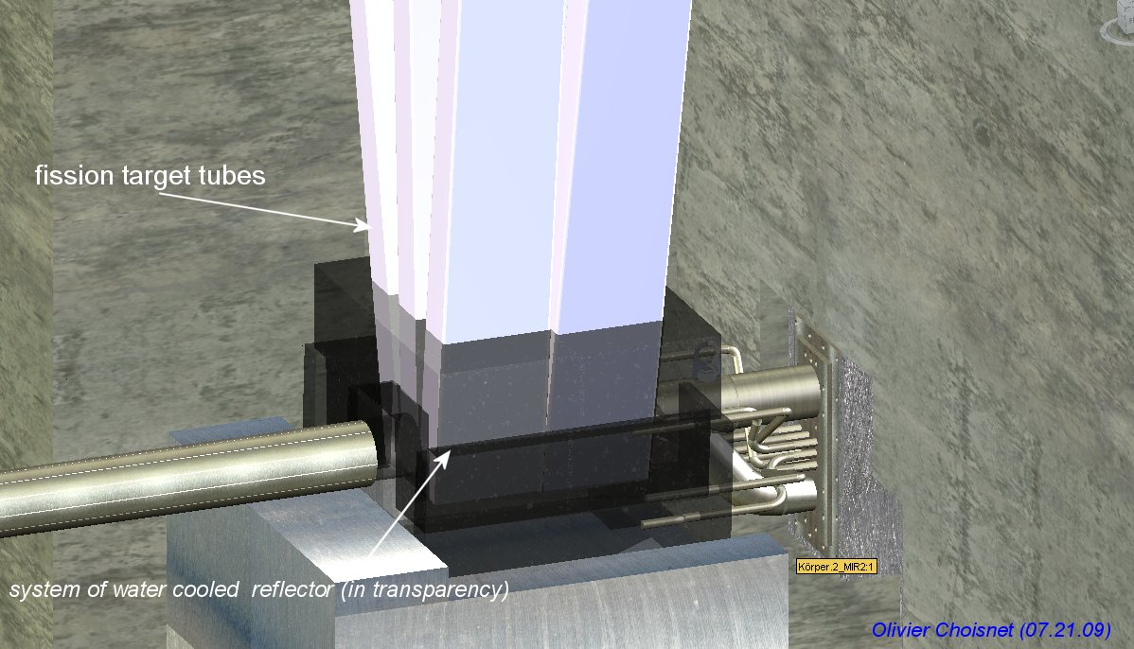
Isotope targets around spallation source

Slide 14
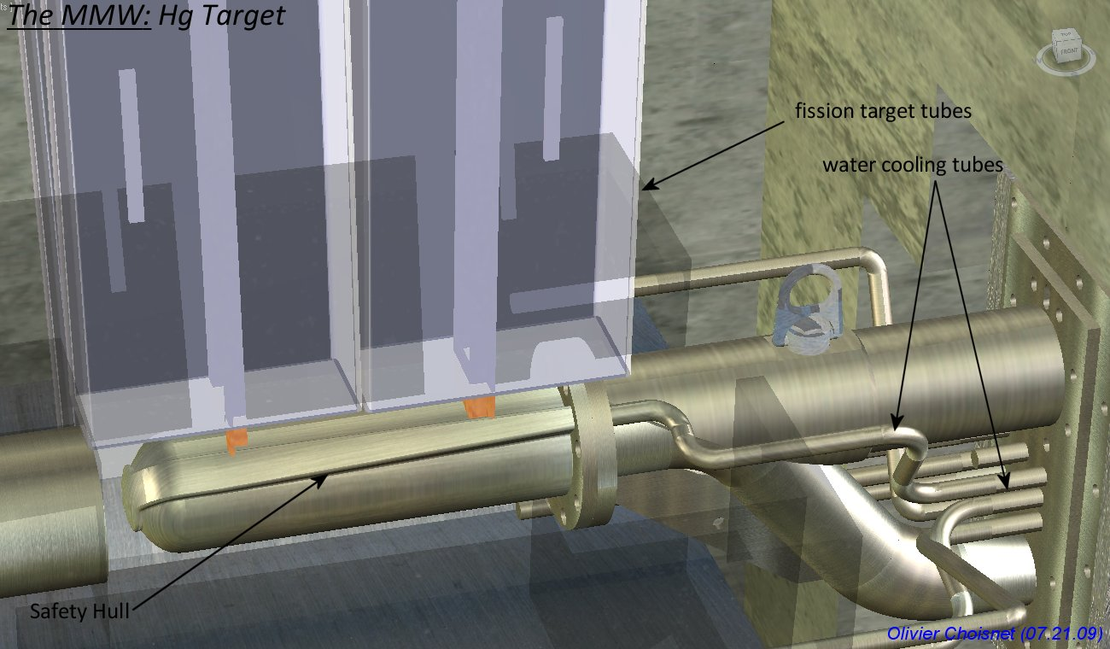
EURISOL Spallation Target

Slide 15
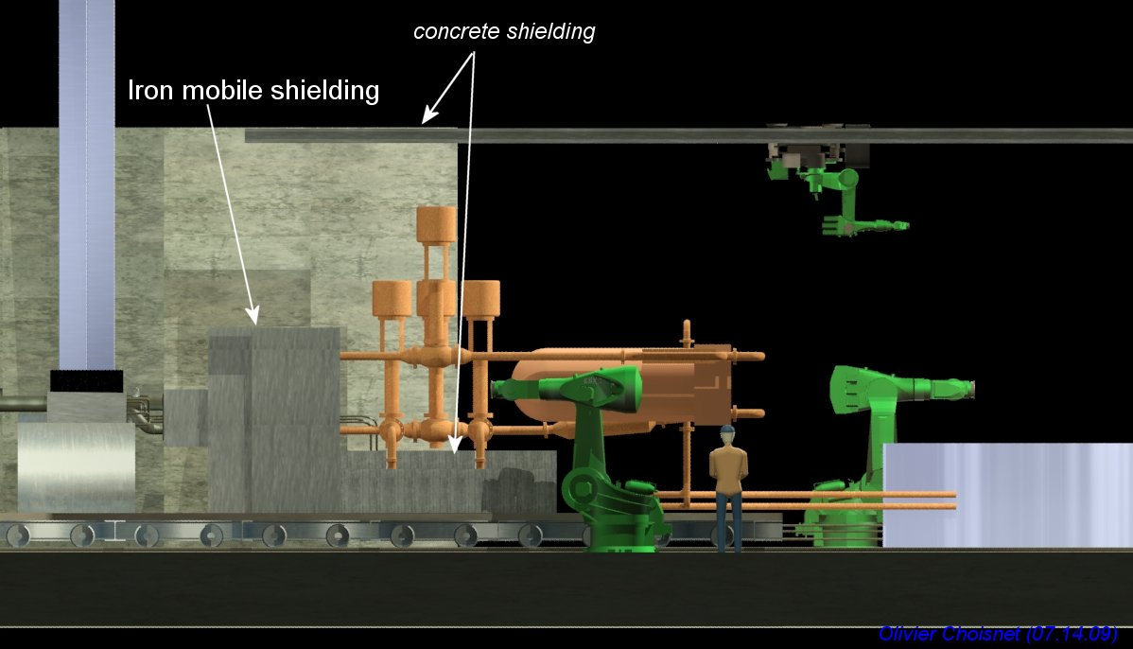
Target station handling EURISOL

Slide 16
Test at full speed 6 m/s

Slide 17
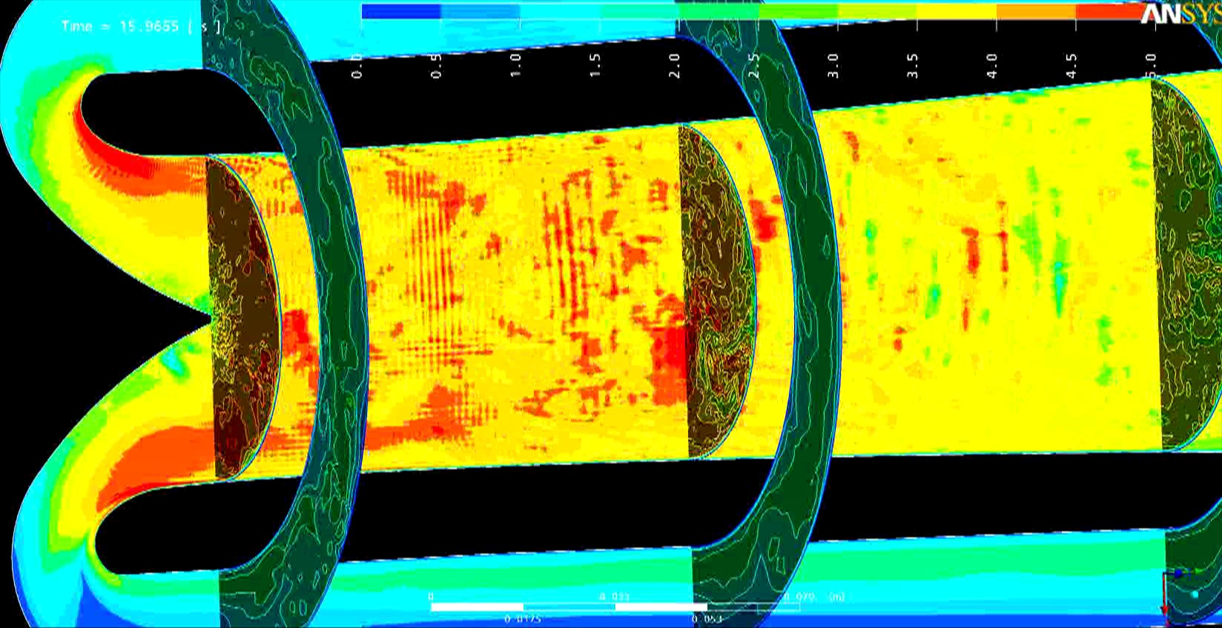
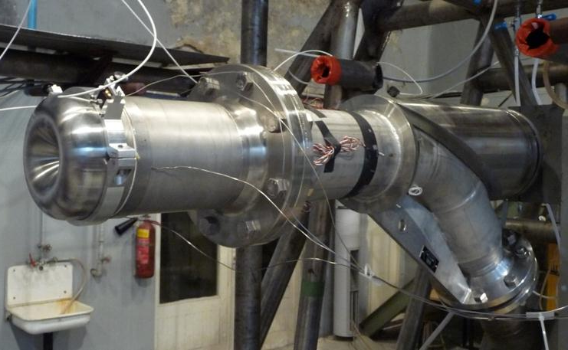
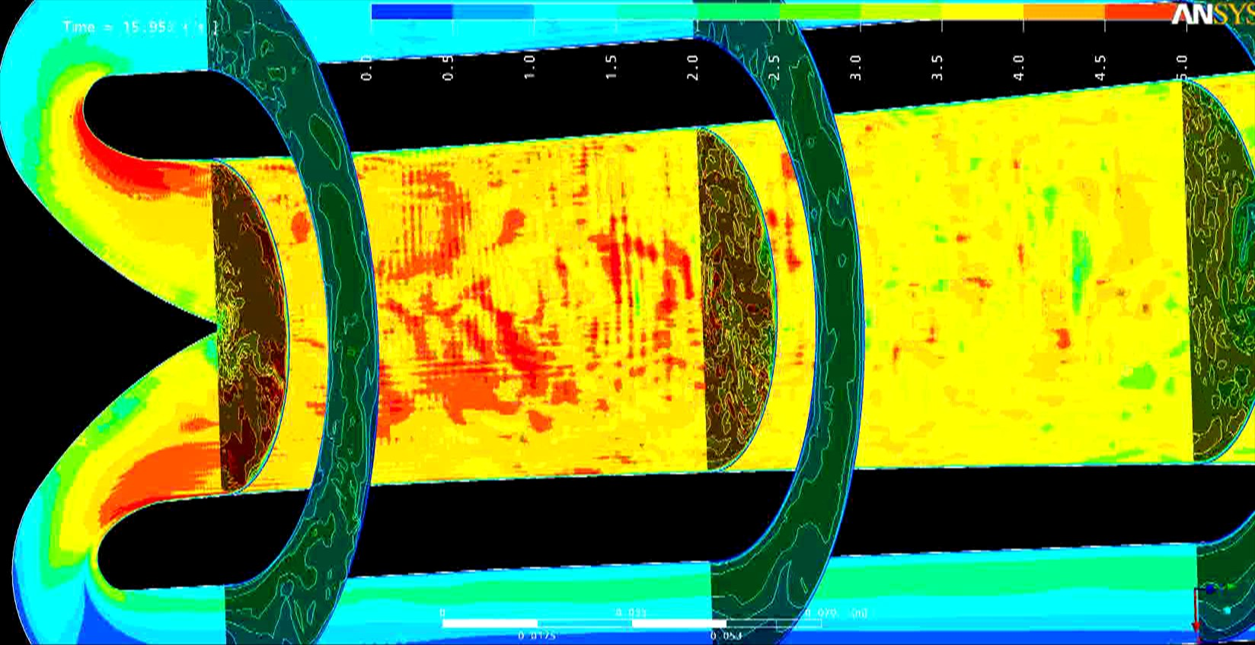
EURISOL Prototype Hg Target

Slide 18
Lessons Learnt
Relevance | Relevant Safety Guideline
System | Multiple containment strategy is vital
 | Natural circulation is of little value
 | Leaks must not flow into the path of the beam
 | Leak analysis and mitigation strategy in place
 | No organic cooling liquid inside source
 | Development using multi-physics analysis
Component | Calibrated electro-magnetic pumps are reliable
 | High-grade finishes reduce drag losses
 | T91 /316 stainless steel are an appropriate choice
Signal | Diversify flow-meter instrumentation
 | Instruments in- and outside of source (beam)
 | Ensure leak detection using diverse sensors
 | Pressure transducers and TCs are resilient

Slide 19
New Improved Design
Develop a versatile target concept to be tested with beams at all possible locations (i.e. wide range of beam power : several kW to MW). The target itself should be adaptable, but keeping all services (heat exchanger, loop…) externalized (i.e. common for all geometries).

Slide 20


Modularity in LM concept
∅ 50 cm
4 MW
∅ 50 cm
2 MW
∅ 50 cm
4 m
1 MW
2 m
1 m
1 m
1 m
n
n
1 m
n
∅ 20 cm
∅ 20 cm
∅ 20 cm

Slide 21
Capacity for beam power < 100 kW
1 m
0.6 m
∅ 5 cm
∅ 10 cm
∅ 30 cm
∅ 20 cm
Section Beam Deposition
Section HEX
Neutron
irradiation
∅ 10 cm
3 cm

Slide 22
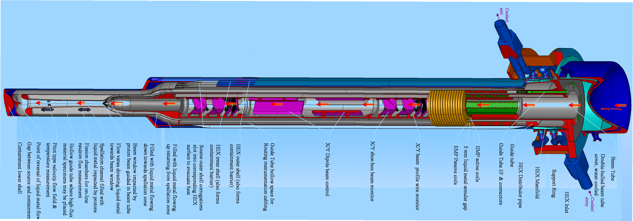

Slide 23
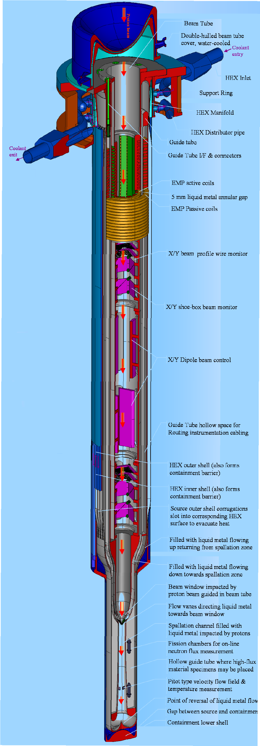

Slide 24
3. Requirements for testing facilities

Slide 25
Conclusions from recent testing
High-power spallation sources are feasible up to ~ 5 MW range
Tests require dedicated facilities rather than one-off experiments
Emphasis on mitigating development risk by partial testing prior to beam testing
Safety is integral part of testing requirements

Slide 26
Testing Facility wish list
Goal:
Power densities critical up to 10 kW/cm³ / 5 MW total power
Safety over performance.
Liquid target / solid target in parallel
Means:
Upgrade existing facilities
Safety concept integral to upgrade
Distinct facilities for TH / structural / radiation
Use subscale testing: kW before MW
Develop laboratory - industrial partnerships

Slide 27
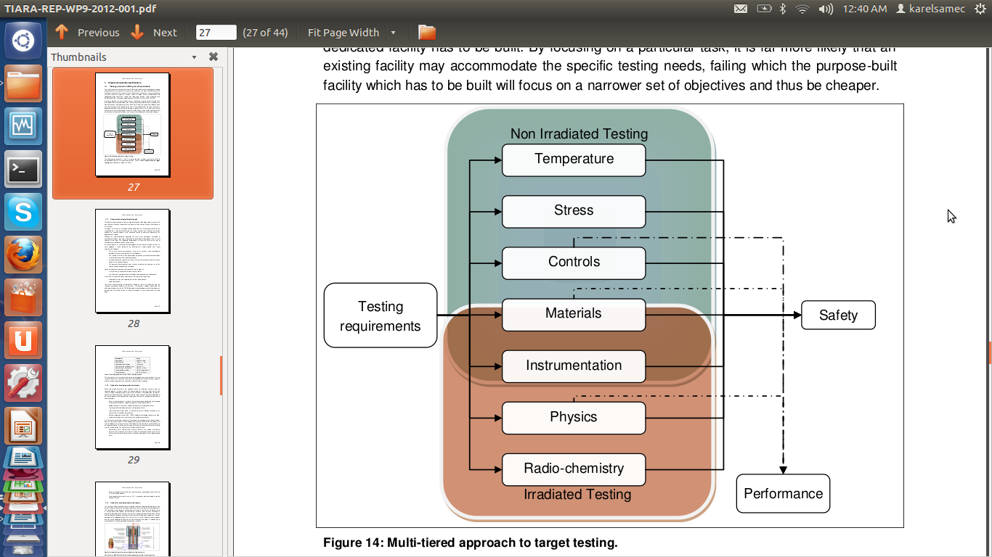
Testing Facility characteristics

Slide 28
4. Proposed facilities & potential Partnerships

Slide 29
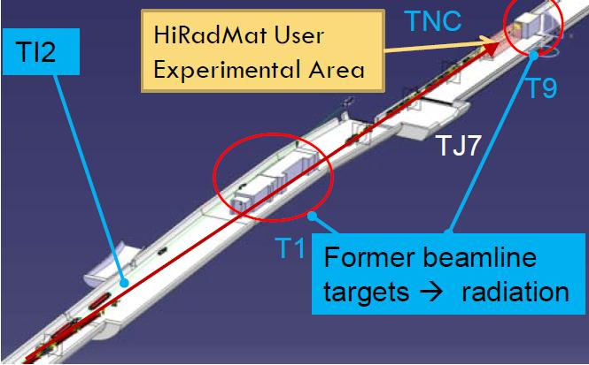
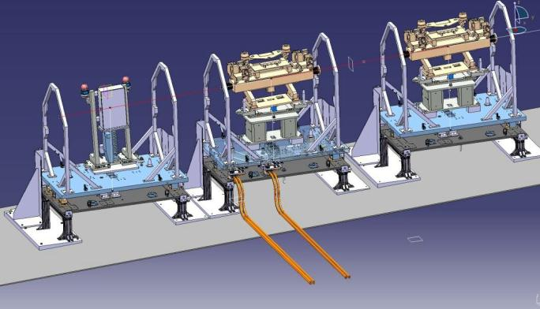
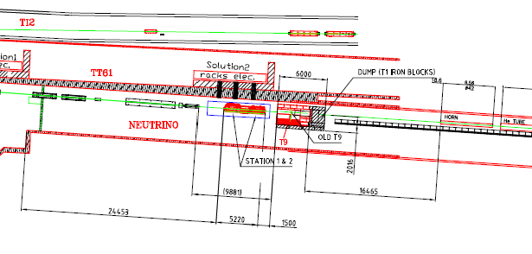
Potential facility at CERN: HiRadMat

Slide 30
5. Current Design Activities

Slide 31
Overall Concept
The facility is to test material samples and instrumentation under varying conditions of:
Proton/Neutron irradiation
Corrosive environments (Liquid metal)
Temperature
Stress
It must be transportable, flexible and adaptable to suit these different needs in different labs.

Slide 32
Overall Concept
The facility:
is a transportable cube, less than 2 meters
comprises a chamber filled with liquid metal for samples irradiated by protons / neutrons penetrating through a EURISOL-type window
has a secondary circuit to as cold source
uses EM Pumps for maximum reliability
uses no organic oils.
is fully shielded and isolated against leaks

Slide 33
First Results
Chosen fluids:
Primary is LBE: 300C / 550C
Secondary is Gallium: 75C / 120C
Cold source is water: 20C / 40C
Chosen power settings:
Up to 100 kW Beam
Maximum 1 GeV proton => deposition length ~ 40cm ( the shorter, the better for higher dpa in samples)

Slide 34
Concluding Remarks
High power spallation targets are currently under development. The “market” is there.
Design work started in September 2012 at CERN on an irradiation station.
Focus of the design is a portable, re-configurable facility that can be accommodated at different sites, a ort of “mecano-set” which the user will tailor to suit his needs at minimum cost and down-time.

Slide 35
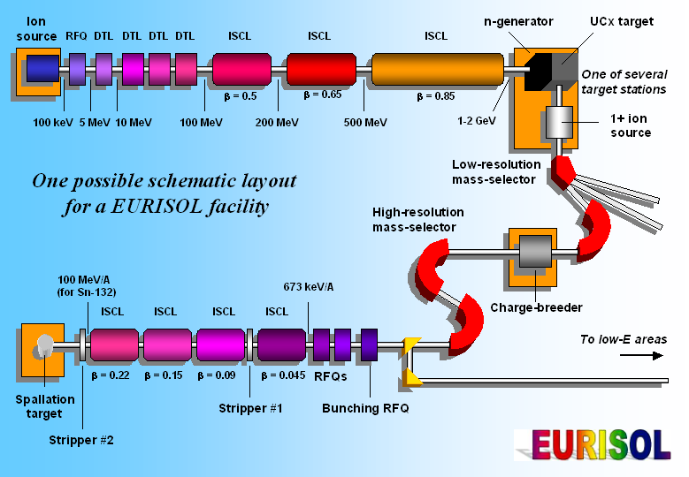
EURISOL
Design Study
THANK YOU

Slide 36
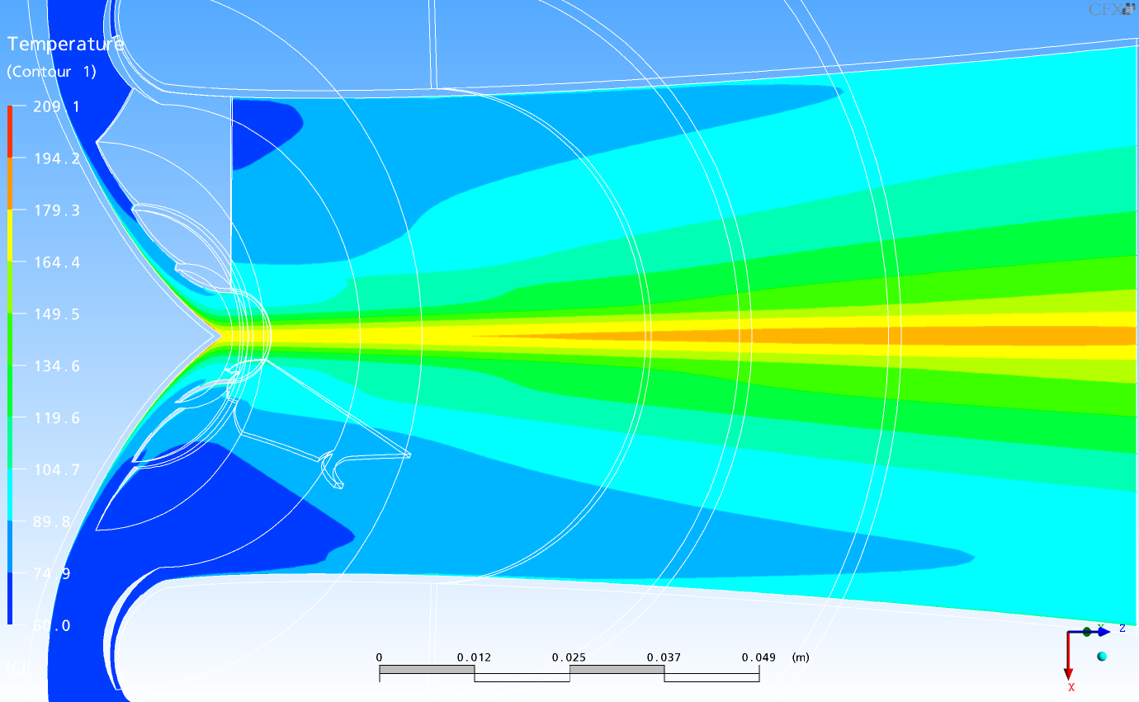
CFD of beam impact
(calculated not tested)

Slide 37
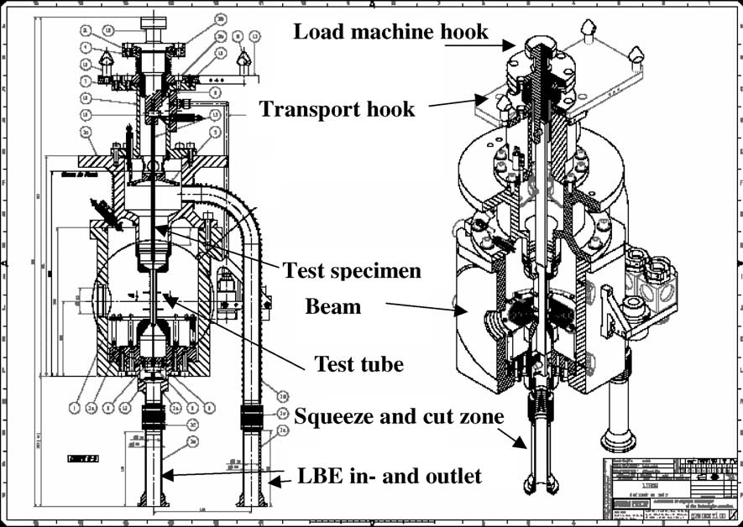
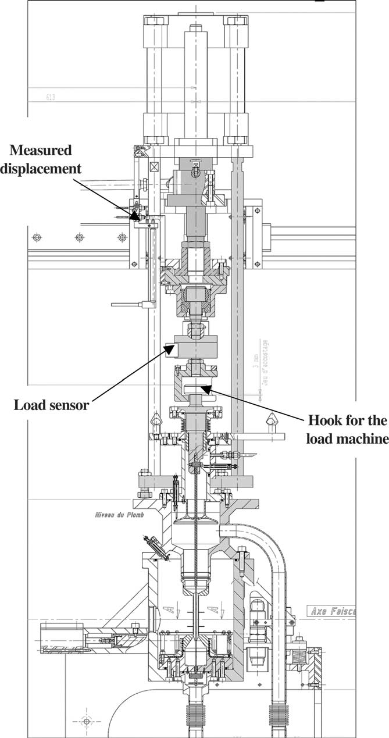
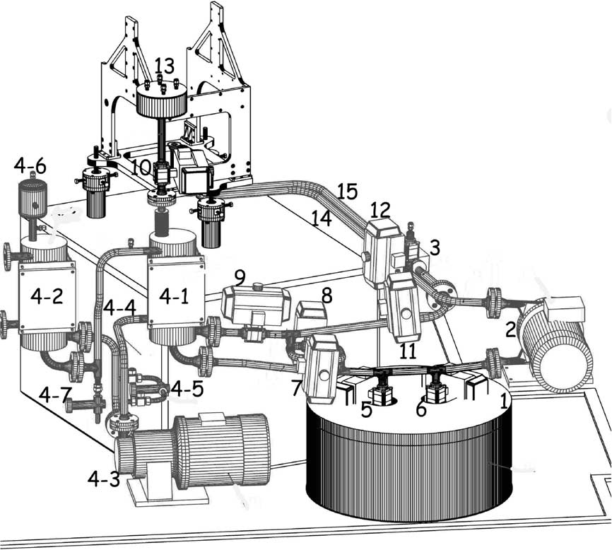
LISOR Experimental Setup at PSI

