Slide 1
Invariant-mass spectroscopy of neutron-rich Be isotopes
Y. Kondo
RIKEN Nishina Center
Contents
  Breakup reactions of ¹⁴Be on a proton target
  Inelastic scattering (¹⁴Be)
  One-neutron removal reaction (¹³Be)
Notes:
I would like to talk about invariant mass spectroscopy of neutron rich Be isotopes.
This is a content of my talk.
We studied the breakup reactions of 14Be on a proton target.
In this experiment,
we studied unbound states of 13Be and 14Be via two reaction processes, namely inelastic scattering and one-neutron removal reaction.

Slide 2
Collaborators
Y. Kondo, T. Nakamura, Y. Satou, T. Matsumoto, N. Aoi, N. Endo, N. Fukuda, T. Gomi,
Y. Hashimoto, M. Ishihara, S. Kawai, M. Kitayama, T. Kobayashi, Y. Matsuda, N. Matsui,
T. Motobayashi, T. Nakabayashi, K. Ogata, T. Okumura, H. J. Ong, T. K. Onishi, H. Otsu,
H. Sakurai, S. Shimoura, M. Shinohara, T. Sugimoto, S. Takeuchi, M. Tamaki, Y. Togano,
Y. Yanagisawa
Tokyo Institute of Technology
RIKEN Nishina Center
Tohoku University
Rikkyo University
Kyushu University
University of Tokyo
Center for Nuclear Study (CNS), University of Tokyo
Notes:
These are the collaborators of this work.

Slide 3
Nuclear Chart
Neutron halo
Magicity loss
¹³Be, ¹⁴Be
Different deformations of
Protons and neutrons
Di-neutron?
Exotic structures
  Neutron halo
  Magicity loss (¹²Be, ³²Mg)
  Di-neutron correlation? (⁶He, ¹¹Li)
  Different deformation of proton/neutron density(¹⁶C)
Notes:
This is the nuclear chart for light mass region.
In this neutron-rich region,
Several exotic structures are reported and discussed.
Such as neutron halo, magicity loss and so on.
Our interests are 13Be and 14Be.
These nuclei are related to these topics.

Slide 4
¹⁴Be and ¹³Be
¹⁴Be
  Drip-line nucleus
  Two neutron halo
  Borromean (¹²Be+n, n+n systems are unbound)
  No bound excited states
    excited states locate above the neutron separation energy (S_{2n}=1.26MeV)
¹³Be
  Unbound nucleus
  Low-lying levels are not clarified
    Several experimental results are not consistent
Breakup of ¹⁴Be on proton
Notes:
I will introduce 14Be and 13Be briefly.
14Be is dripline nucleus and known to be a two neutron halo nucleus.
It is known that no bound excited states exist below the neutron separation energy.
13Be is an unbound nucleus.
Its low lying levels are not clarified because several experimental results are not consistent.
This figure is the summary of the unbound states of 13Be observed experimentally.
Most of experiments report the candidate of d-wave resonance at around 2MeV.
But as for the low-lying states, they are not consistent with each other.
To study these nuclei, we performed the invariant-mass spectroscopy via the breakup of 14Be on proton.

Slide 5
Breakup Reactions on a low-Z target
Inelastic scattering
One-neutron removal reaction
¹⁴Be
  Angular distribution
  → J^{π} assignment
  cross section
  →collectivity
¹³Be
  Momentum distribution of ¹³Be system
  →J^{π} assignment
n
¹⁴Be
¹⁴Be*
θ
¹²Be
n
¹²Be
¹²Be
n
n
n
n
p
~ 70 MeV/u
Invariant mass
n
¹⁴Be
¹³Be
θ
¹²Be
n
¹²Be
¹²Be
n
n
p
~ 70 MeV/u
n
Coulomb breakup cross section is small
Notes:
In breakup reaction by a low-Z target,
Coulomb breakup cross section is small,
And inelastic scattering and one-neutron removal reaction mainly occur.
In the inelastic channel, we can investigate the unbound states of 14Be.
14Be is excited into unbound state by a target proton, and decays into 12Be and two neutrons.
By measuring the momentum vectors of all outgoing particles,
we can know the invariant mass of the unbound state of 14Be.
The angular distribution of 14Be is useful to deduce the spin parity of the observed states.
In the one neutron removal reaction,
One of neutrons in 14Be is knocked-out by the target proton, and 13Be is produced.
Since 13Be is unbound, This decays into 12Be and a neutron.
So, by measuring the momentum vectors of 12Be and neutron,
we can study the unbound state of 13Be.
In this reaction, we also analyzed the momentum distribution of the outgoing 13Be
Because the momentum distribution is useful to deduce the orbital angular momentum of the knocked-out neutron.

Slide 6
Momentum Distribution of ¹³Be (transverse)
Example of momentum distribution
width of P distribution
  depends on the orbital angular momentum of a knocked-out neutron
l=2
l=1
l=0
l=0
l=1
l=2
Momentum distribution → spin-parity assignment of ¹³Be
Notes:
This figure is an example of the momentum distributions.
The width of the momentum distribution depends on the orbital angular momentum of the knocked-out neutron.
The distribution is calculated by CDCC calculation by Matsumoto-san
with the assumption of the 13Be core.
If the ground state of 14Be is expressed like this,
we can deduce the spin parity of an observed level from the momentum distribution.

Slide 7
Experiment
Notes:
next I will show you the experimental setup.

Slide 8
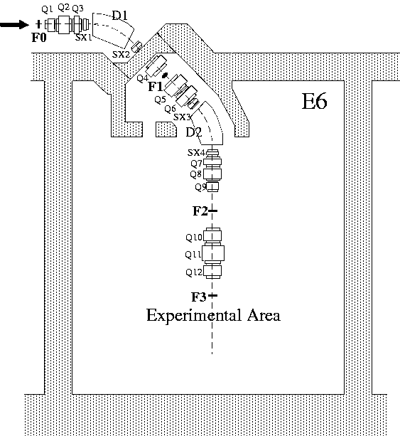
Experimental Setup
Primary beam
¹⁸O 100 MeV/u
Production target
Be 6 mm
¹⁴Be
Energy : ~ 70MeV/u
Intensity : ~8,000 counts/s
Purity : 90%
Plastic scintillator
1 mm
RIPS （RIKEN Projectile-fragment Separator)
Notes:
We performed the experiment at RIKEN using the RIPS beam line.
We used the primary beam of 18O at 100 MeV/nucleon.
And used the beryllium target as a production target.
Then we obtained the secondary 14Be beam like this.

Slide 9
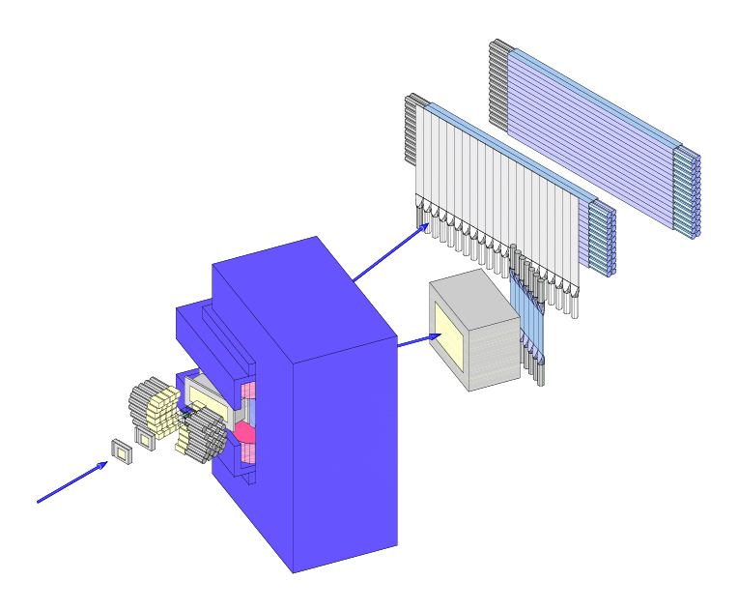
Experimental Setup
Drift chamber (MDC)
Angle of ¹²Be
Veto counter
n
NaI(Tl) scintillator
γ ray from ¹²Be
Neutron counter
(plastic scintillator)
¹²Be
PPAC
Angle of ¹⁴Be
charged particle Hodoscope
(plastic scintillator)
Velocity of ¹²Be
Dipole magnet
¹⁴Be
Drift chamber (FDC)
Particle Identification
~ 70 MeV/u
Reaction Target
Liquid H₂ (227 mg/cm²)
Detect ¹²Be and (a) neutron(s) in coincidence
Notes:
The secondary 14Be beam obtained by RIPS bombarded a liquid hydrogen target.
The outgoing 12Be was detected and analyzed by the spectrometer equipped by the dipole magnet, two drift chambers, and a plastic scintillator hodoscope.
The outgoing neutron was detected by the neutron hodoscope array.
In addition we put the NaI detector for the gamma rays emitted from the outgoing excited 12Be.

Slide 10
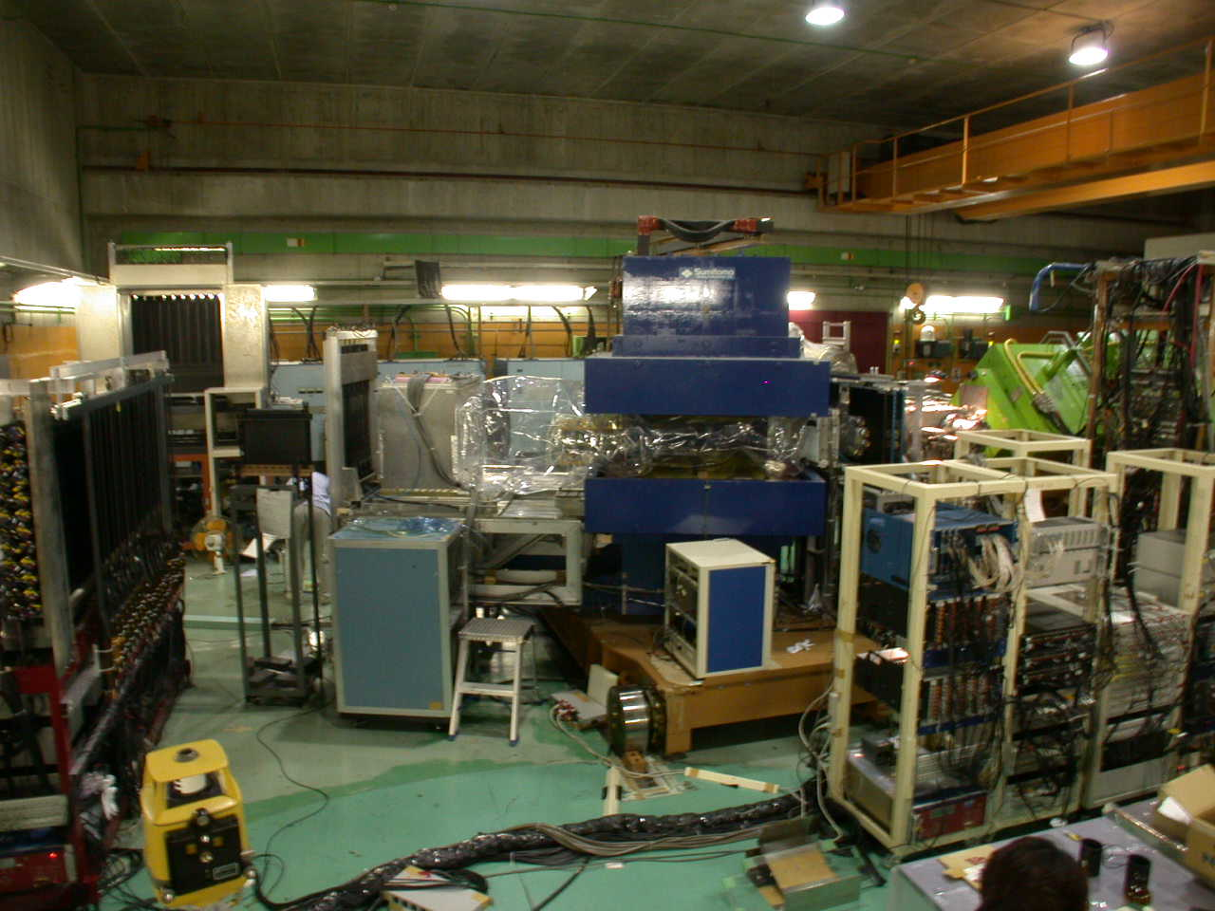
Experimental Setup (photo)
Neutron Detector
Drift Chamber
Hodoscope
Target
Dipole Magnet
RIPS
Beam
He bag
Notes:
This is the photo of the experimental setup.
This is the end of RIPS, and beam comes from this direction.
This is the target position.
The blue one is the dipole magnet.

Slide 11
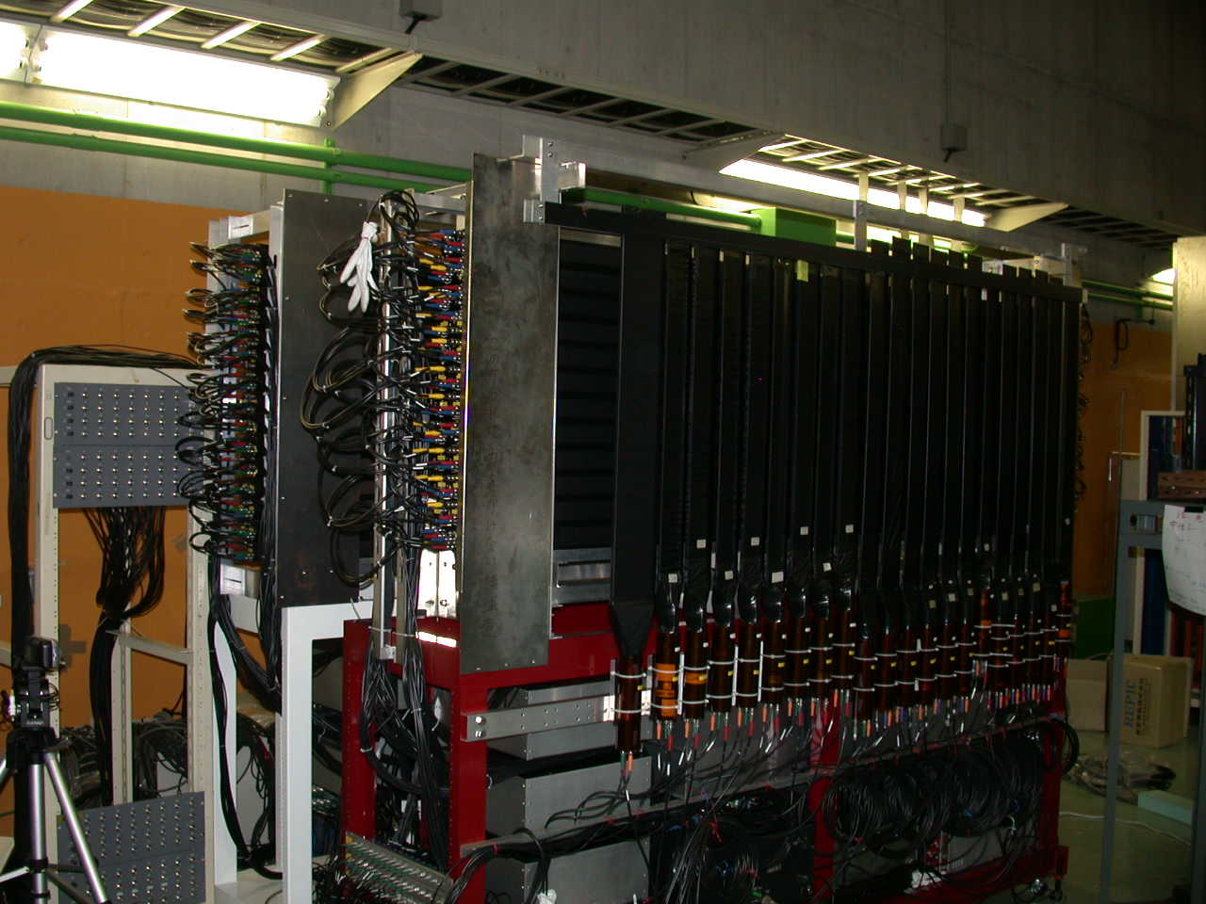
Neutron counter
Neutron counter
Neutron Counter
54bars
6x6x214cm³
Charged particle VETO
(thin plastic scintillators)
Beam direction
Efficiency
For 1n detection
~2m
Notes:
This is the photo of the neutron detector.
It consists of 54 bars of plastic scintillator.
Each bar has a dimension of 6cm x 6 cm x 214cm.
To eliminate the charged particle background, thin plastic scintillators were placed in front of the neutron detector.
The efficiency was about 20% for one neutron detection.

Slide 12
Results
(Inelastic scattering)
Relative energy spectrum (¹²Be+n+n)
Angular distribution
n
¹⁴Be
¹⁴Be(2⁺)
θ
n
¹²Be
n
¹²Be
¹²Be
n
n
n
p
Notes:
Next, I will show you the experimental results.

Slide 13
Neutron Crosstalk Analysis
Inelastic scattering
  ¹⁴Be+p → ¹⁴Be* → ¹²Be+n+n
  Select M_{n}=2 (detection multiplicity)
  →crosstalk rejection (position, timing)
Two neutron event
Crosstalk events
Same Wall event
Crosstalk
One neutron is detected by two (or more) detectors
Different Wall event
NEUT-A
NEUT-B
Notes:
In the inelastic scattering process,
two neutrons are emitted in the reaction.
So we selected Mn=2 events, where Mn is the neutron detection multiplicity.
But the multiplicity two events includes the true two neutron events and crosstalk events,
Which is two hits caused by one neutron.
So we have to eliminate this crosstalk events.
In the analysis of the inelastic channel, we set the kinematical condition, such as position and timing information, to eliminate the crosstalk events.

Slide 14
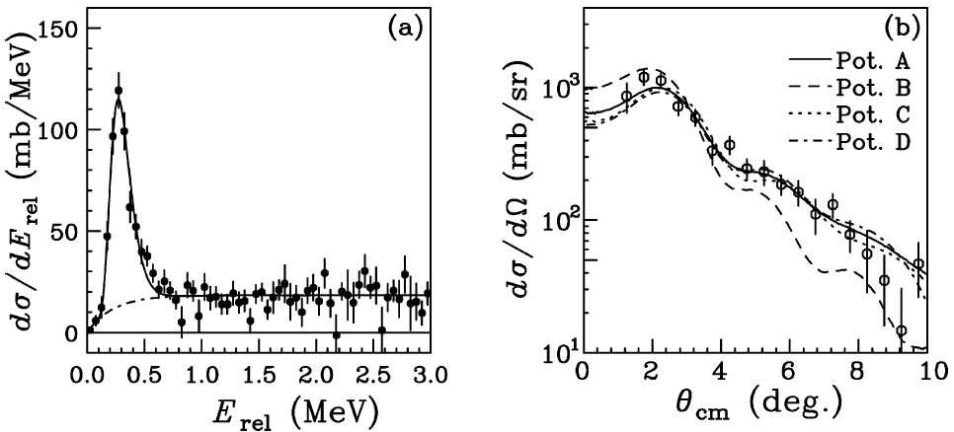
Comparison with ¹⁴Be+C data (previous experiment)
neutron crosstalk events are eliminated
efficiency and acceptance are corrected
Similar peak at around 0.3MeV was observed
¹⁴Be(2⁺)
p(¹⁴Be,¹²Be+n+n)
69 MeV/nucleon
C(¹⁴Be,¹²Be+n+n)
68 MeV/nucleon
(previous exp.)
E_{r}=0.28(1)MeV
ΔL=2
T. Sugimoto,
T. Nakamura,
Y. Kondo et al
PLB 654,160 (2007)
Notes:
This figure is the relative energy spectrum of 12Be+two neutron system.
Here, neutron crosstalk events are eliminated,
and efficiency and geometrical acceptance are corrected.
We observed a peak at around 0.3MeV, which is similar to the previous measurement using carbon target.
This 0.3MeV peak corresponds to the first excited 2+ state of 14Be.
These are the spectrum and angular distribution of 14Be gated by this peak obtained in the previous experiment, which is the measurement using carbon target.

Slide 15
¹⁴Be+p experiment
p(¹⁴Be,¹²Be+n+n)
69 MeV/nucleon
¹⁴Be(2⁺)
E_{rel}=0.25(1) MeV
σ =12.5±0.2±1.6 mb
(A)
p(¹⁴Be,¹⁴Be(2⁺) )
69 MeV/nucleon
(B)
E_{rel}(¹²Be+n+n) (MeV)
DWBA analysis
  Two optical potentials
    (A) A.A. Korsheninnikov et al.
    PLB343, 53 (1995)
    (B) R.L. Varner et al.
    Phys. Rep. 201, 57 (1991) (CH89)
◊δ =1.40(19) fm (¹⁴Be+p)
Width is dominated by the experimental resolution
(~100keV (1σ) @ 0.25MeV)
(1σ)
Y. Kondo, T. Nakamura, Y. Satou et al.: to be submitted
Notes:
The spectrum and angular distribution are analyzed.
The relative energy spectrum is fitted with the peak and background.
The obtained resonance energy is 0.25MeV
and inelastic cross section is 12.5 mb.
We found that the width of the peak is dominated by the experimental resolution,
which is approximately expressed like this.
The angular distribution of the 2+ excitation is compared with the DWBA calculation.
Here, we used two different optical potentials.
Each optical potential parameter set well describes the experimental distribution.
From the DWBA analysis,
we obtained the quadrupole deformation length of 1.40fm in the proton target data.

Slide 16
2⁺ energy & deformation length
2⁺ energy
  Lower than ¹²Be
Deformation length
  Smaller than ¹²Be
Proton/neutron collectivities can be deduced (now in progress)
Notes:
This figure shows the systematics of the excitation energy and deformation length obtained by the proton and carbon targets.
Our obtained values are indicated by the red box.
As you can see, the both excitation energy and deformation length of 14Be are smaller than 12Be.
Since sensitivity to the proton/neutron excitation is different between proton and carbon targets,
we expect to extract the proton/neutron collectivities separately from these deformation lengths.
the analysis is now in progress.

Slide 17
Decay of ¹⁴Be(2₁⁺)
E_{c-n1}
¹²Be
sequential
n
E_{c-n2}
phase space
E_{n-n}
n
E_{c-(nn)}
Phase space decay
  ¹⁴Be(2₁⁺) → ¹²Be+n+n
Sequential Decay
  ¹⁴Be(2₁⁺)
  → ¹³Be+n (E_{rel}=0.1MeV)
  → ¹²Be+n+n (E_{rel}=0.15MeV)
Notes:
We also studied the decay process of the 2+ state of 14Be.
This figures show the correlations between two body relative energies.
These three are the experimental data.
For example,
Ecn1 denotes the relative energy between 12Be and one neutron.
And Enn is the relative energy between two neutrons.
The experimental data was compared with the simulation by assuming the two different decay process.
Red is the simulation by assuming the phase space decay without any correlations.
Blue is the result by assuming the sequential decay through the intermediate state of 13Be.
The experimental data is very similar to the simulation of the phase space decay,
And different from the sequential decay.
These are the comparison by the one-dimensional plot.
You can see the agreement of the experimental data with the phase space decay simulation.
From this comparison,
We concluded that that the 2+ state of 14Be decay into the three body directly without any correlations.

Slide 18
Results
(One-neutron removal)
Relative energy spectrum (¹²Be+n)
Transverse momentum distributions
n
¹⁴Be
¹³Be
θ
n
¹²Be
n
¹²Be
¹²Be
n
p
n
Notes:
Next, I will show you the experimental results for the one-neutron removal reaction channel.

Slide 19
Subtraction of Inelastic Component
p(¹⁴Be,¹²Be+n+n)
69 MeV/nucleon
¹⁴Be(2⁺)
One-neutron removal channel
(one neutron is emitted)
E_{rel}=0.25(1) MeV
σ =12.5±0.2±1.6 mb
Corresponds to ¹⁴Be(2⁺)
M_{n}=1 events
M_{n}=1 events
Inelastic channel
Estimated from M_{n}=2 events
E_{rel}(¹²Be+n+n) (MeV)
knocked out
One-neutron removal channel
Inelastic channel
(two neutrons are emitted)
not detected
two cases in M_{n}=1 events
  inelastic component should be subtracted
Notes:
This is the relative energy spectrum of 12Be+ neutron system.
To select the one-neutron removal reaction channel,
we chose Mn=1 events.
But Mn=1 events include these two processes.
The first case is the one-neutron removal channel. In this case, one neutron is emitted and detected.
Another case is the inelastic channel. In this process two neutrons are emitted.
If one of them is detected and another is not detected,
the detection multiplicity becomes one. So this component should be eliminated.
The skyblue histogram shows this component in Mn=1 estimated from the Mn=2 events.
This low-energy peak corresponds to the 2+ state of 14Be.
By subtracting the inelastic component,
we obtained the spectrum for the one-neutron removal reaction like this red histogram.

Slide 20
¹³Be→¹²Be+n+γ
¹³Be→¹²Be(2⁺)+n
(E_{γ}=2.1MeV)
¹³Be→¹²Be(1⁻)+n
(E_{γ}=2.7MeV)
σ=11(2)mb
(E_{rel}=0~4MeV)
σ=5.3(7)mb
(E_{rel}=0~4MeV)
¹²Be+n σ=89(6)mb
for ¹²Be+n+γ is small
Notes:
We also analyzed the gamma-ray coincident events.
these figures are the relative energy spectra for 12Be + neutron in coincidence with 2.1 and 2.7 MeV gamma rays, respectively.
The integrated cross section up to 4MeV are 11 and 5.3 mb.
These are small compared to the cross section of the one-neutron removal reaction.

Slide 21
Relative Energy Spectrum
p(¹⁴Be,¹²Be+n)
Two peaks at 0.5MeV, 2MeV
Transverse momentum distribution
(not longitudinal)
  Width of momentum distributions are different between peak regions
σ=89(6)mb
(E_{rel}=0-4MeV)
E_{rel}(¹²Be+n) (MeV)
0.25-0.75MeV
2.0-2.5MeV
P_{x} resolution
~30MeV/c
Notes:
This is the relative energy spectrum.
We observed two peaks at around 0.5 and 2 MeV.
These plots are the transverse momentum distributions for these peak regions.
The width of the momentum distribution is clearly different.
This indicates the difference of the orbital angular momentum of the knocked-out neutron.
To analyze the data quantitatively,
we performed the fitting.

Slide 22
Fitting of E_{rel} spectrum and momentum distributions
Relative energy spectrum
  p- and d-wave components → Breit-Wigner shape
  s-wave component → G.F. Bertsch et al: PRC 57, 1366 (1998)
Momentum distribution → CDCC calculation (by T. Matsumoto)
  ¹³Be is assumed to be a core in ¹⁴Be
  ¹³Be-p interaction
    JLM interaction J. Jeukenne et al.: PRC16, 80 (1977)
  n-p interaction
    R.A. Malfliet and J.A.Tjon NPA127, 161 (1969)
  ¹³Be-n potential
    Wood-Saxon form
      Depth is adjusted to reproduce the separation energy
a : Scattering length
Notes:
In the fitting procedure,
we took into account the three components having the angular momeneta of l=0,1, and 2.
We used the Breit Wigner shapes for l=1,2 components,
and used this form for l=0 components for the fit of relative energy spectrum.
For the fit of the momentum distributions,
the theoretical distributions are obtained by the CDCC calculation.
In this calculation, we assumed that 13Be is a core in 14Be.

Slide 23
Relative Energy Spectrum
p(¹⁴Be,¹²Be+n)
0.5 MeV peak
→p-wave resonance
2 MeV peak
→d-wave resonance
σ=89(6)mb
(E_{rel}=0-4MeV)
p
s
d
E_{rel}(¹²Be+n) (MeV)
0.25-0.75MeV
2.0-2.5MeV
p
s
d
p
d
s
Notes:
This is the fitted results.
From the fit, we found that the 0.5MeV peak is the p-wave resonance and 2MeV peak is the d-wave as reported in the several experimental studies.

Slide 24
Relative energy spectrum
p state E_{r}=0.50(1) MeV
Γ=0.36(2)MeV
p-wave component
  E_{r}=0.50(1) MeV
  Γ=0.36(2) MeV
    consistent with Γ_{sp} (l=1)
  J^{π}=1/2-
d-wave component
  E_{r}=2.48(7) MeV
  Γ=2.4(2) MeV
    larger than Γ_{sp} (l=2)
    →other state @ 2MeV?
s component
a_{s}~ -3fm
d state E_{r}=2.48(7) MeV
Γ=2.4(2)MeV
single particle width
p-wave @0.50MeV
Γ_{sp}~0.5MeV
d-wave @2.48MeV
Γ_{sp}~1.4MeV
Notes:
Here, I show the resonance parameters.
The resonance energy for p-wave resonance is 0.5MeV
and its width is 0.36MeV.
This width is consistent with the single particle width of 0.5MeV.
For the d-wave resonance,
resonance energy and width are 2.48 and 2.4MeV, respectively.
This width is somehow wider than the single particle width of 1.4MeV.
So, This 2MeV peak may include other state.
But we could not separate due to the experimental resolution.

Slide 25
Summary of the observed levels
The 2⁺ state in ¹⁴Be locates lower than the g.s. of ¹³Be
Sequential decay process is energetically forbidden
Notes:
This is the summary of the observed states and decays.
In the present study,
We observed the resonances of 13Be at 0.5MeV and 2MeV above the neutron separation energy.
And the 2+ of 14Be locates at 0.25MeV above the 12Be+2n.
And this is below the lowest resonance of 13Be.
This is why the 2+ state directly decays into three body
because the sequential decay of this 2+ state through states of 13Be is energetically forbidden.

Slide 26
Low-lying state of ¹³Be
This
work
The low-lying negative parity state
→ Intruder state
Notes:
This is the comparison of the observed states of 13Be with the previous experimental studies.

Slide 27
Energy Levels of ¹²Be and ¹³Be
Shell model calculation
  PSDMK
  D.J. Millener et al.: NPA255, 315 (1975)
    Provides the shell closure at ¹²Be
  SFO (spin-flip p-n monopole interaction)
  T. Suzuki et al.: PRC67, 044302 (2003)
    resonably reproduce the magicity loss at ¹²Be
¹²Be
¹³Be
  PSDMK
    Higher excitation energy of 1/2⁻
  SFO
    Ground state of 1/2⁻ → good!
    several states at ~2MeV
¹³Be
Intruder 1/2- state
←→disappearance of N=8 magicity
→ explained by spin-flip p-n monopole interaction
Notes:
The energy levels of 13Be are compared with the shell model calculation.
As a reference, the energy levels of 12Be are also shown.
We used PSDMK and SFO interactions for the shell model calculation.
The PSDMK is the conventional interaction and SFO is the new interaction with the enhanced spin-flip pn monopole interaction.
For 12Be, PSDMK gives higher level energies while SFO well reproduce the magicity loss.
This fact shows the validity of the SFO interaction.
For 13Be, PSDMK predicts the higher excitation energy of 1/2-.
But SFO predicts the ground state of 1/2- and consistent with the experiment.
In addition, Many states around 2MeV are predicted by SFO.
These states may be the reason for the wider width of 2MeV resonance than single particle width.
Anyway, what I want to emphasize is this low-lying 1/2- state.
This intruder 1/2- state can be explained by the enhanced spin-flip p-n monopole interaction.

Slide 28
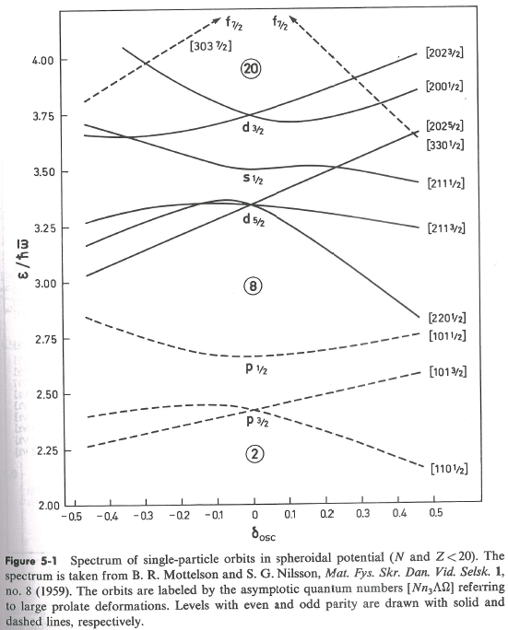
Deformation?
Ref) A. Bohr and B.R. Mottelson
Nuclear structure Vol.1
  energy gap between [220 ½] and [101 ½] orbitals disappears with large prolate deformation
  Large quadrupole deformation (β~0.6) of ¹²Be
    H. Iwasaki et al. PLB481, 7 (2000)
intruder 1/2- state of ¹³Be
→ indicate large deformation?
Notes:
The intruder state may be explained by another story “deformation.”
This is a Nilsson diagram taken from text book.
The 1/2+ and 1/2- orbitals are energytically degenerate at large prolate deformation.
And such a large deformation is observed for 12Be.
So the low-lying 1/2- state of 13Be may indicate the large deformation.

Slide 29
Summary
Breakup reactions (¹⁴Be+p)
Inelastic scattering
  2⁺ state of ¹⁴Be
  Phase space decay of 2⁺ state
One-neutron removal reaction
  Low-lying p-wave (intruder) resonance of ¹³Be
Notes:
Summary.
We studied the one-neutron knockout reaction of 14Be,
And the unbound states of 13Be were observed.
By analyzing the momentum distribution of the peak,
the 0.5MeV peak was assigned to the p-state which is corresponds to the assignment of 1/2-.
The observation of the low-lying p-wave resonance indicates the disappearance of the shell gap between p and sd shells.

